Slide 1
Topic 5: Community Rating System (CRS) Overview

Slide 2
Topic 5 Objectives
Know the benefits of NFIP’s higher standards and the Community Rating System (CRS).
Notes:
Review the objective:
At the end of this topic, you should know the benefits of NFIP’s higher standards and the Community Rating System.
Present the following:
The NFIP and CRS communities adopt floodplain management best practices. In this topic, we will discuss how investing in the NFIP and CRS makes communities safer and saves money.
Explain to the participants that they are highly encouraged to explore the following site regarding key information needed to fulfill floodplain management responsibilities as local elected officials:
Elected Officials' Flood Guide – ASFPM Flood Science Center (https://floodsciencecenter.org/products/elected-officials-flood-risk-guide/)

Slide 3
CRS Program with Community Flood Insurance Discounts
Communities can get CRS credits for applying higher standards, mitigation actions, and outreach activities.
CRS credits lead to flood insurance premiums savings.
All NFIP-insured structures receive discounts.
~40% of flood insurance claims come from structures not in mapped high-risk flood areas.
Notes:
Present the following:
About 40% of flood insurance claims come from structures outside of mapped high-risk flood areas. Higher standards protect your community more from the impacts of flooding than just NFIP minimums. FEMA incentivizes higher standards through the CRS.
The CRS is a voluntary program that gives communities points for applying higher floodplain management standards, mitigation actions, and outreach activities. The credits save community members money on flood insurance premiums. All NFIP-insured properties in the community qualify for the discount.

Slide 4
CRS Classes and Their Discounts
CRS rates communities from 9 to 1.
Each CRS class earns an additional 5% discount on flood insurance premiums.
Class 1 communities receive the highest discount.
CRS Class | Discount Percentage
9 | 5%
8 | 10%
7 | 15%
6 | 20%
5 | 25%
4 | 30%
3 | 35%
2 | 40%
1 | 45%
Notes:
Present the following:
The Community Rating System evaluates communities based on how much they invest in flood-damage prevention activities.
Communities earn a rating from 9 to 1. Communities with a 1-rating receive the largest discount: 45% discount on flood insurance premiums.
Flood-damage prevention activities include high standards, mitigation actions, and outreach activities.

Slide 5
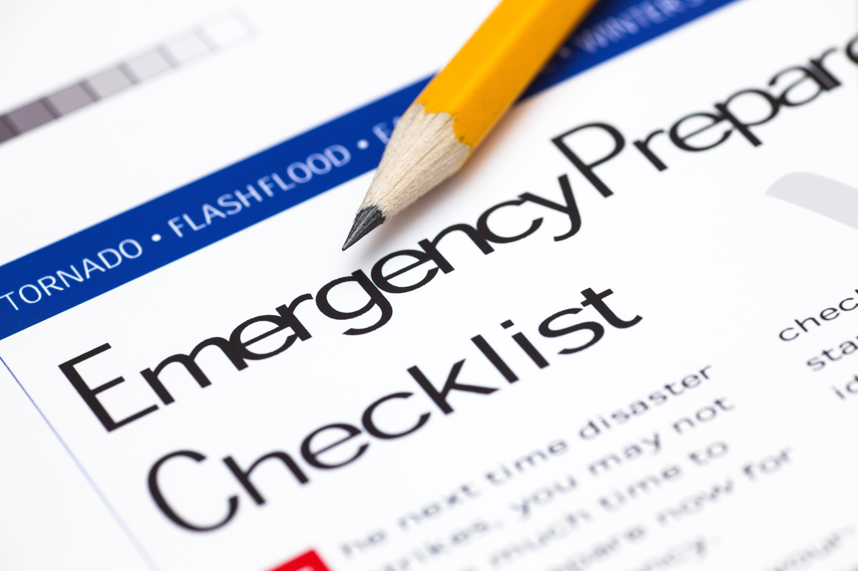
Earn Discounts Through Activities
Public Information (300 series):
Teaching the community about flood protection
Conducting outreach
Mapping and Regulations (400 series):
Adopting higher standards
Preserving open space in the floodplain
Notes:
Present the following:
Your community can earn points for:
Public Information:
Teaching the community about flood protection: These activities can include everything from teaching people about their flood hazards to encouraging people to buy flood insurance.
Conducting outreach: Outreach includes things like holding publicly attended demonstrations and providing individual property protection advice.
Mapping and Regulations:
Adopting higher standards: Higher standards can include regulations like not allowing fill in the floodplain and requiring freeboard.
Preserving open space in the floodplain: Conservation activities include protecting natural floodplain functions, managing stormwater, and enforcing higher regulatory mapping standards.

Slide 6
Earn Discounts Through Activities (cont.)
Flood Damage Reduction (500 series):
Regularly maintaining drainage systems
Completing repetitive loss area analysis
Warning and Response (600 series):
Creating dam safety plans
Emergency warning dissemination
Notes:
Present the following:
Your community can also earn points for:
Flood Damage Reduction:
Regularly maintaining your drainage systems
Completing repetitive loss area analysis to better understand your community’s risk and mitigation opportunities.
Warning and Response:
Dam Safety Plans/Emergency Warning distribution: These activities strengthen communication and help your community respond faster to flood events.
Transition to the next sub-topic:
Now, let’s talk about the steps to joining the CRS.

Slide 7
Steps to Join the Community Rating System (CRS)
Meet prerequisites for joining CRS:
Be NFIP-compliant.
Maintain construction documentation permanently.
Take flood insurance and mitigation actions.
Submit a letter of interest to your FEMA Regional Office.
Submit a CRS application.
Notes:
Present the following:
Communities can join the Community Rating System anytime. First, you need to submit a letter of interest to your FEMA Regional Office. The FEMA Regional Office will work with you to submit your application.
Your community must meet certain prerequisites before joining the CRS:
Be in the Regular Phase of NFIP for at least one year
Be in full compliance with the NFIP
Maintain construction documentation (Elevation Certificates) permanently
Mitigate repetitive loss properties
Maintain required flood insurance policies for community-owned buildings
Include the Limit of Moderate Wave Action (LiMWA) on all new or revised coastal floodplain maps. Communities do not need to regulate to LiMWA.

Slide 8
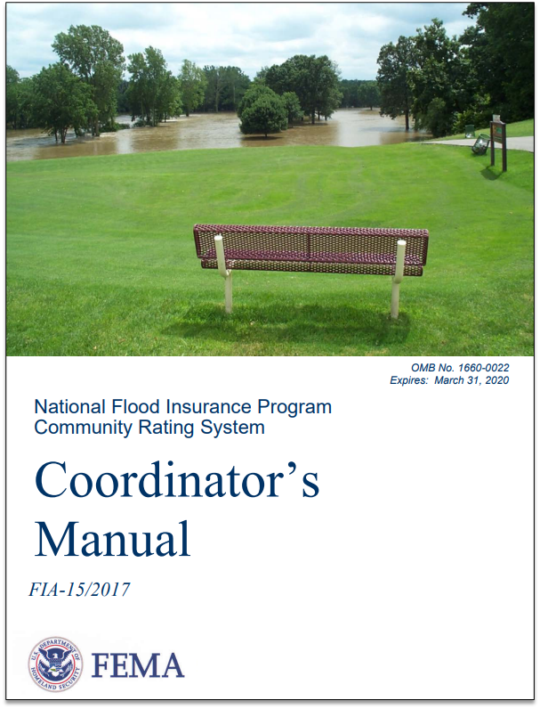
Maintaining CRS Participation
Your community must recertify that you are doing your credited activities.
Every three or five years the CRS Specialists visit.
CRS Specialists help your community compile documentation.
Notes:
Present the following:
Your community must maintain your CRS program membership by:
Recertifying that you are doing your credited activities each year.
Having cycle verification visits every three or five years, depending on your class.
The Insurance Services Office and their team of CRS Specialists help communities understand and compile the information you need to stay in the CRS.
Option B:
Co-Presenter: If your community is in the CRS, explain how you support it.

Slide 9
Other Programs Similar to CRS
THIRA: Threat and Hazard Identification and Risk Assessment
Fire Suppression Rating Schedule (FSRS): Rates your fire department's ability to serve the community
Building Code Effectiveness Grading Schedule (BCEGS): Rates your building codes and how you enforce them
Notes:
Present the following:
There are other risk-related programs you may be familiar with.
THIRA and the Fire Suppression Rating Schedule (FSRS) rate how well your fire department serves your community:
Like CRS, the rating scale is from 10 to 1. Communities with the best service are rated 1.
There are mitigation actions you could take to improve both your FSRS and CRS ratings, such as community risk reduction and emergency communication systems.
The BCEGS program assesses a community’s building codes and their enforcement. The BCEGS program uses a rating scale from 1 to 5. The program focuses on limiting losses from natural hazards through building code enforcement.

Slide 10
CRS Participation
Community Geography
Communities by Class
Source: FEMA at www.fema.gov/floodplain-management/community-rating-system Date: April 2023
Notes:
Present the following:
These images show CRS participation nationally.
Over 1,500 communities participate in the CRS.
Most of the communities that participate are Class 5 through Class 9.
Completing prerequisites and earning points for discounts require large investments of time and money.
Encourage your audience to visit the following site about FEMA’s Community Rating System:
FEMA.gov | Community Rating System (https://www.fema.gov/floodplain-management/community-rating-system)
Option B:
Before presenting, follow these steps to reflect your State-level data:
Change the title of the slide to [Insert State Name] CRS Participation.
Visit website: FEMA.gov | Community Rating System (https://www.fema.gov/floodplain-management/community-rating-system).
Navigate to “CRS Data Visualizations,” by scrolling down or clicking the “Data Visualizations” box near the top of the webpage.
Select the “State Profile” tab.
Select your State.
Take a screen capture of the available data and replace the examples in the slide.
Explain:
Our State has [NUMBER] participating communities with [NUMBER] national flood insurance policies.
In total, communities in our State earn [DOLLAR AMOUNT] in premium discounts per year.
The FEMA.gov Community Rating System is a great place to find more information about higher standards your communities can adopt.
Explain a few additional facts that relate to your audience.
Transition to the next sub-topic:
Now, let’s discuss additional benefits of higher standards.

Slide 11
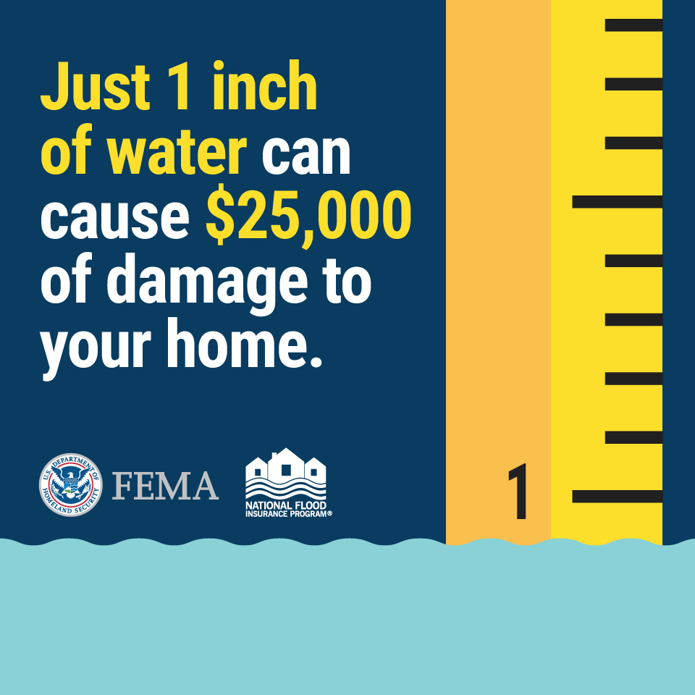
Benefits of Higher Standards
Less damage from flooding and faster recovery
More affordable flood insurance
Safer places to live
Economic growth
Notes:
Present the following :
Become more resilient: Make your community (individuals, businesses, community organizations, and infrastructure) better able to recover from a disaster.
Make flood insurance more affordable.
Ensure safer, damage-resistance development.
Maintain economic growth that is at less risk of flooding.

Slide 12
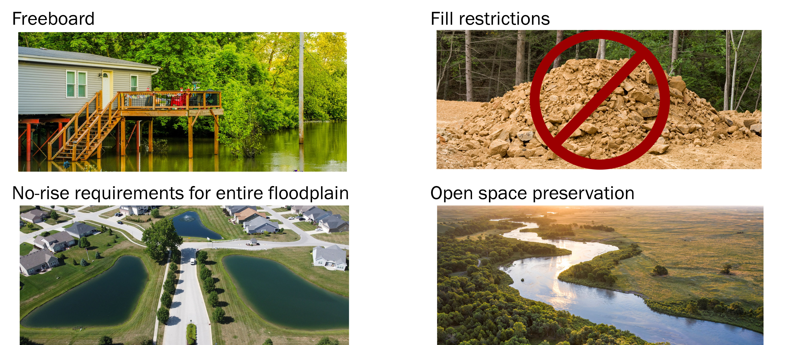
Common Higher Standards
Notes:
Present the following:
Higher standards are not one-size-fits-all. Your community should adopt the higher standards that fit your community’s needs. Popular higher standards:
Freeboard: Additional height above the Base Flood Elevation (e.g., two feet). It is most beneficial where there is new construction, redevelopment, and Substantial Improvement.
No-rise requirements: Require a no-rise analysis within the floodway portion of the SFHA. No-rise ensures the development would cause no increases in flood levels. It can be beneficial for communities with a lot of development near, but outside of, floodways and communities without floodways.
Fill restriction: Ensure new development does not displace flood waters. It is most effective in communities that are not fully built out.
Open space preservation: Create a community asset from a floodplain, like a park, which can flood. Deed restrictions stop development on the land, reducing flooding.
Option B:
Co-Presenter:
Describe the higher standards (if any) your community enforces.
Describe how the public and developers reacted to the higher standards.

Slide 13
Recommended Higher Standards for Substantial Improvement/Substantial Damage
Higher Standard | Further Details
Cumulative Substantial Improvement | Require compliance when the total value of all improvements or repairs over a specified period equals or exceeds 50% of the value of the structure
Cumulative Substantial Damage | Apply Substantial Damage requirements when multiple damage events add up to 50% over time
Repetitive Loss Property | Properties that meet the NFIP definition of repetitive loss must comply with current regulations
Lower threshold for Substantial Improvement and/or Substantial Damage | Set the threshold for Substantial Improvement and/or Substantial Damage lower than 50%. Increases the number of older homes brought into compliance with smaller improvements or after less severe damage.
Historic structures | Require historic structures to comply with Substantial Improvement and/or Substantial Damage requirements. Or require to the extent that buildings can still be deemed historic.
Notes:
Present the following:
Explain: There are also higher standards related to Substantial Improvement (SI) and Substantial Damage (SD).
Choose a couple of items on this slide to discuss.
Lower thresholds for Substantial Improvement and/or Substantial Damage: Sets the threshold for SI/SD lower than 50%. The number of older homes brought into compliance increases because SI/SD is triggered after making improvements that cost less or after less severe damage.
Higher standards are beneficial to all communities, including those that are more built out, have an older housing stock, or have experienced repeated flood damages.

Slide 14
Investing in Your Community
Higher standards, building code minimums, and public mitigation grant projects save more than they cost.
Case Study: The Left Hand Creek Flood Project saved Longmont, CO an estimated $22 million.
Notes:
Present the following:
Higher standards, building code minimums, and public mitigation grant projects save your community more money than they cost.
Some of these investments were made in Longmont, Colorado, a community of 90,000 residents:
In 2012, the community improved the creek channel design, updated two bridge culverts, and removed 110 structures.
The former mayor said that without this project 1,000 more homes would have flooded in the 2013 flood.
Myrtle Beach, FL, a community of 39,000 people, adopted a three-foot freeboard higher standard. This higher standard qualified them for the CRS program and discounts on flood insurance premiums. It also protected structures from flood damage from Hurricane Joaquin in 2015.
Encourage audience to read more about the case study:
Building back smarter/more resilient – Longmont, Colorado (https://floodsciencecenter.org/products/elected-officials-flood-risk-guide/success-stories/building-back-smarter-more-resilient-longmont-colorado/)
Higher Standards Mean Lower Flood Insurance Rates for Myrtle Beach Property Owners (https://www.fema.gov/case-study/higher-standards-mean-lower-flood-insurance-rates-myrtle-beach-property-owners)
Option B:
Co-Presenter: Describe the benefits of the flood mitigation projects your community has implemented.

Slide 15
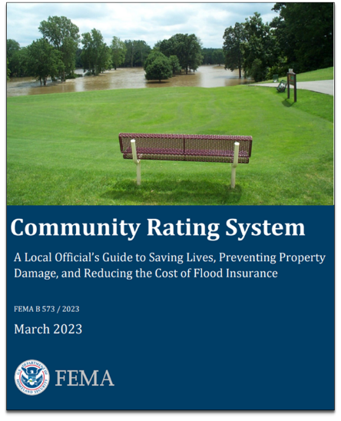
Resources
NFIP CRS Coordinator’s Manual
Addendum to the CRS Coordinator’s Manual
Brochure for the Community Rating System
Community Stories and Case Studies
Building Community Resilience with Nature-Based Solutions
Notes:
Present the following:
For additional information, check out these resources:
For more information, check out these resources:
CRS Coordinator’s Manual: In-depth, full-service resource about the CRS
Addendum to the CRS Coordinator’s Manual: Clarifications to the Coordinator’s Manual and a summary of new credit opportunities
Brochure for the Community Rating System: Brief information about the CRS.
Community Stories and Case Studies: Case studies and testimonials of participating CRS communities.
Building Community Resilience with Nature-Based Solutions: Guide for implementing sustainable planning, design, environmental management, and engineering that includes natural features and processes.
Encourage audience to visit these links to learn more about the CRS:
Addendum to the CRS Coordinator’s Manual (https://www.fema.gov/sites/default/files/documents/fema_community-rating-system_coordinator-manual_addendum-2021_FAQs.pdf)
Brochure for the Community Rating System (https://www.fema.gov/sites/default/files/documents/fema_crs-brochure_032023.pdf)
Building Community Resilience with Nature-Based Solutions (https://www.fema.gov/sites/default/files/documents/fema_riskmap-nature-based-solutions-guide_2021.pdf)
CRS Case Studies, Fact Sheets and Blogs (https://www.fema.gov/floodplain-management/community-rating-system/case-studies-fact-sheets-blogs)
NFIP CRS Coordinator’s Manual (https://www.fema.gov/sites/default/files/documents/fema_community-rating-system_coordinators-manual_2017.pdf)

Slide 16
Activity: CRS and Higher Standards Discussion
Which of these higher standards do you think your community should adopt and why?
Freeboard
No-rise requirements
Fill restrictions
Open space preservation
Lower thresholds for SI/SD
Notes:
Present the following:
Purpose:
To help the audience understand if their community is fully equipped to protect citizens from flooding and enforce NFIP regulations.
Procedure:
Direct the audience to Activity 5.1 in the Participant Manual.
Ask: Which of these higher standards do you think your community should adopt and why?
Freeboard
No-rise requirements
Fill restrictions
Open space preservation
Lower thresholds for SI/SD
Potential answers:
Freeboard:
Provides protection from flood damage for new construction, reconstruction, and Substantial Improvements.
No-rise requirements:
Benefits communities that have a lot of development near, but outside of, floodways. No-rise requirements also benefit communities that do not have floodways.
Fill restrictions:
Most effective in communities that are not fully built out.
Open space preservation:
Best for communities with a lot of community-owned open space and parks and communities with a lot of home buyouts.
Lower thresholds for SI/SD:
Benefits communities that are built out, have an older housing stock, and/or have sustained repeated flood damages.
Review the benefits of any higher standards not shared by the audience.
Option B:
Co-Presenter: Explain the strategies (e.g., outreach, engagement. etc.) your community used to support the adoption and implementation of your higher standards.

Slide 17
Topic Summary
CRS is a voluntary incentive program that encourages floodplain management that exceeds the minimum requirements of the NFIP.
Benefits of higher standards:
Less damage from flooding and faster recovery
More affordable flood insurance
Safer places to live
Economic growth
Notes:
Present the following:
On the slide, you’ll see what we covered in this topic. In the next topic, we will summarize the presentation.

