Slide 1
Topic 2: NFIP Overview

Slide 2
Topic 2 Objective
Describe how elected local officials and Floodplain Administrators can support local communities through the NFIP
Notes:
Review the objective:
At the end of this topic, you should be able to describe how you and your Floodplain Administrators can support local communities through the NFIP.
Present the following:
Let’s start with an overview of the NFIP including:
The purpose of the program,
Elements that make the NFIP effective and responsibility of the government to invest in the NFIP,
The benefits of the NFIP, and
How the NFIP and your Floodplain Administrator can best support your community.
Explain the importance of the Elected Official’s Flood Guide:
Elected Officials' Flood Guide – ASFPM Flood Science Center (https://floodsciencecenter.org/products/elected-officials-flood-risk-guide/)

Slide 3
What’s My Community’s Flood Risk?
Risks vary by community.
Anywhere it can rain, it can flood.
Floods are the leading cause of natural disaster losses in the US.
99% of US counties were impacted by a flooding event between 1996-2019.
Notes:
Present the following content:
Ask: Do you understand your community’s flood risk?
Explain: There is always a risk of flooding, even if the community has not flooded recently. The NFIP has floodplain mapping information to help communities understand their flood risk.
Flood risk varies from community to community.
Flood risk is everywhere. Anywhere it can rain, it can flood.
Floods are the leading cause of natural disaster losses in the United States. In the past 20+ years, 99% of all US counties have experienced flooding.
It’s your responsibility as a local elected official to promote your community’s public health, safety, and general welfare. A strong floodplain management program is part of that responsibility.
Option B:
Co-Presenter: Describe the impacts of recent floods in your area (community, region, State, etc.).

Slide 4
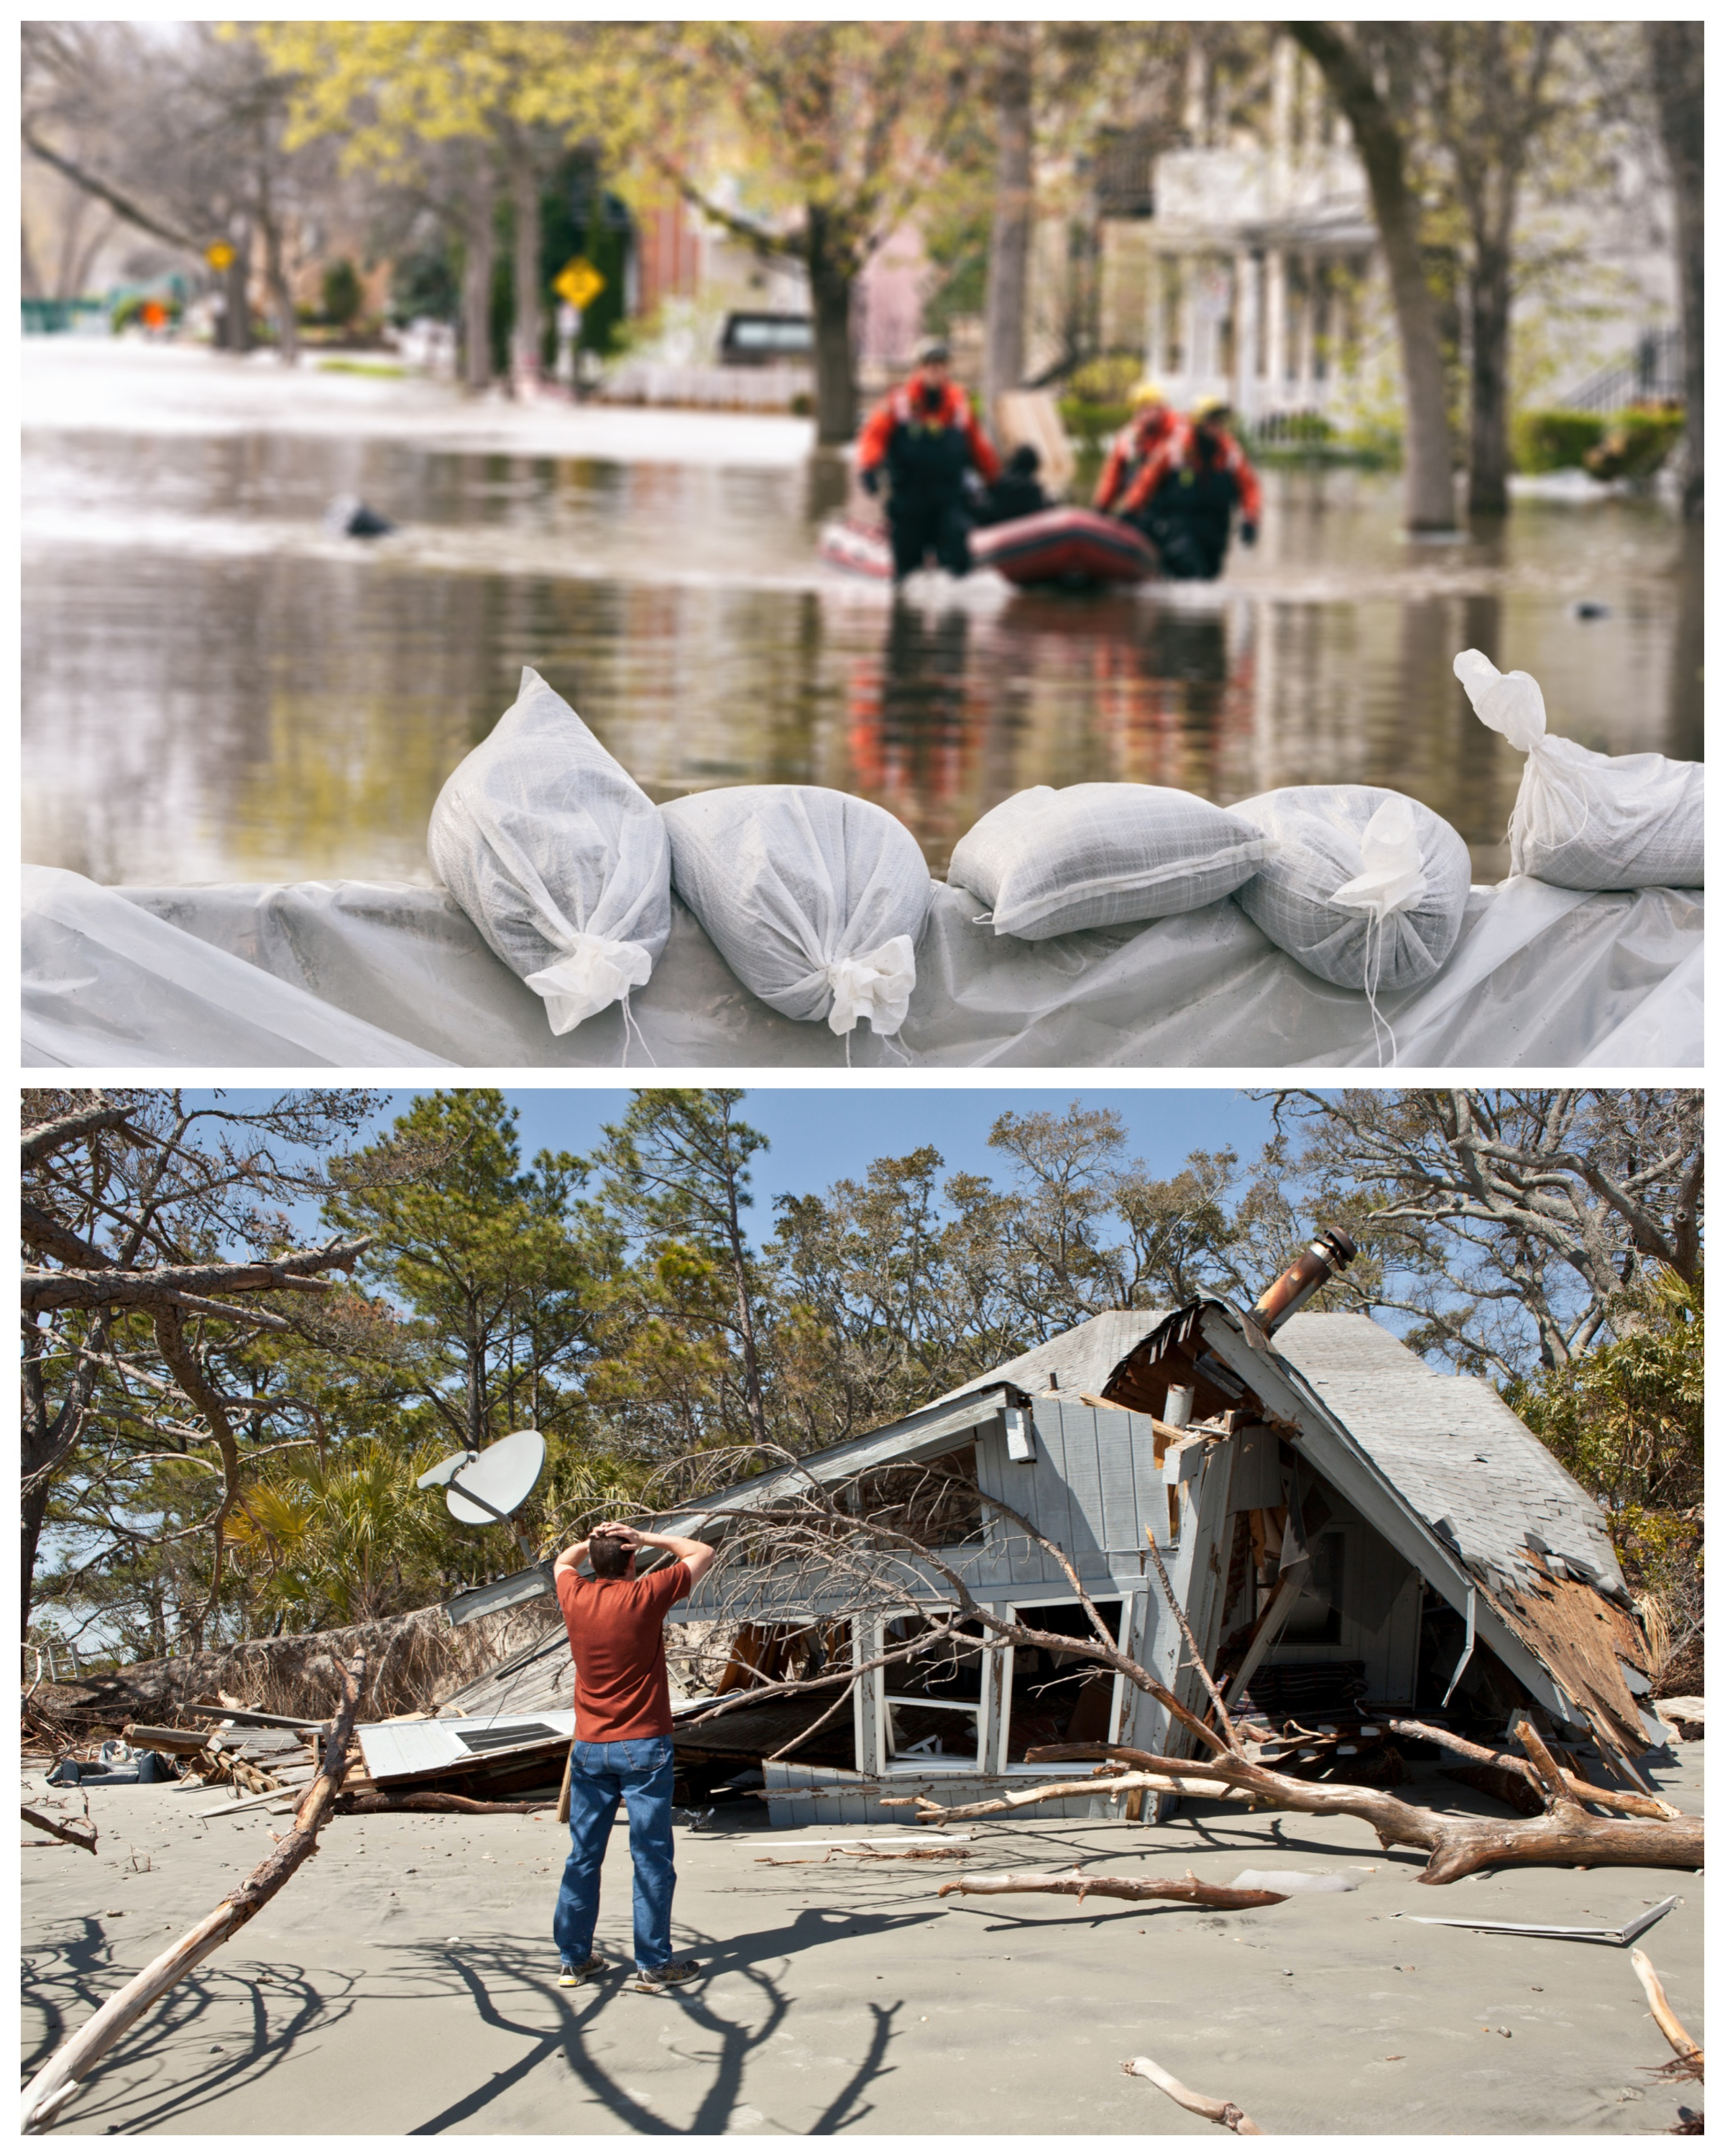
Impacts of Flooding and Floodplain Mismanagement
Liability for not applying or enforcing floodplain regulations
Disruptions to public health, safety, and welfare
Economic impacts
Damage to critical services and facilities (hospitals, police, fire, etc.)
Notes:
Present the following:
Ask: What happens if you don’t have a strong floodplain management program?
Explain: Flooding impacts public health, safety, and welfare.
According to the National Weather Service, flooding deaths outnumber all thunderstorm-related deaths. First responders are at risk during rescue operations. Your community may be liable for flood damages if you don't regulate and enforce the floodplain regulations in known flood risk areas.
Explain: Other impacts include ecological, social, and economic:
Floods affect businesses too. Economic impacts can be long-lasting after a flood. According to floodsmart.gov, “at least 40% of businesses never reopen following a disaster. Commercial property insurance does not generally cover flood damage. Only flood insurance does.”
Uninsured structures that have been repeatedly damaged by floods and are not insured may not be repaired. When that happens, owners of those properties no longer pay taxes, limiting how much money can be used to pay for disaster recovery. There may also be less available housing.
Floods decrease employment in communities by an average of 3.4%. Floods also often result in lower average municipal bond ratings.
Refer audience to the following resource:
Costs and Consequences of Flooding and the Impact of the National Flood Insurance Program - American Institutes for Research Study
(https://www.fema.gov/sites/default/files/2020-07/fema_nfip_eval-costs-and-consequences.pdf)
Transition to the next sub-topic:
Next, let’s talk about the National Flood Insurance Program (NFIP) and its benefits.

Slide 5
Purpose of the National Flood Insurance Program (NFIP)
August 1, 1968
Reduce flood risk and damages
Provide access to flood insurance
Reduce spending on Federal Disaster Assistance
Notes:
Present the following:
The NFIP is a longstanding and effective program created to help protect communities and individuals from the impacts of flooding. The NFIP:
Reduces flood risk for communities,
Provides access to flood insurance to property owners, and
Reduces spending on Federal Disaster Assistance.
There are more than 22,000 NFIP-participating communities.

Slide 6
Why Flood Insurance Is Important And Needed
Disaster assistance rarely covers everything, creating debt.
Flood Insurance:
Average claim payment: $75,000
Claims paid for all flooding in all flood zones.
No payback is required.
Policies not canceled for repeat losses.
Coverage available for buildings and contents.
Disaster Assistance:
Average payout: $4,000
Requires Presidential Disaster declaration
Disaster loans must be repaid with interest.
Individual disaster assistance may only be accessible if many structures are significantly damaged.
Notes:
Present the following:
Explain: Your community may ask you:
“Why is flood insurance necessary?”
“Does Federal disaster assistance cover all flood expenses?”
“Does homeowner’s or renter’s insurance cover flood expenses?”
Emphasize: On average, flood insurance payouts are better than disaster assistance.
Explain the differences between flood insurance and Federal disaster assistance:
The average flood insurance claim payment from 2017-2022 was $75,000.
Disaster assistance requires a Presidential Disaster Declaration, which is uncommon. Most assistance comes as a loan that must be repaid with interest.
Meanwhile, Federal disaster assistance often comes as a Small Business Administration loan or FEMA disaster grant. Between 2017 and 2022, the average Individual and Household Program – Housing Assistance award was about $4,000 per household (during presidentially declared disasters).
Flood insurance policies are offered in all flood zones. Renters can get contents coverage. Flood insurance payouts are sent quicker than disaster assistance funding.
Flood insurance is a regular investment that property owners and renters can make that does not require repayment or create a debt burden.

Slide 7
Benefits of NFIP Participation
NFIP Flood Insurance
Safer, damage-resistant development
Grants and loans
Faster recovery with more financial support
Structures built to community-adopted NFIP regulations sustain about 80% less damage.
Notes:
Present the following:
Communities benefit from the NFIP if they adopt floodplain management standards.
Flood insurance coverage is required for federally backed loans and mortgages for properties in the floodplain. The NFIP offers access to NFIP flood insurance for all structures, including high-risk structures and structures that may not qualify for private flood insurance.
Flood insurance helps disaster victim recovery.
NFIP minimum standards are designed to keep people and properties safe from flooding. As we saw in the video, structures built to adopted floodplain regulations sustain about 80% less damage than those built before the regulations were adopted.
NFIP grants and loans are also available. Communities can use this funding for mitigation projects that reduce risk, protect property, and save lives.

Slide 8
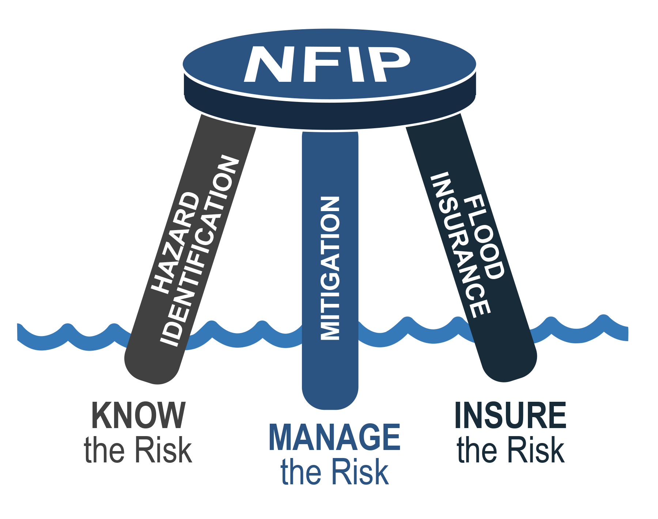
Three-Legged Stool
National Flood Insurance Program (NFIP):
Hazard Identification: Know the Risk
Mitigation: Manage the Risk
Flood Insurance: Insure the Risk
Notes:
Present the following:
Explain: The NFIP has three core elements that support one another. You can only have strong floodplain management with all three legs. Communities play a role in each leg.
Hazard Identification: Know the Flood Risk: The first leg of the stool is knowing your flood risk by identifying the hazards to people and infrastructure in your community. If you don’t know your risk, you can’t properly mitigate it.
Mitigation: Manage the Risk: The second leg is managing your community’s flood risks through mitigation actions, including consistently enforcing floodplain management regulations. If you don’t mitigate, damages will be greater, and insurance may not cover all your losses.
Flood Insurance: Insure the risk: The third leg is insuring the risk through flood insurance. Federally backed flood insurance is available to communities that participate in the NFIP. But insurance only covers financial losses; it doesn’t change your risk. If you don’t insure, you aren’t financially protected from flood damages.
Transition to the next sub-topic:
Next, let’s talk about the Federal, State, and local responsibilities in the NFIP.

Slide 9
Federal Responsibilities in the NFIP: FEMA
Flood hazard maps and products
Mitigation planning and technical assistance
Minimum floodplain development standards
Federal flood insurance
Federal disaster and mitigation funding
Monitor community NFIP compliance
Notes:
Present the following:
FEMA has Federal responsibility. FEMA and the Federal Government:
Make flood hazard maps and products to help communities understand flood risk and regulate floodplain development.
Provide mitigation planning and technical assistance.
Set the minimum floodplain development standards for local communities.
Offer access to Federal flood insurance.
Distribute Federal funding.
Ensure communities enforce their NFIP programs.

Slide 10
State Responsibilities in the NFIP
Support NFIP communities
Provide enabling land use authority
Establish higher standards
Provide technical assistance
Manage their own mapping program through a cooperative agreement with FEMA (optional)
Support FEMA in monitoring community NFIP compliance
Notes:
Present the following:
State support and roles in the NFIP include:
Providing enabling land use authority, sometimes requiring communities to adopt the minimum NFIP regulations.
Setting higher standards for development and construction through State laws and regulations.
Evaluating and documenting floodplain management standards ensuring local regulations meet the requirement or helping you adopt higher standards.
Providing technical assistance to communities on NFIP requirements. You can contact your State NFIP Coordination office for support when you have questions about your community’s program.
Some States have mapping programs through an agreement with FEMA.
States also support FEMA in monitoring community NFIP compliance.

Slide 11
Local Community Responsibilities in the NFIP
Adopt local floodplain management ordinances that meet or exceed State laws and NFIP minimum development standards
Appoint a Floodplain Administrator and ensure they receive all necessary training/resources
Enforce local floodplain management ordinances consistently
Complete Substantial Damage assessments and determinations
Promote proactive floodplain management
Evaluate and mitigate flood risk:
Adopt higher standards
Work with FEMA to ensure accurate, updated flood hazard information
Notes:
Present the following:
Your local community is responsible for effective implementation of the NFIP.
Adopting local floodplain management ordinances that meet or exceed State laws and NFIP standards.
Appointing a Floodplain Administrator who has the authority to enforce your community’s ordinance.
Ensuring Floodplain Administrators are using accurate flood risk information to promote safe development. FPAs help find ways to mitigate the risk of flooding. They also work with FEMA, the State, and other parties to find funding.
Transition to the next sub-topic:
Next, let’s talk about the consequences of NFIP non-compliance.

Slide 12
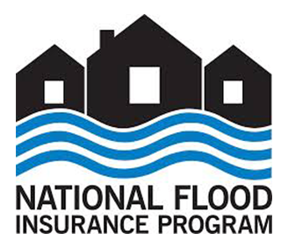
Consequences of NFIP Non-compliance
Sanctions if on probation:
Higher flood insurance costs
Sanctions if suspended (not participating):
No Federal flood insurance
Lack of certain types of Federal funding
Lack of certain types of disaster aid
Increased risk of flood damage
Notes:
Present the following:
Explain: There are consequences for not participating in the NFIP. Communities can also be placed on probation or suspended for not enforcing their regulations.
Community on probation: All policyholders receive a $50 surcharge on their policies.
Community suspended: No one in the community is eligible for Federal flood insurance. Private flood insurance options may be available.
Community Rating System (CRS) program communities placed on probation and suspension may be removed from the program. Residents will lose their CRS flood insurance premium discounts.
Certain federally backed loans for structures require a flood insurance policy. Getting private flood insurance may be more difficult if the community is not in the NFIP. Not being eligible for federally backed loans is harmful for communities that need housing development to support population growth.
Not participating in the NFIP makes certain disaster aid unavailable.
If you don’t enforce strong floodplain management standards, your community risk of flood damage may increase.

Slide 13
Activity: What Is the Purpose of the NFIP?
What are your priorities as a local official?
How does the NFIP benefit your community?
How do your priorities overlap with the purpose of the NFIP?
Notes:
Purpose:
If time allows, this activity can help your audience understand local priorities, roles, responsibilities, and benefits of the NFIP.
Procedure:
Direct the audience to Activity 2.1 in the Participant Manual.
Ask them to take three minutes to write down responses to the following:
What are your priorities as a local official?
How does the NFIP benefit your community?
How do your priorities overlap with the purpose of the NFIP?
Discuss audience responses to the questions.
Emphasize that strong floodplain management programs, the NFIP, and their priorities should overlap.
Possible priorities of a local elected officials:
Public safety
Economic development
Public health
Benefits of the NFIP:
NFIP Flood Insurance
Safer, damage-resistant development
Increased community resilience
Access to grants and loans (including federally backed mortgages)
Option B:
Co-Presenter:
Give examples of your priorities as a local elected official (e.g., public safety, economic development, etc.).
Explain how those priorities overlap with the purpose of the NFIP.

Slide 14
Unit Summary
NFIP helps protect communities and individuals from the impacts of flooding.
Local, State, and Federal governments must share roles and responsibilities to support the NFIP.
Benefits of the NFIP:
NFIP Flood Insurance
Safer, damage-resistant development
Increased community resilience
Access to grants and loans
Notes:
Present the following:
On the slide, you’ll see what we covered in this topic. In the next topic, we will discuss the resources your communities need to respond to and recover from disasters.

