Slide 1
Leveraging Artificial Intelligence and Robotics for Concrete Spillway and Arch Dam Condition Assessments
National Dam Safety Program Technical Seminar | 2022

Slide 2
Presentation Outline
Dam Safety Inspections - More Important than Ever
Current Inspection Methods and Areas for Improvement
Artificial Intelligence and Robotics for Condition Assessments

Slide 3
Dam Safety: A Changing Landscape
Changing Environmental Conditions
Aging Infrastructure
Rural Development Increases Consequence Classification of Rural Dams
Notes:
Moral of the story: Risks are higher, and are increasing

Slide 4
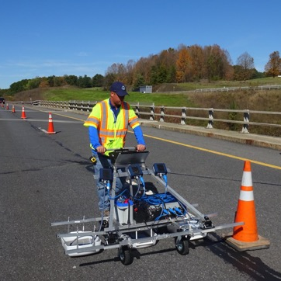
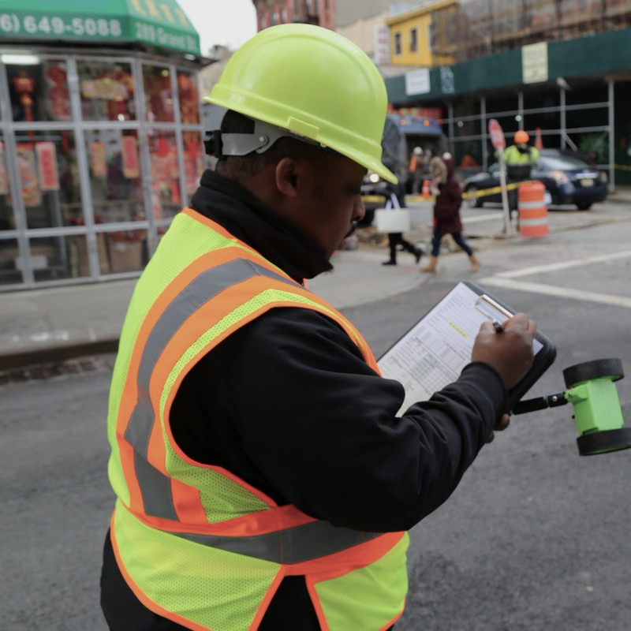
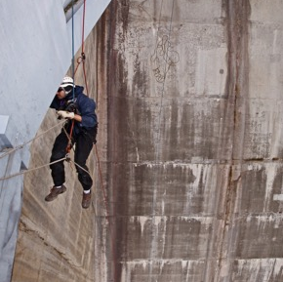
Current Dam Inspection Methods Cannot Meet Growing Needs
Expensive
Laborious / Time Consuming
Challenges with Repeatability/Referencing Previous Inspection Reports
Personnel Safety is a Risk, especially in Emergency Conditions
Notes:
Current inspection method is inadequate to meet these growing inspection needs.

Slide 5
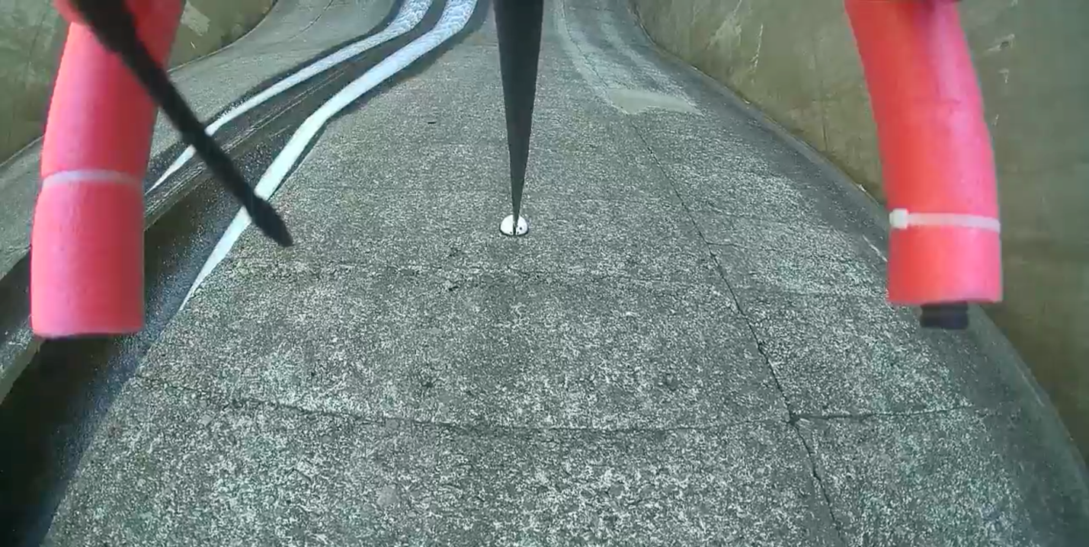
A New Inspection Method
Combining Automated Unmanned Aerial Vehicle Flights, Image Processing, and UAV-Based Acoustic Sounding Techniques to scientifically, repeatably assess structure’s health
Step 1: LiDAR Data Collection to Generate an Automated Flight
Step 2: Collect RGB/Thermal Imagery
Step 3: Collect Acoustic Data
Notes:
Our idea was: Instead of using our eyes and ears to map cracks and listen to damage, can we use cameras and machinery to do it for us?

Slide 6
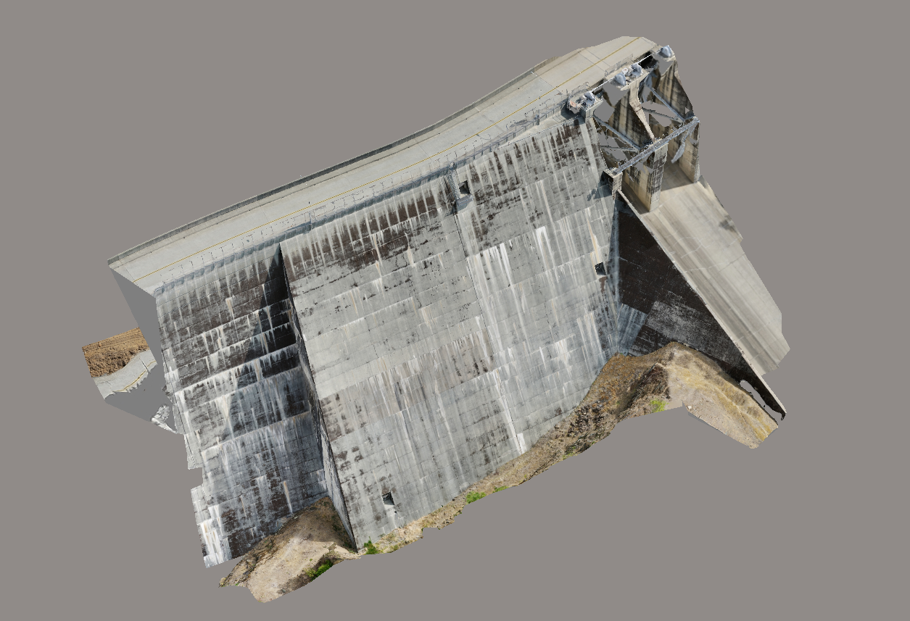
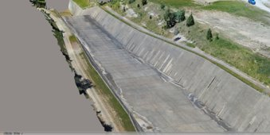
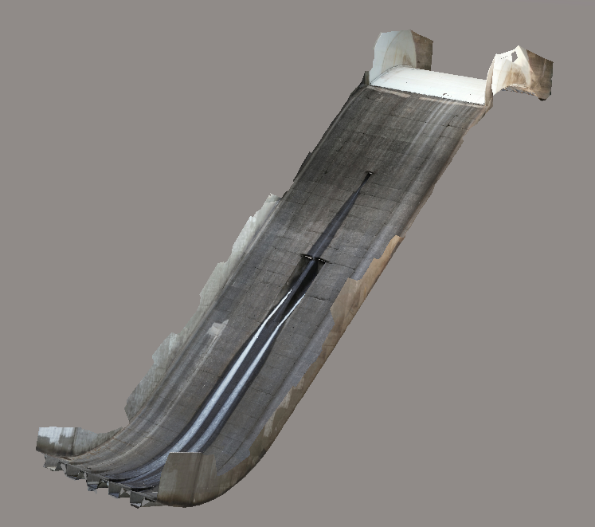
Build 3D Photogrammetric Model of Structures

Slide 7
New Inspection Method Benefits
Repeatable for Change - Tracking
Additional Productivity
Referenceable Digital Time Stamp of Structure's condition
Personnel Safety
No Scaffolding or Accessibility Equipment Needed
Referenceable Time Stamp
5x Faster
50% More Cost- Effective

Slide 8
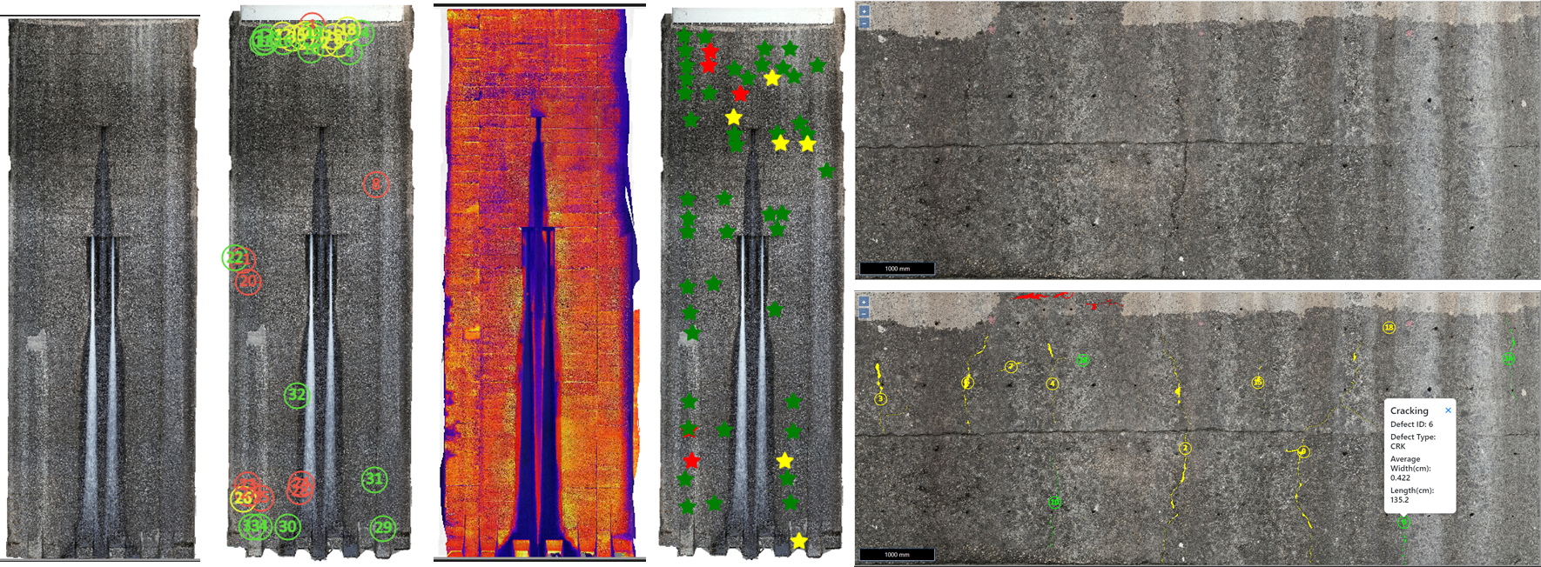
Next Level Inspections: Damage Detection and Change Detection
Using Image Processing and Multiple Digitized Data Layers to Detect Damage

Slide 9
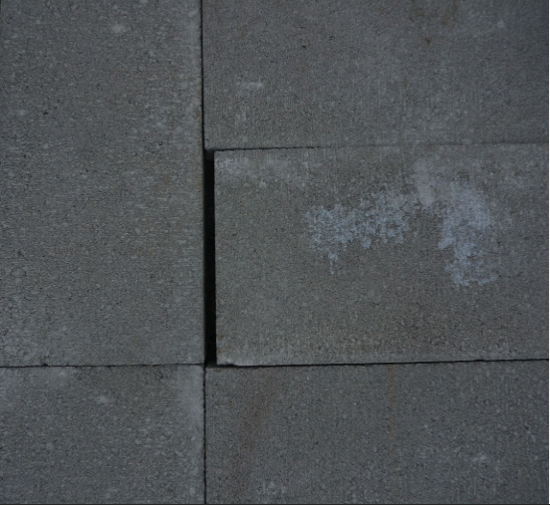
The Science: Damage Detection and Change Detection
Test Setup-Before
Test Setup-After
Computed Width by the Software = 1.19 mm
Physical/Manual Measurement= ~1-1.3 mm
GSD= 0.17 mm/pixel
Computed Width by the Software = 10.71 mm
Physical/Manual Measurement = ~9-11 mm

Slide 10
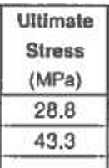
The Science: Damage Detection and Change Detection (2)

Slide 11
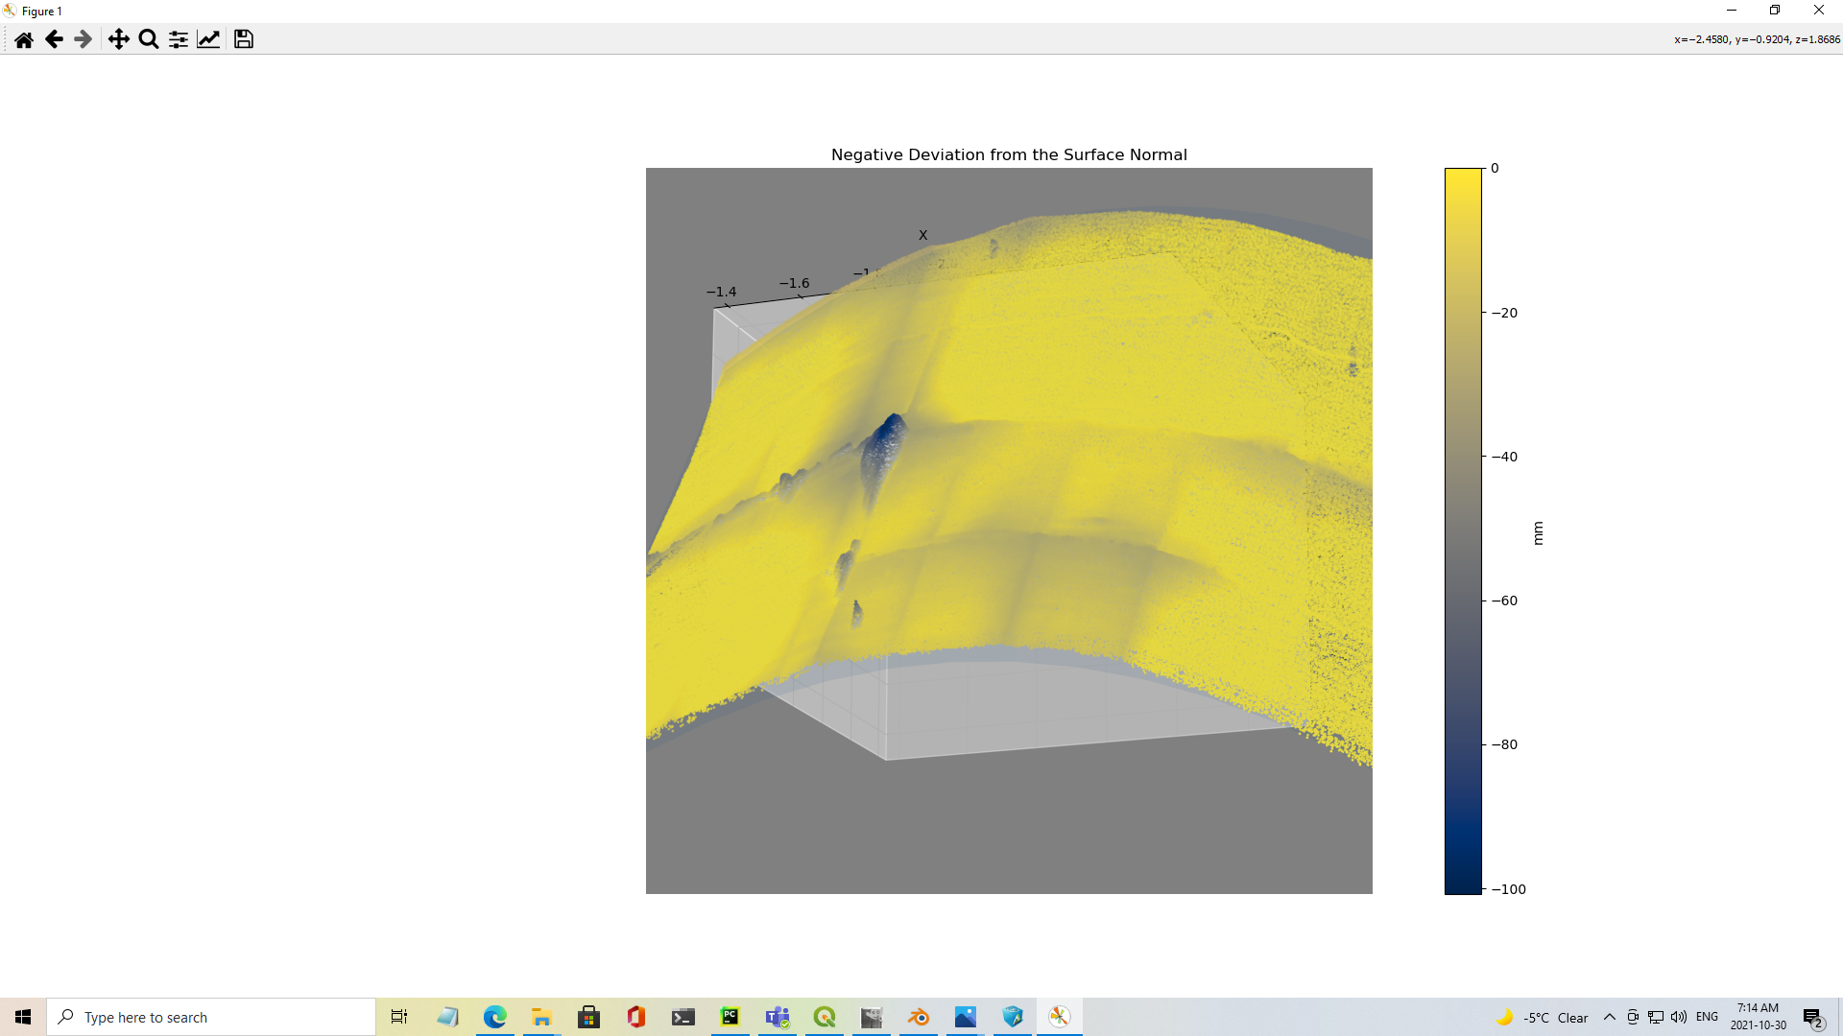
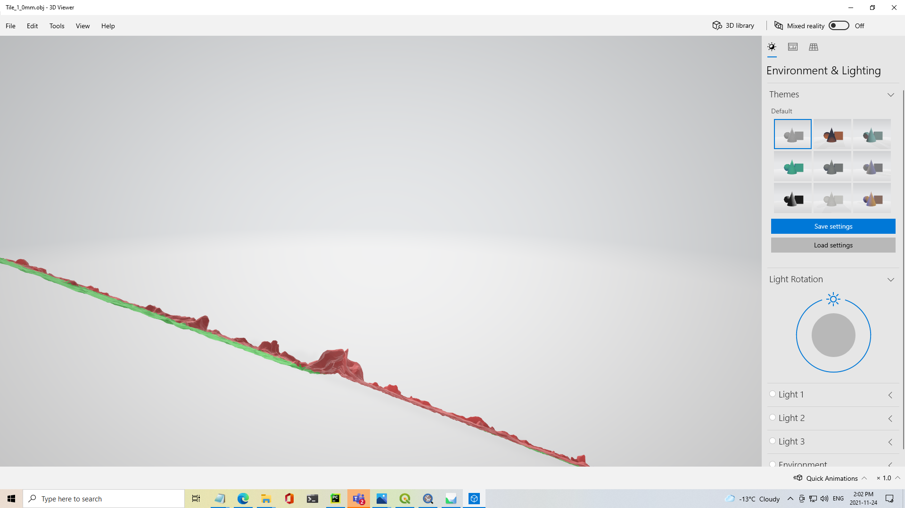
R&D Work: Offset and Volumetric Measurements using Photogrammetry
Volumetric Measurements for Spalling (Deviation from Expected Mean)
Offset (Deviation from Expected Mean)

Slide 12
Moral of the Story
Digitize the Inspection Process for Personnel Safety, Reducing the Need for Rope Access and Heavy Machinery
Ability to Monitor Assets and Detect Changes in Areas of Concern
Easily Implement Annual, More Detailed Inspections with Fewer Resources

Slide 13
Contacts
Mission: Making Infrastructure Safer
Ryan Coppersmith
Vice President, Pacific US Region
rcoppersmith@niricson.com
Joshua Fowler
Vice President, Rocky Mountain Region
jfowler@niricson.com

