Slide 1
Experience with Using Remote Monitoring in Dam Emergency Response
National Dam Safety Program Technical Seminar | February 23 - 24, 2022

Slide 2
Presentation Outline
Background
Dam Emergency Response
Remote Monitoring System
Remote Monitoring Data Management
Remote Monitoring Station Maintenance
Summary and Good Practices

Slide 3
Background
Notes:
Divider Slide

Slide 4
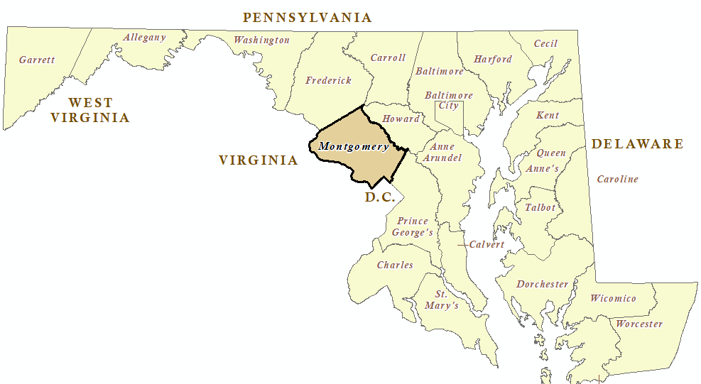
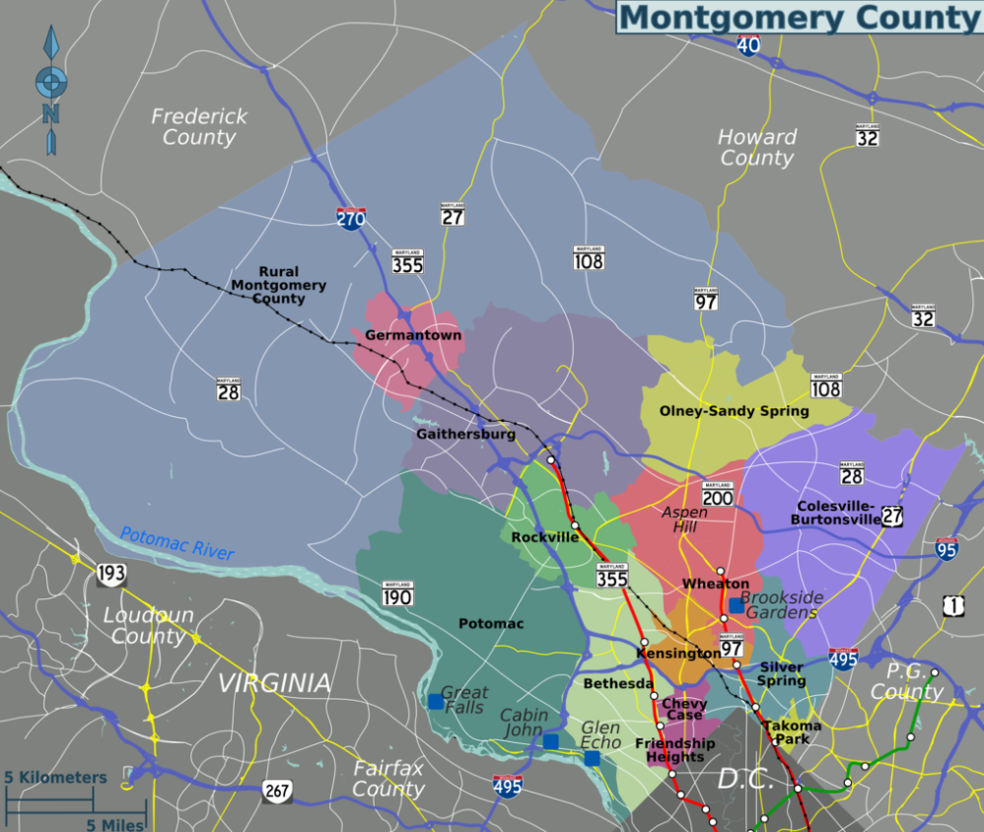
Montgomery County, MD
Area: 507 sq mile
Population: 1.1 million
19 Municipalities

Slide 5
Dam Hazard Classification
MDE Dam Safety Program
Dam Owner’s Responsibilities:
Inspections
Operation and Maintenance
Emergency Action Plans (EAPs)

Slide 6
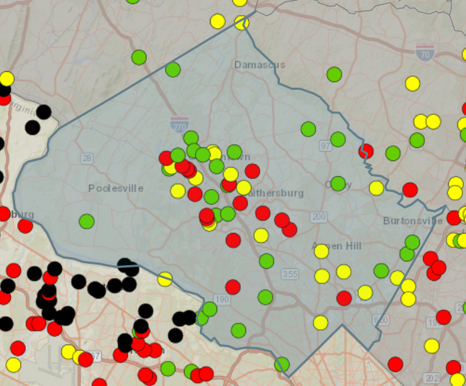
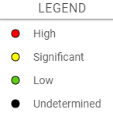
Dams in Montgomery County
Majority Earthen Dams
16 High Hazard Dams
15 Significant Hazard Dams

Slide 7
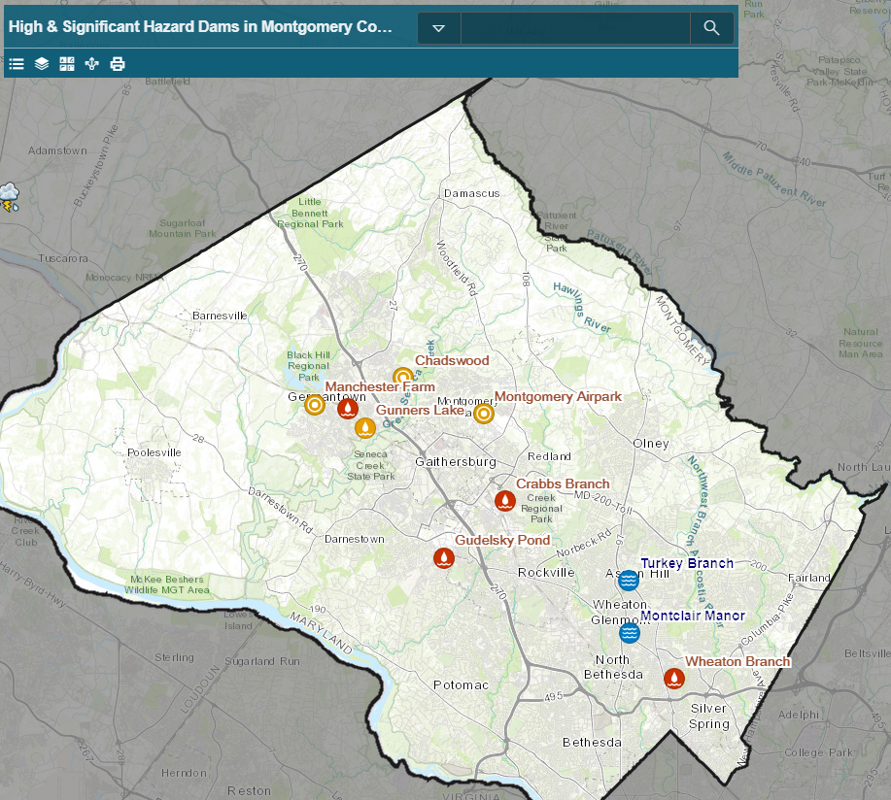
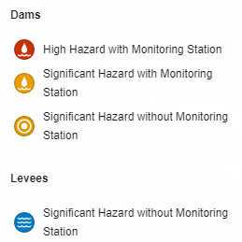
DEP’s Responsibilities
DEP is currently responsible for
8 Dams and 2 Levees
Crabbs Branch Dam
Gudelsky Pond Dam
Railroad Branch Dam
Wheaton Branch Dam
Chadswood Dam
Gunners Lake Dam
Manchester Farm Pond Dam
Montgomery Airpark Dam
Montclair Manor Levee
Turkey Branch Levees

Slide 8
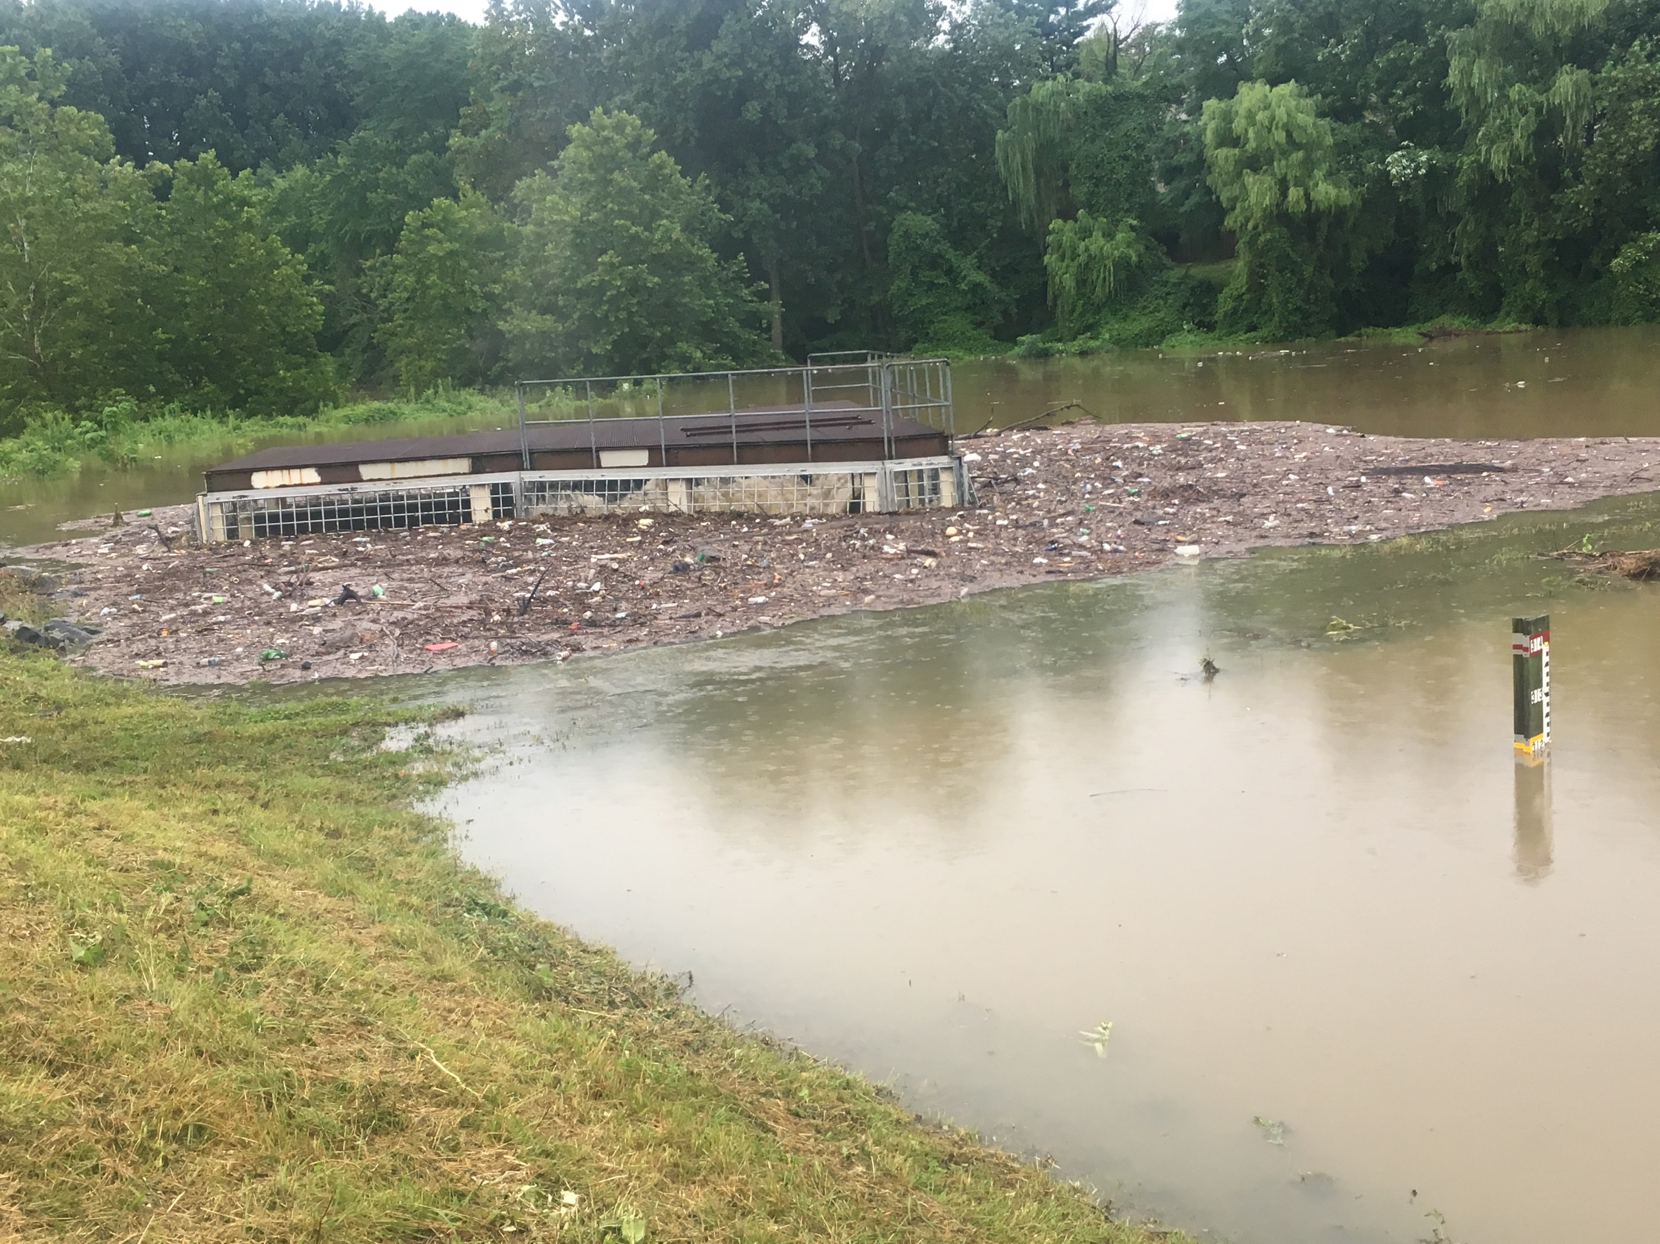
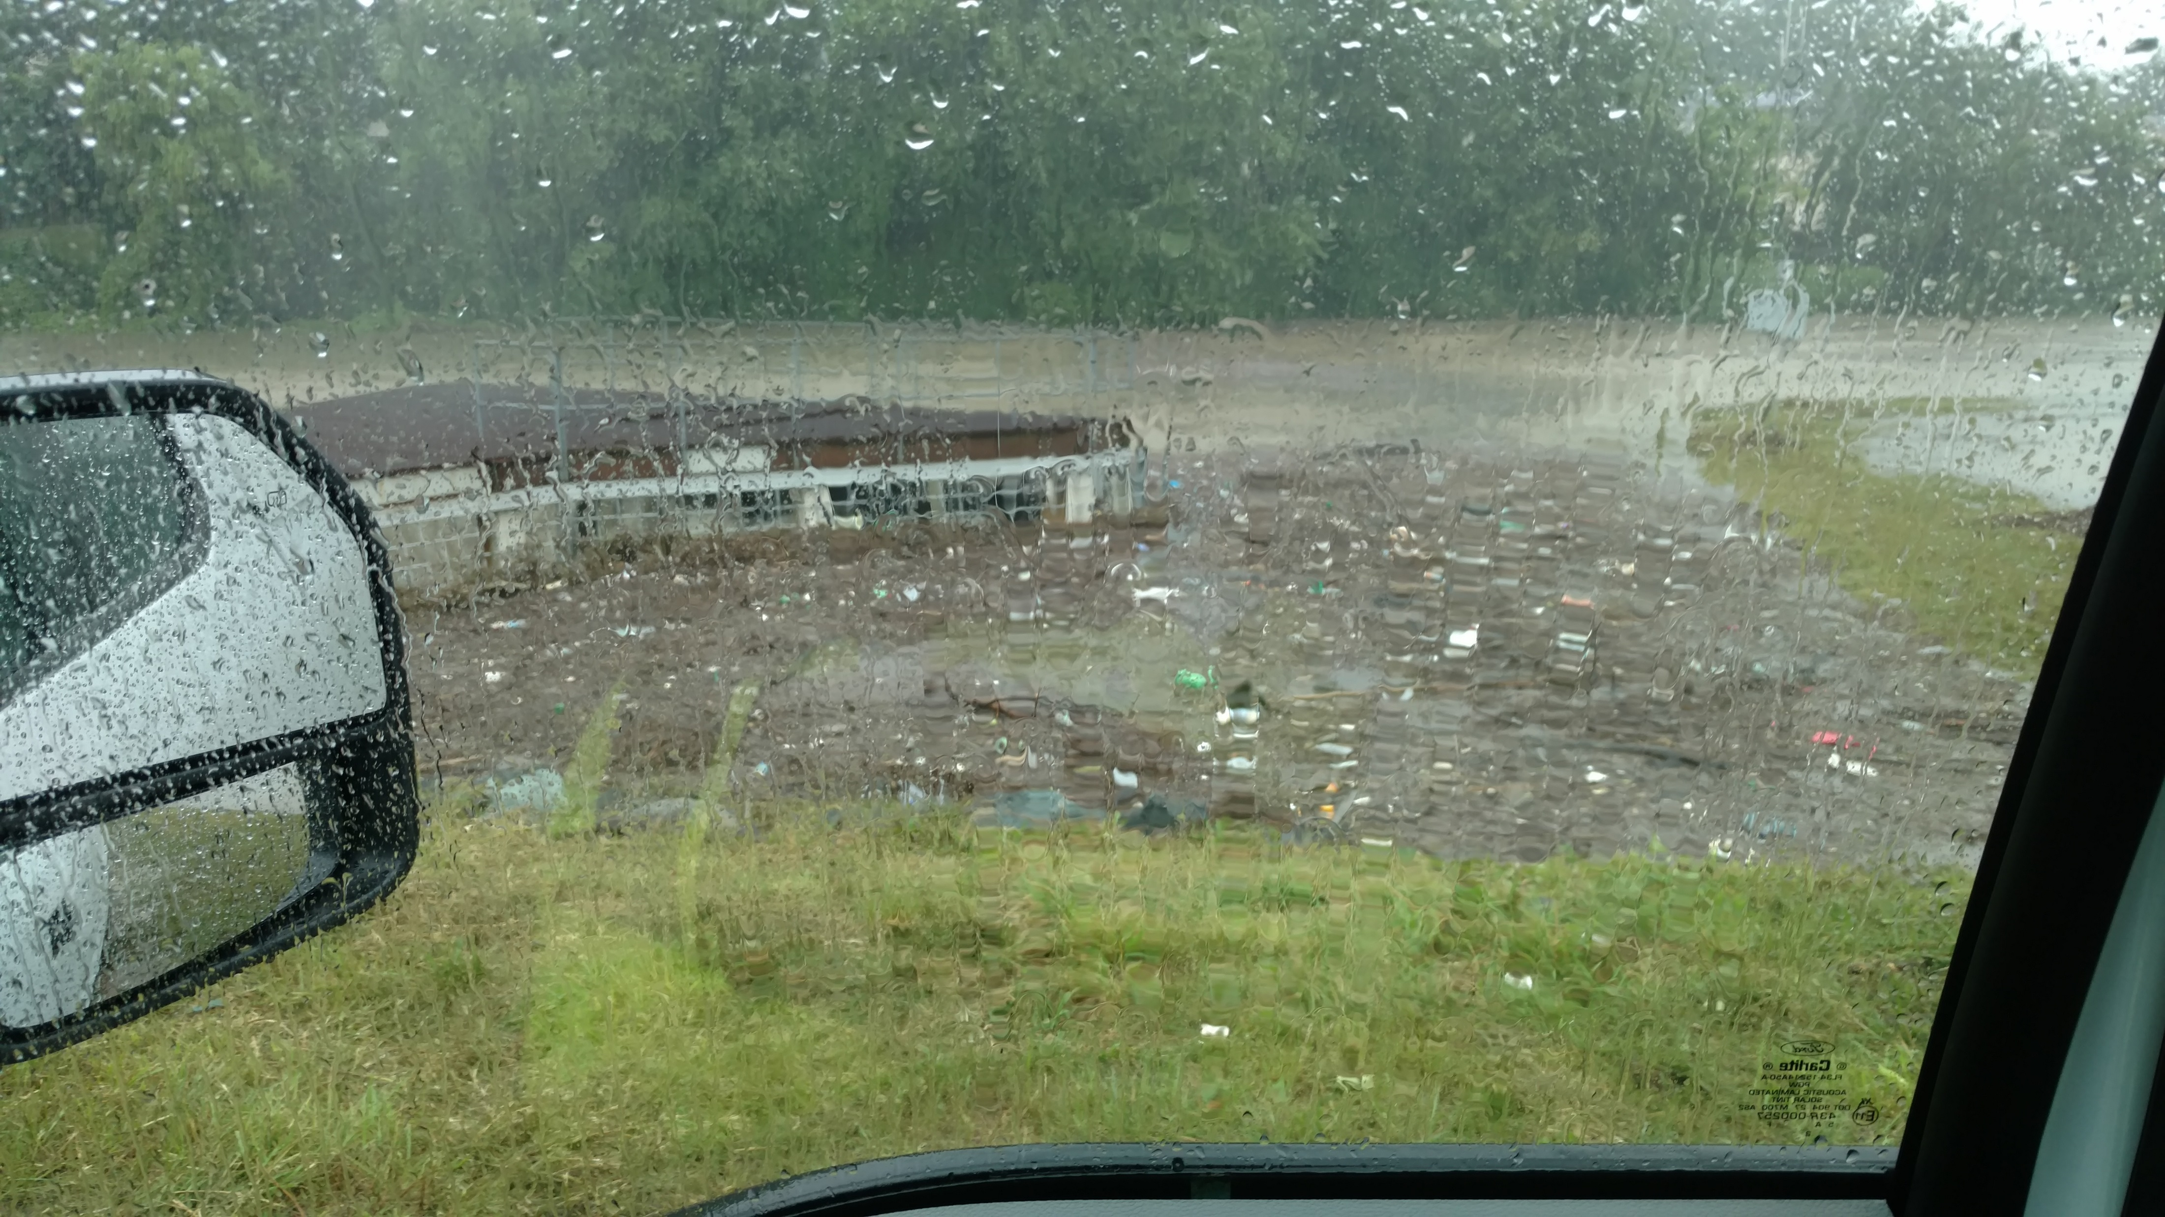
July 28th & 29th, 2017 Severe Rainfall Event
WHEATON BRANCH

Slide 9
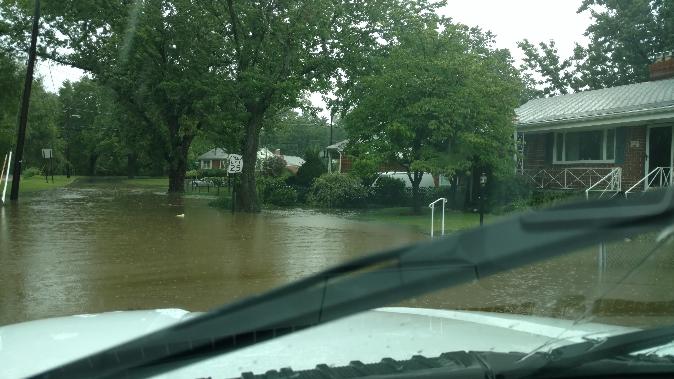
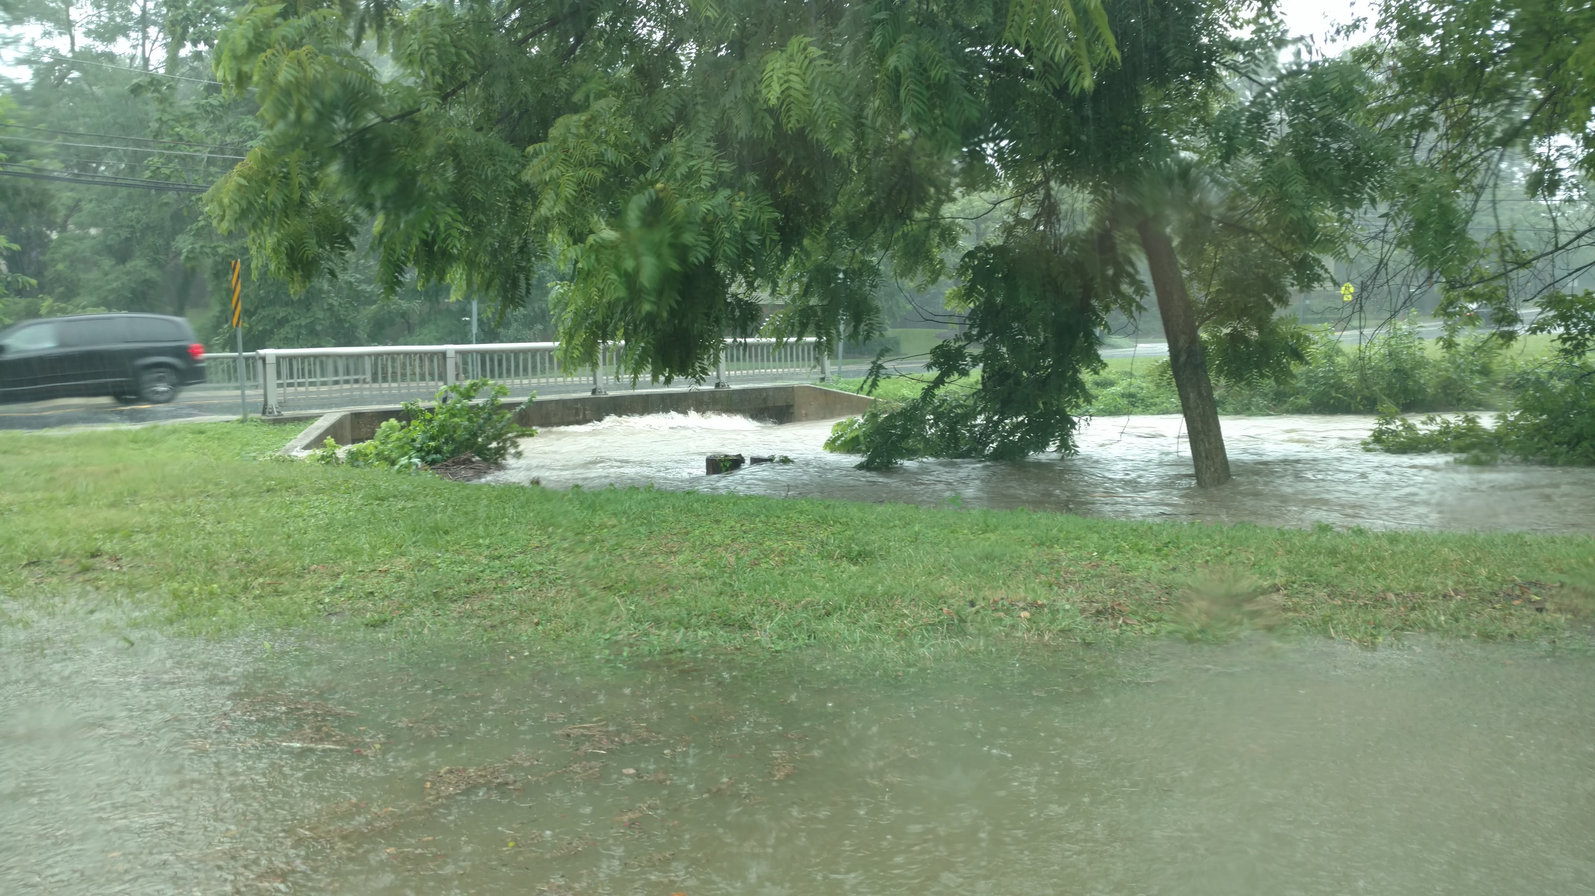
July 28th & 29th, 2017 Severe Rainfall Event (2)
WHEATON BRANCH on 7/28
UPSTEAM OF DENNIS AVE. BOX CULVERT

Slide 10
Dam Emergency Response

Slide 11
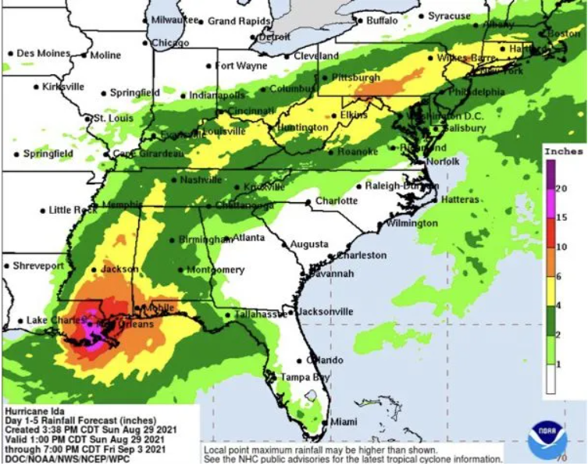
Dam Emergency Response (2)
DEP’s Emergency Response governed by Emergency Action Plans (EAPs)
Share responsibility with other County’s departments (OEMHS, Police, Fire, DOT, and others)
DEP Staff in Emergency Operation Center (EOC)
DEP Dam Monitoring Procedures

Slide 12
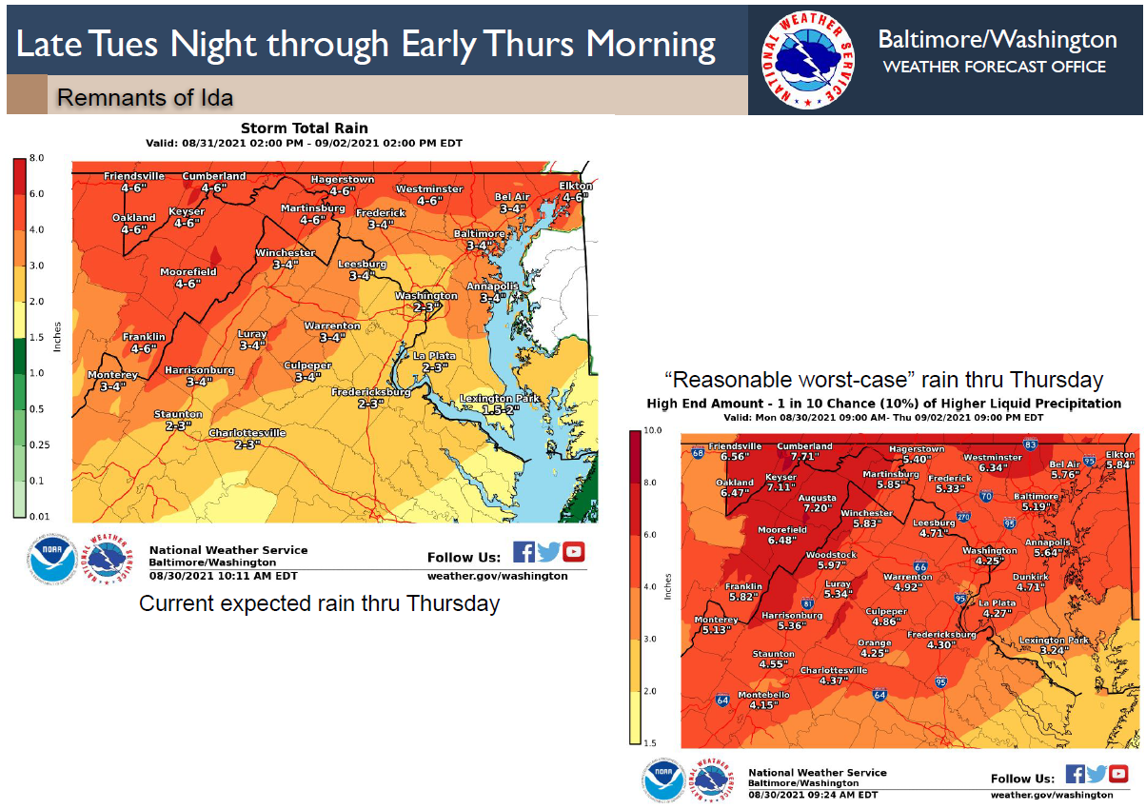
When Do We Mobilize?
Start monitoring remotely: precipitation and water levels
Activation: Full Mobilization – when rainfall amounts as predicted by NWS are:
3” rain in 6 hours
4” rain in 12 hours
5” rain in 24 hours
Use of remote monitoring during the dam safety emergency event

Slide 13
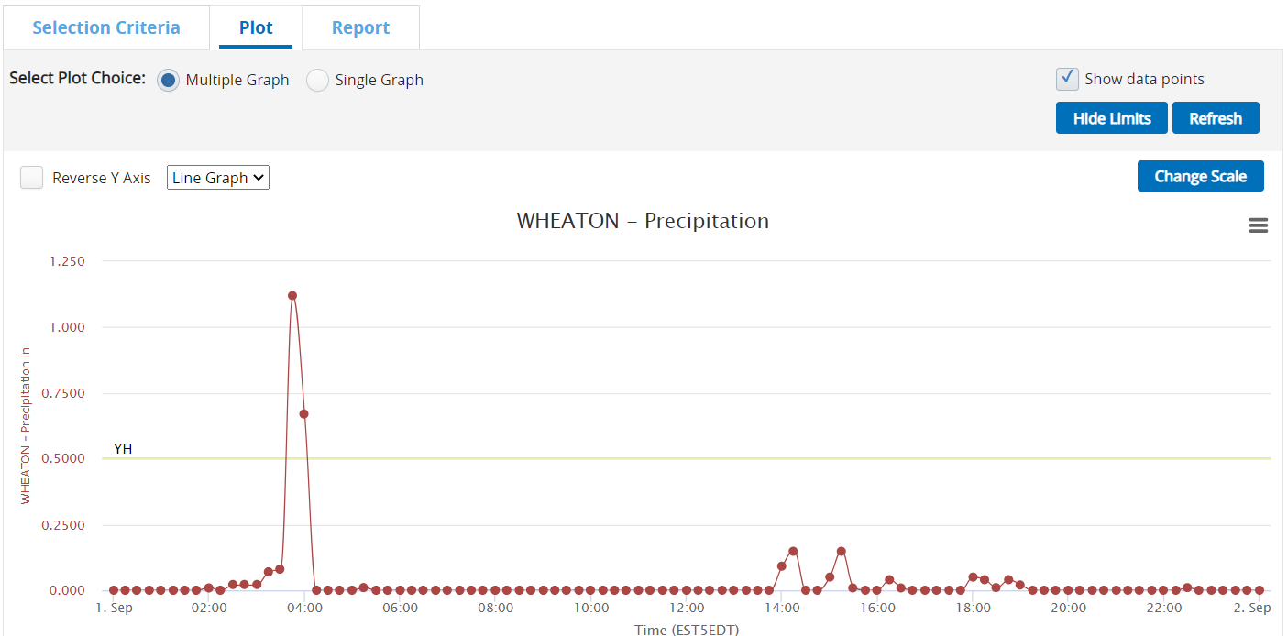
Wheaton Branch During Hurricane Ida
Date/Time(EST5EDT) | Precipitation(in)
Total 6 hr Precipitation | 2.02
Total 12 hr Precipitation | 2.11
Total 24 hr Precipitation | 2.69

Slide 14
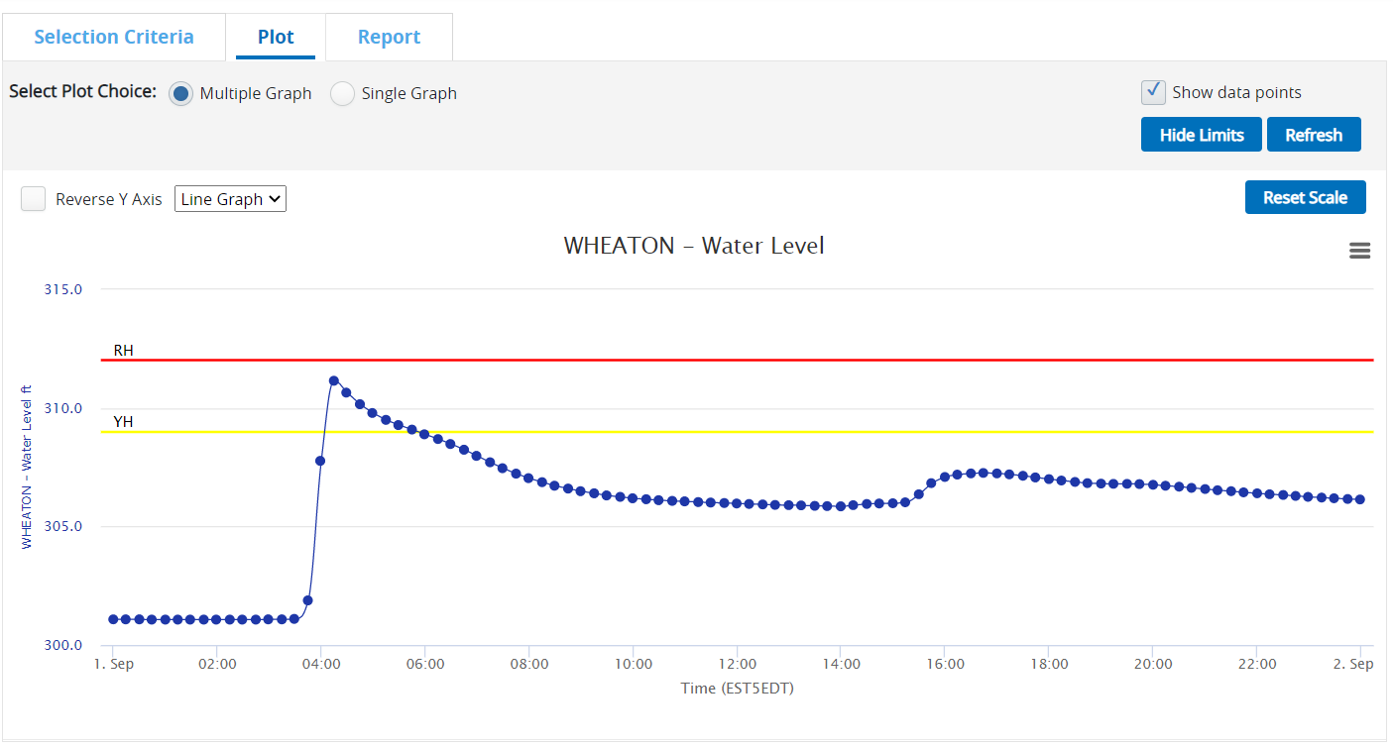
Wheaton Branch During Hurricane Ida (2)

Slide 15
Benefits of Using Remote Monitoring System
Monitor water levels in real time for detection of rising water levels and provide early warnings about high water levels or flooding.
Alert County staff, first responders, property owners, communities, and residents to potential flood hazards
Get the right data in-time to make critical decisions.
Help preserve infrastructure, protect lives and properties
Access data from anywhere
Easily share important data through graphs, notifications, alarms and data reports

Slide 16
Remote Monitoring System
Notes:
Divider Slide

Slide 17
History on Remote Monitoring
2006 County acquired remote monitoring system under a contract with Sutron
5 stations installed
In 2018 one additional station with camera was installed
Originally used radio signal. Switched to Cellular signal
Originally used Pressure Transducers. Later switched to Bubblers
4 new stations to be installed in 2022

Slide 18
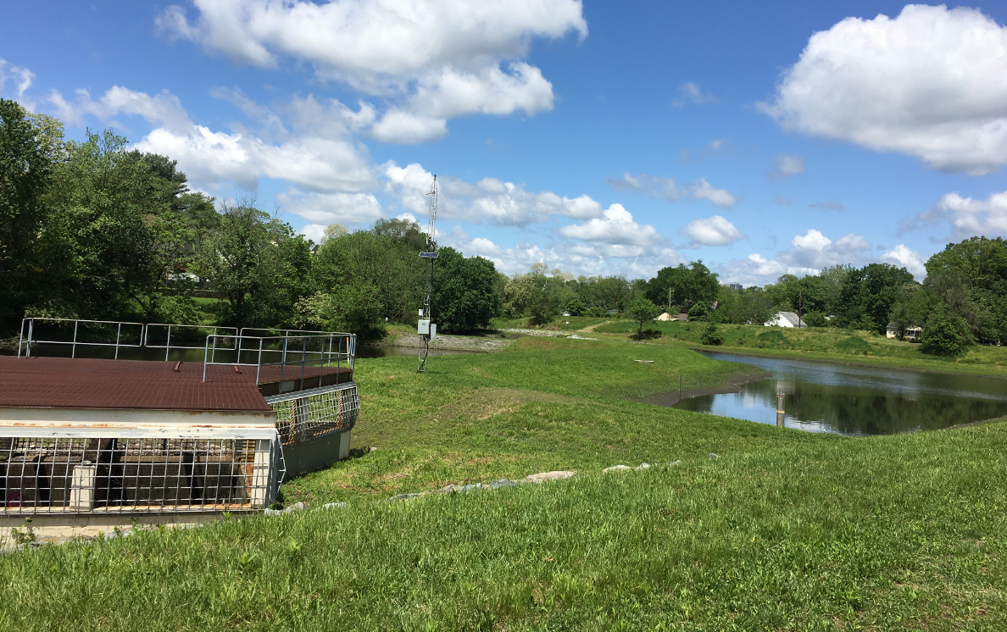
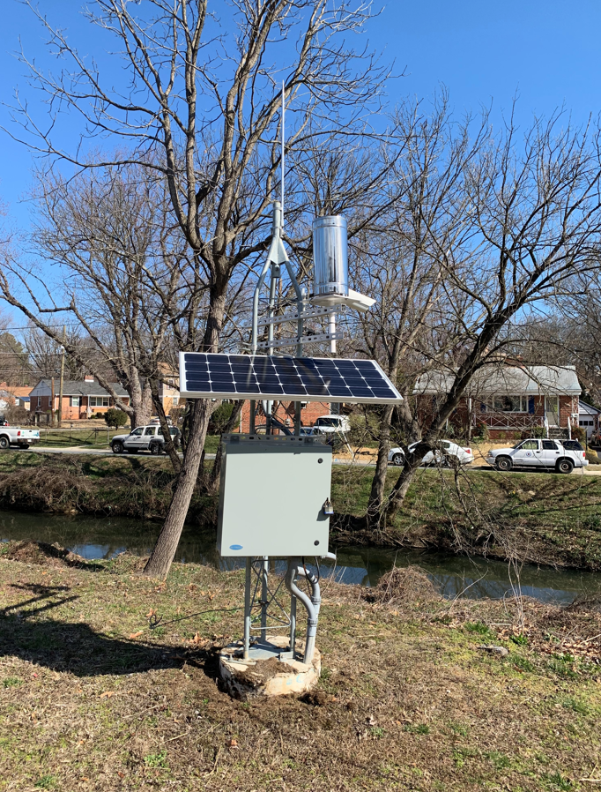
Existing Remote Monitoring Stations
Dams with Monitoring Stations
Wheaton Branch Dam
Crabbs Branch Dam
Gudelsky Pond Dam
Railroad Branch Dam
Gunners Lake Dam
Dennis Ave Bridge Station
Hydromet Monitoring Station
Staff Gauge
Riser Structure
Stage 3
Stage 2

Slide 19
Remote Monitoring System Components
Equipments
System Integration
Data Management

Slide 20
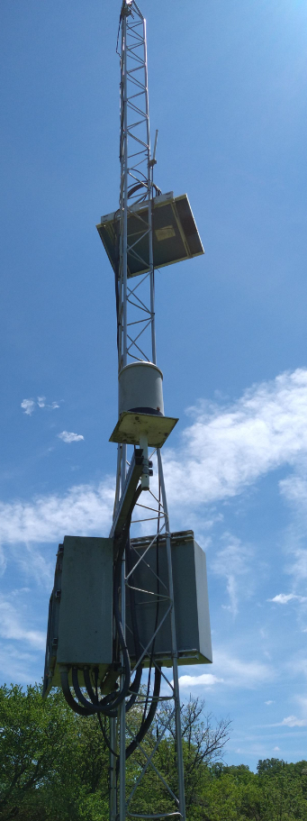
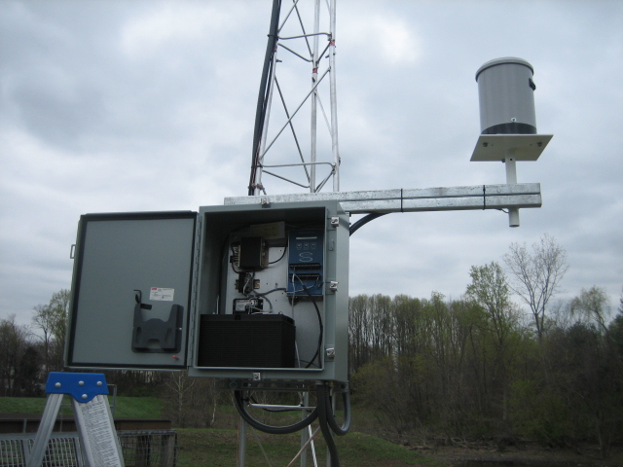
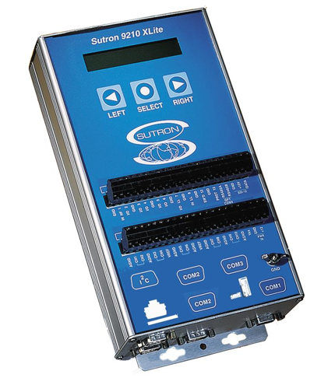
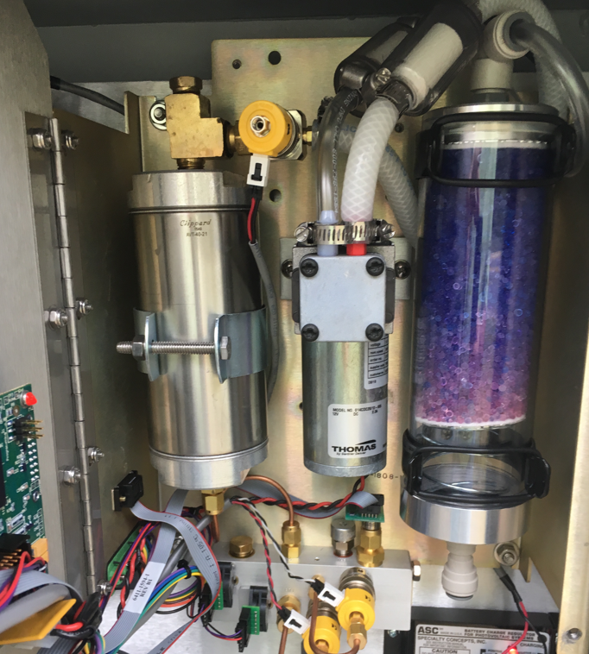
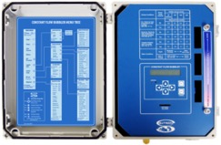
Equipment
Tower
Power Supply (Solar, Battery)
Tipping Bucket Rain Gauges
Modem
Sutron Xlite 9210 Data Logger
Water Level Sensor (Pressure Transducer, Bubbler)
Solar Panel
Rain Gauge
Enclosure Boxes
Bubbler

Slide 21
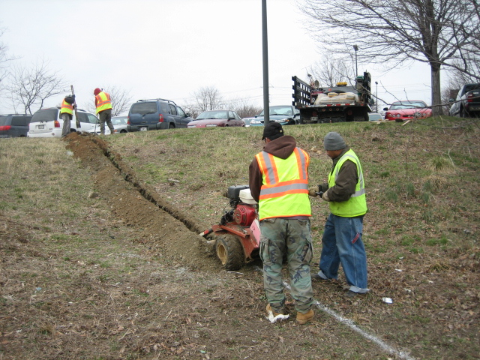
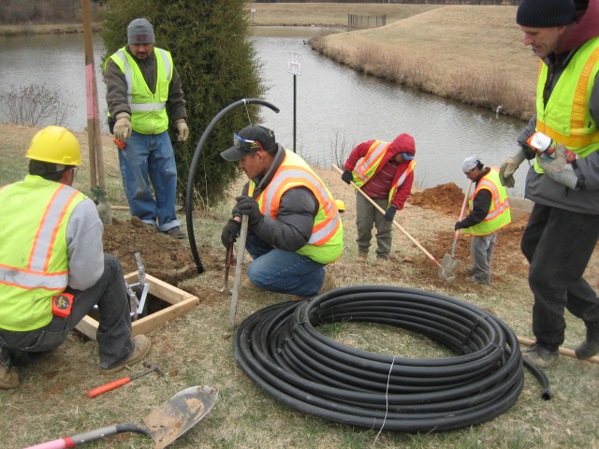
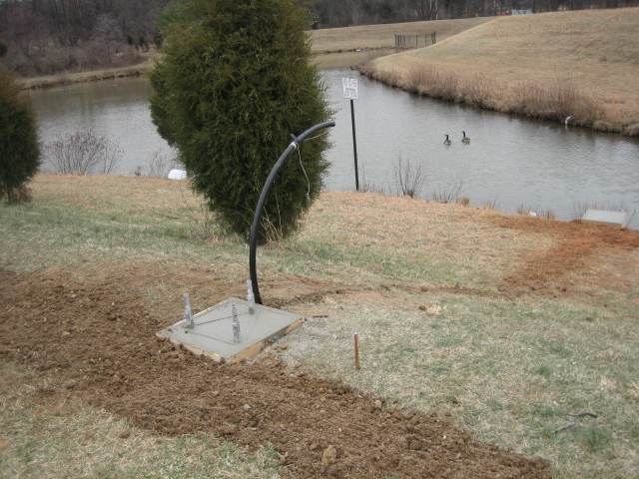
Example of Station Construction – Civil Work
Trench Excavation
Forming Tower Base
Conduit for the orifice

Slide 22
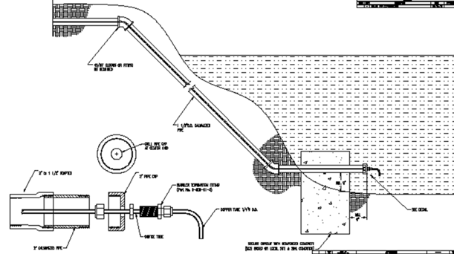
Water Level Gauge – Sutron Bubbler
Advantages
No expensive equipment in the water
No damage during flood conditions
Self cleaning
Important to know
Best practices to install bubbler line

Slide 23
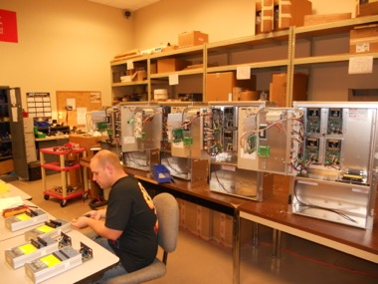
Remote Monitoring System Integration
System Integration Based on County Needs
Water Level Sensor (Bubbler or Pressure Transducer)
Remote Real-time Data Acquisition (Data Logger)
Communications (Mobile Data Transmission)
Data Management Software (HydrometCloud)
Factory Assembly and Testing
Deliver and Install Station

Slide 24
Remote Monitoring Data Management
Notes:
Divider Slide

Slide 25
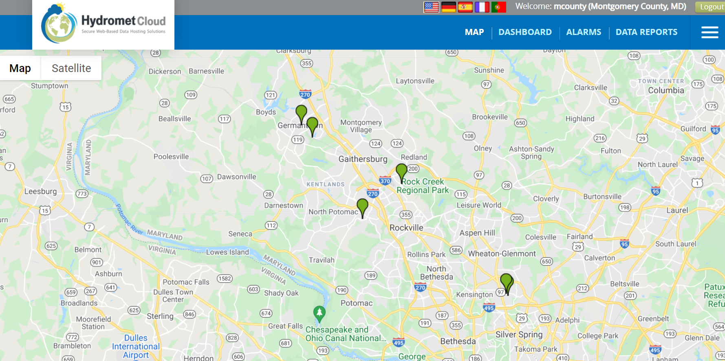
Hydromet Cloud
Cloud-based Data Hosting Site
View-Analyze-Download Station Data
http://hydrometcloud.com
24/7 Real Time Access of Station Data
Interactive Google Maps with Station Tabs for Current Data
Map Marker Color Coded for Alarms (Yellow, Red)
Live Images
Data Reports

Slide 26
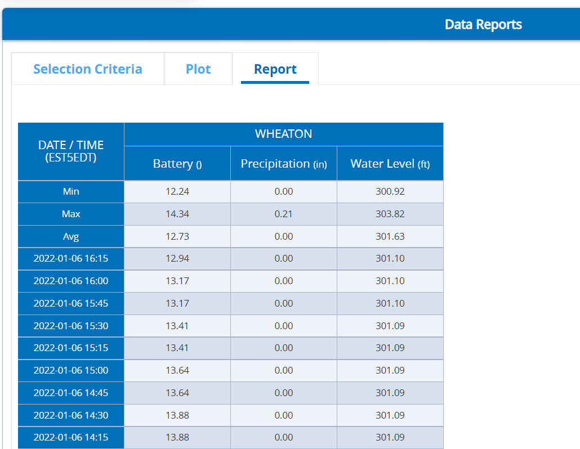
Data Report
Display Data for Select Parameters
Define Time Range
Export to Tables, Excel
Plot to Graphs

Slide 27
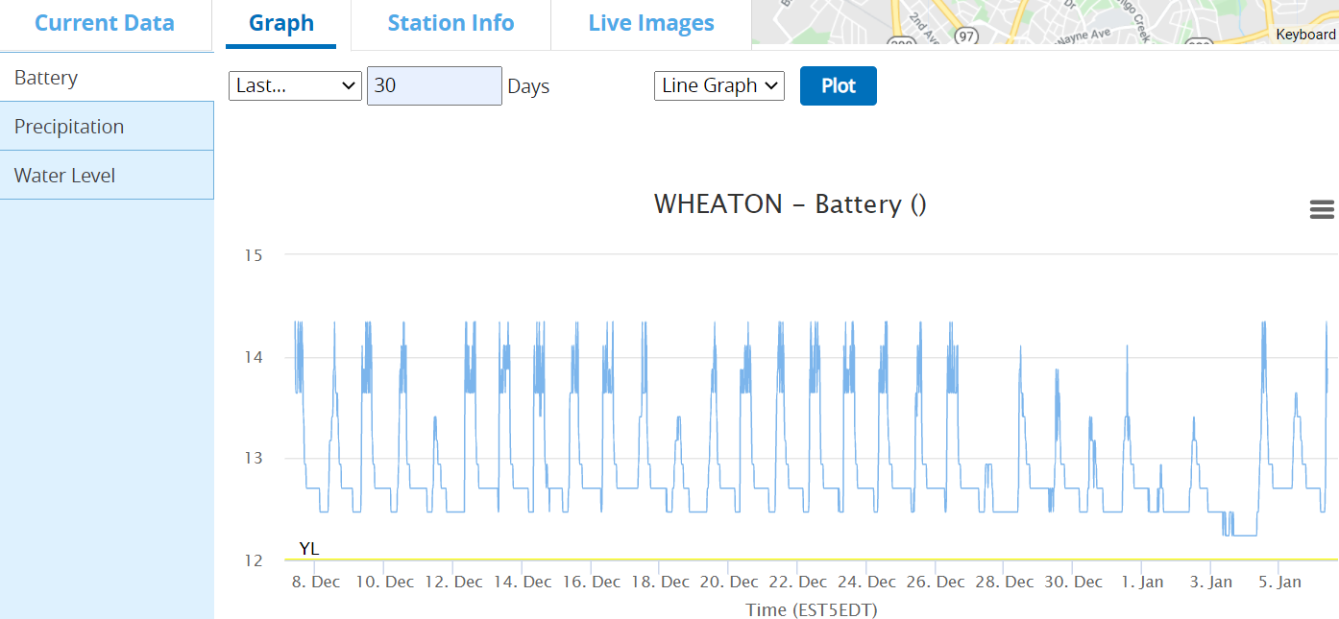
Graph - Battery

Slide 28
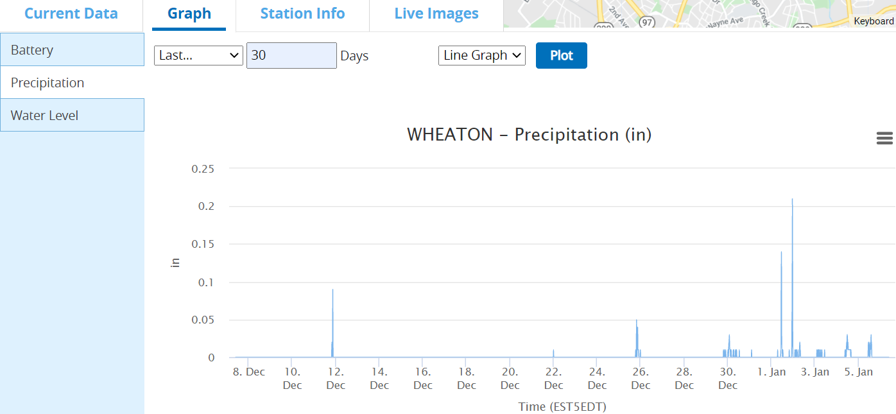
Graph - Precipitation

Slide 29
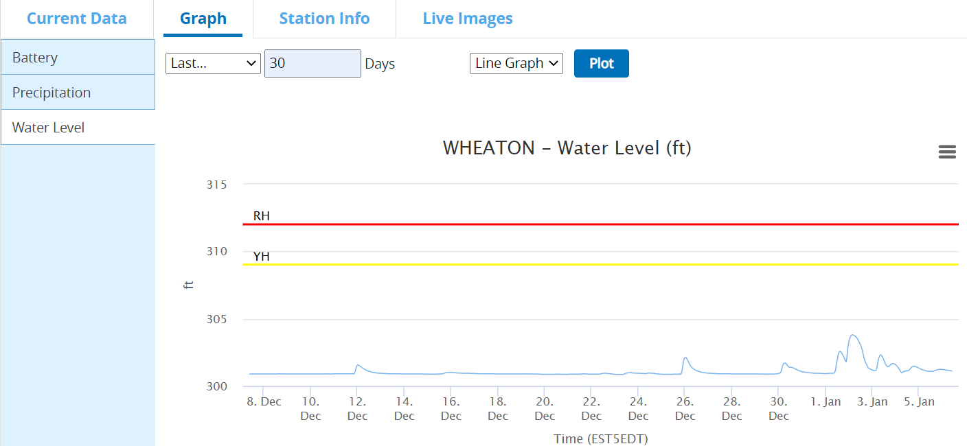
Graph – Water Level

Slide 30
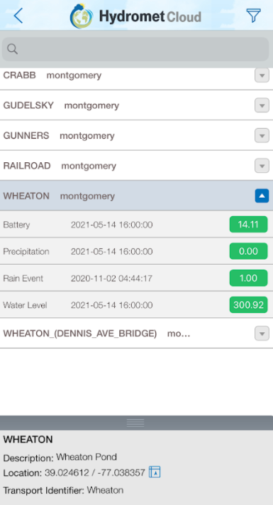
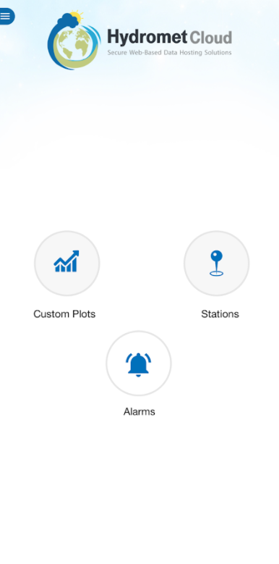
Hydromet Cloud Mobile App
Mobile Phone
Tablet

Slide 31
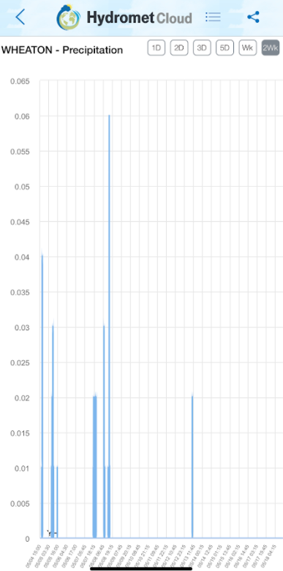
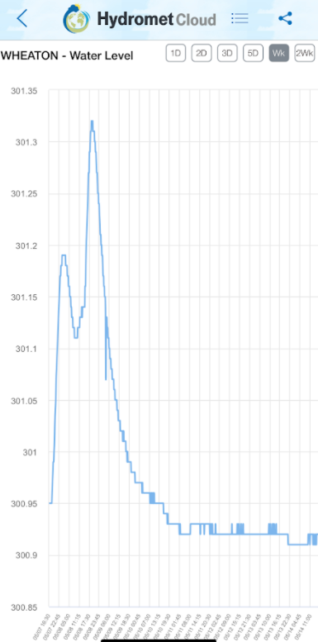
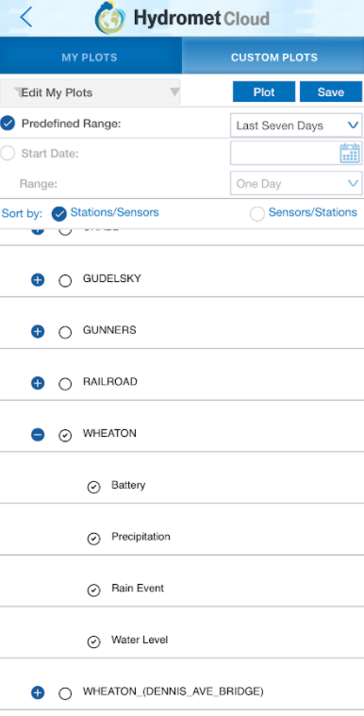
Hydromet Cloud Mobile App (2)
Graphs
Custom Plots

Slide 32
Alarms and Notifications
Alarms Set Up through Hydromet Cloud
Alarms on Battery, Precipitation, and Water Levels

Slide 33
Remote Monitoring Station Maintenance

Slide 34
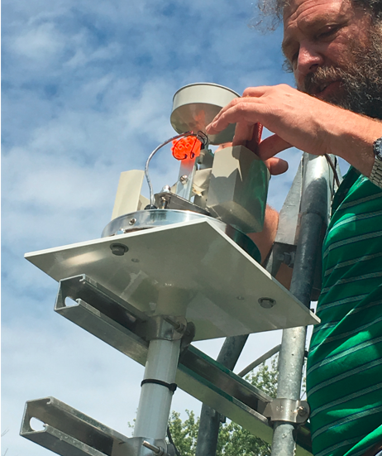
Station Maintenance
Implement Station Maintenance Bi-annually
Inspect Equipment Conditions, Connections and Power Supply Components
Check Power Supply Status
Disassemble and Clean Tipping Bucket Rain Gauges
Calibrate Stage Logger to Staff Gauge Readings
Replace Desiccants
Clean Camera Lens

Slide 35
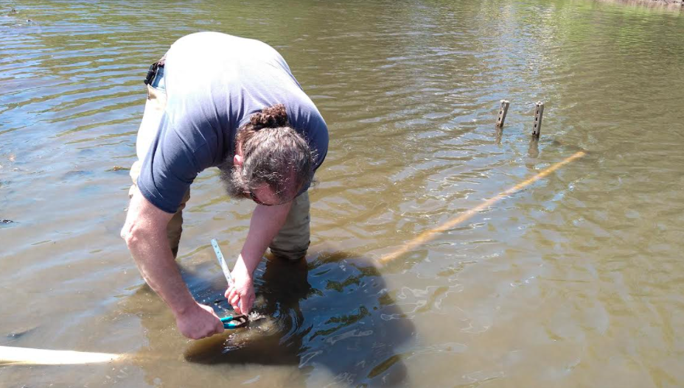
Station Maintenance (2)
Monitor Station Weekly through HydrometCloud
Address Station Repair Needs
Battery Replacement
Solar Panel Vandalism
Sensor Replacement
Bubbler Cable Repair
Rain Gauge Repair
Upgrade Station Equipment as Needed
Download Historical Data Twice A Year

Slide 36
Summary and Good Practices
Remote Monitoring System – A Great Tool to Use During Dam Emergency Response
Access Extensive Data through Hydromet Cloud
Provide Early Warning on Flooding
Get the Right Data in-time to Make Critical Decisions
Implement Station Maintenance Bi-annually
Monitor Station Status Weekly through Hydromet Cloud
Address Station Repair and Upgrade Needs
Download Data to Track Long Term Station Performance

Slide 37
Questions?
Leying Zhang
Montgomery County DEP
Email: Leying.Zhang@montgomerycountymd.gov
Gene Gopenko
Montgomery County DEP
Email: Gene.Gopenko@montgomerycountymd.gov

