Slide 1
Leveraging DSS-WISE Lite to Improve Preparedness A State Dam Safety Program Perspective
National Dam Safety Program Technical Seminar | February 23-24, 2022
Notes:
Title slide + Image Option 2

Slide 2
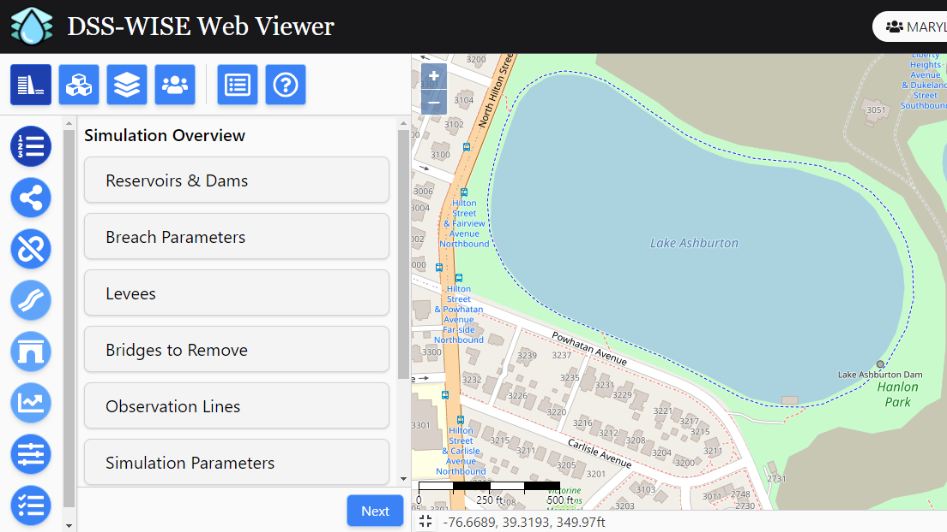
Divider Slide (Option 1)
Notes:
Introduce self. Thanks.
Intro: By now I think this screen is relatively familiar among many in the audience. DSS Wise has been in use for over 5 years now – and with the current v3.0 release from November 2021, the application has hit a level of maturity that really adds a lot of value to the users. In fact in preparing this presentation I looked back at some notes I had made when the beta version was released in 2016 - which had a wish list of improvements – and with a few exceptions, everything is now active in the software.

Slide 3
Maryland's Experience With DSS-WISE Lite
Notes:
So I’d like to use this time to talk about some exciting projects that we are working on using DSS Wise, and future plans to leverage the software even more. Admittedly, not all of this will be groundbreaking from an engineering standpoint – but on the big picture level, how we operate with our emergency management partners, floodplain managers, and citizens – I really feel that this work is a big step forward for our state program.

Slide 4
Past use of DSS-WISE Lite
August 2016 - Maryland begins use of DSS-WISE Lite
A simple method to check dam breach analyses submitted for permit applications
Rapid assessment of hazard potential when a “new” old dam comes to our attention
April 2017 – Law passed requiring EAP and TTX for High and Significant Hazard Dams
Accepted as “temporary” mapping for EAPs where owners didn’t have maps
DSS-WISE Lite not accepted as a hazard classification tool or for long term use in EAPs

Slide 5
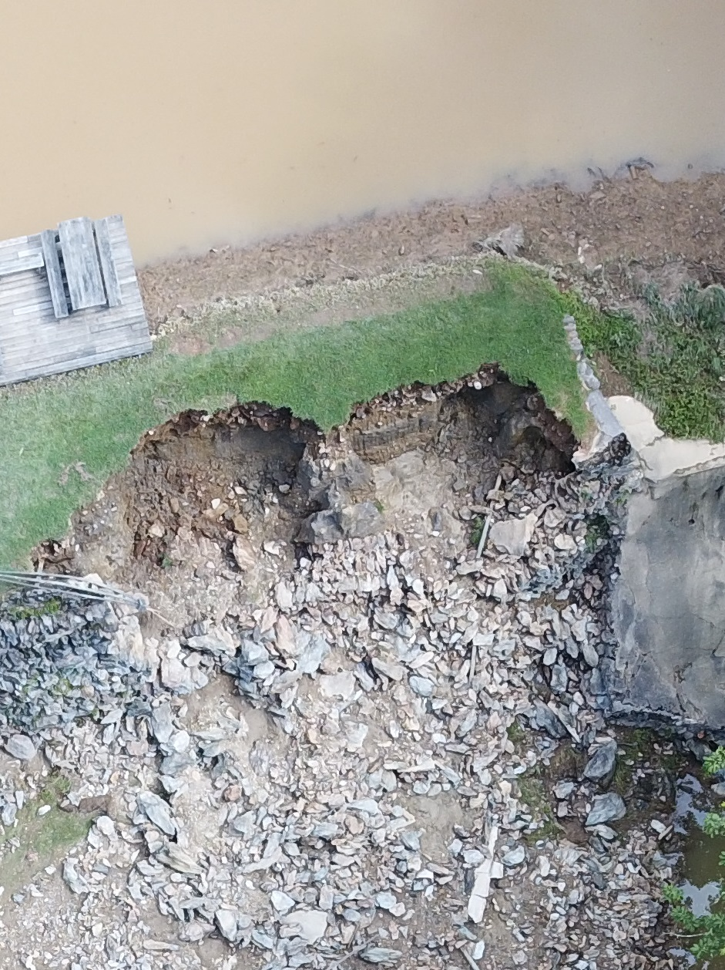
Past use of DSS-WISE Lite (2)
July 2018 - Cascade Lake Dam overtops and is close to failure. Ran DSS-WISE Lite in Emergency Management mobile command vehicle on site to inform response actions
Push to increase public awareness of dam locations and inundation areas
How to get around varying ages and quality of inundation mapping?
What about owners who wouldn’t provide mapping for public consumption?
What homeland security issues will sharing information pose?

Slide 6
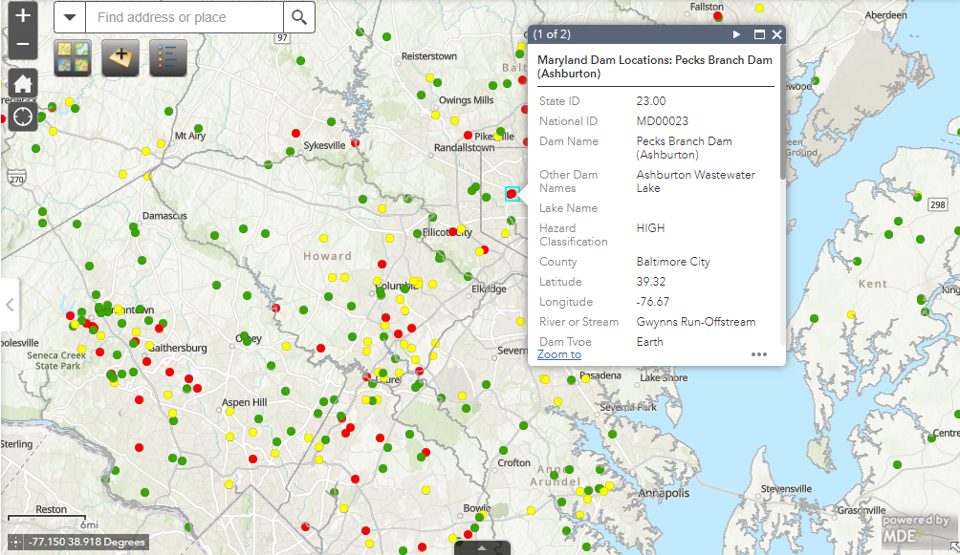
Dam Safety WebMap
Notes:
We’ve been hosting this data for about 3 years now – dam locations and some limited information – basically mirroring what is publically available in the NID – but dam locations alone fall short in two ways – first it doesn’t portray the whole picture in terms of what living near/with dams means – but also its not compelling/exicting enough to get people to dig deeper into the information.

Slide 7
Present use of DSS-WISE Lite Products
Spring 2019 – Apply to FEMA Hazard Mitigation Grant Program funds to run DSS-WISE Lite simulations on all ~550 inventory dams
Partnership with Maryland Environmental Service to perform analyses and GIS support
Sunny Day and Brim-Full failures
Integrate inundation shapefiles into mdfloodmaps.net
September 2020 – Grant awarded
FEMA-DR-4376-MD-0010
Project kick-off in December 2021
Notes:
By integrating into the md floodplain mapping program we support FEMA moonshot goal of doubling flood insurance policies
This was a key to the application to clearly show folks the hazard mitigation aspects/benefits – where dam inundation mapping may be more esoteric and maybe not ger as much traction.

Slide 8
Present use of DSS-WISE Lite Products (2)
DSS-WISE was selected as the preferred methodology for mapping inundation areas for this project
Relative ease and speed to set up models
Consistent modelling methodology aids in clear, plain-language communication of what inundation boundaries portray
Human Consequences (HCOM) module is a value add
Maryland Public Information Act
Withholding of information relating to public security is discretionary
Requires record-holder to justify withholding based on assumption that inspection would result in adverse outcomes
Default posture should strongly favor release

Slide 9
Present use of DSS-WISE Lite Products (3)
Both mdfloodmaps.net and a recently released Dam Safety webmap will serve as content hosts for the inundation information
Dam Safety webmap will be pushed as an engagement tool for the public to include other important layers that enhance context
Critical infrastructure points, dam watershed delineations, property data, environmental layers and social/demographic layers
Communication strategy: advertise webmap to 900+ dam safety community persons on state email list and to general public
Population-at-Risk Data from the Human Consequences (HCOM) module
Screen for hazard creep, available for quantifying risk, assist local emergency planning
Notes:
PAR data will not be shared publically (unless on request). It will be shared with local emergency managers to improve their planning and dam appendix to local haz mitigation plans
How do we disseminate to state/local planning depts. So that development can be located outside of inundation zones?

Slide 10
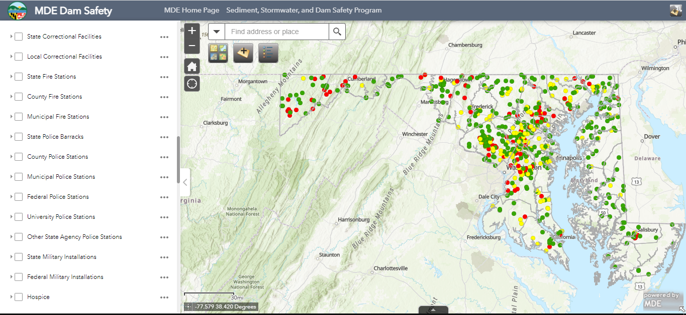
MDE Dam Safety Map
Notes:
Describe the web tool and some of the layers that will be presented

Slide 11
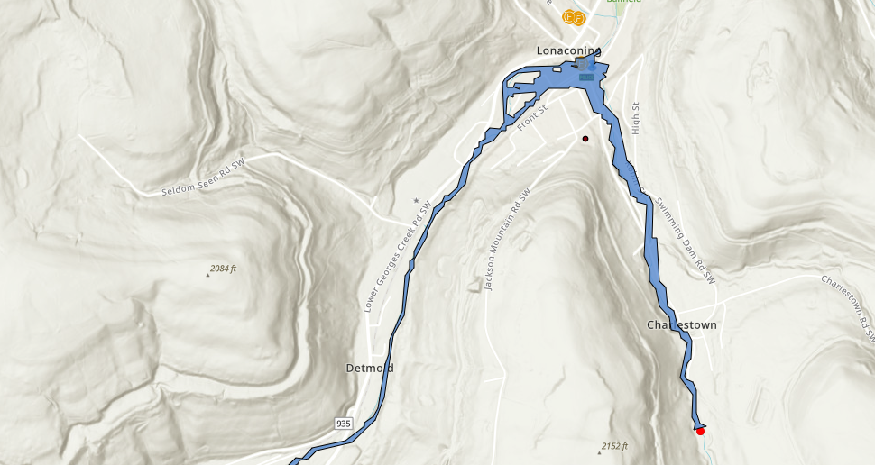
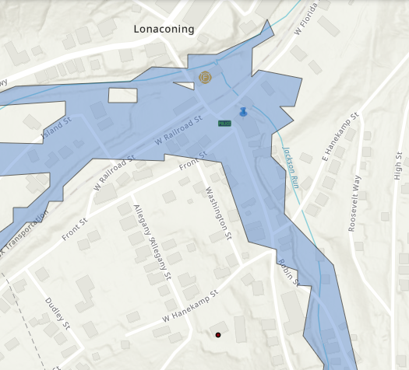
Downtown Lonaconing in Western Maryland
Notes:
Here is a good example of the value of the inundation mapping project – both for the public, local government as it relates to planning/mitigation strategies, and our objectives. The Charlestown Reservoir is located in a valley just south of Lonaconing MD – in Allegany County MD. The dam is relatively small, but is classified as a high hazard dam due to the many homes and other structures located downstream. Once the dam breach flow reaches Lonaconing proper it joins with Goerges Creek, which historically has been a trouble location for flooding. In this case, the Flood Insurance mapping extents are greater than this dam failure area – so the newly added data may not help with increasing insurance rates – but what is important to highlight here is the location (POINT) of the town hall and administrative offices, the local police department, and the Georges Creek Ambulance service. So in a dam failure we see that all of those structures are impacted (and rather quickly) – we also can see that the Goodwill Volunteer Fire Company No. 1 to the north would be essentially isolated from any needs to the south. Lastly – the black dot here is a local retirement home – which is not directly impacted, but is cutoff from all other services. So any needs of the residents will be unmet until access is restored. In this case, we will consider adding the retirement home to the EAP as a contact, and in table top exercises we may include the local health department or others to find out how we can shelter and care for the residents and their potential special needs.

Slide 12
Future Uses of DSS-WISE Lite Products
Notes:
So I’d like to use this time to talk about some exciting projects that we are working on using DSS Wise, and future plans to leverage the software even more. Admittedly, not all of this will be groundbreaking from an engineering standpoint – but on the big picture level, how we operate with our emergency management partners, floodplain managers, and citizens – I really feel that this work is a big step forward for our state program.

Slide 13
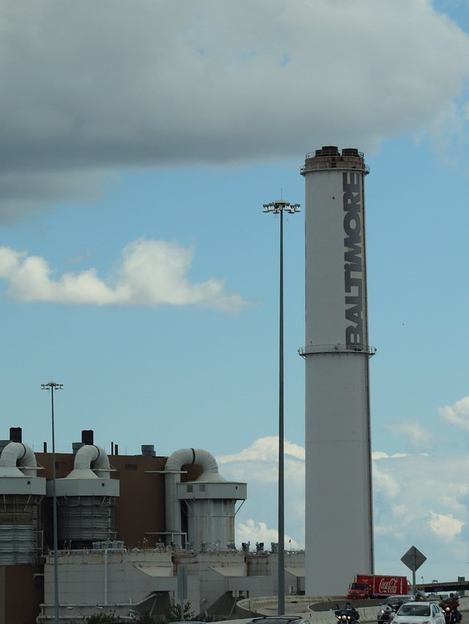
Future use of DSS-WISE Lite Products
January 2021 – MDE releases Environmental Justice Policy and Implementation Plan
Charge: How to respond to existing inequities?
Enhanced inspections
Broader outreach/inclusion for permitting
For dams, do we look at just the dam, the inundation area, the watershed, combination?
May 2021 – State legislation passed that emphasizes resilience to flood events
Notes:
"IMG_1424a" by Elvert Barnes is licensed under CC BY-SA 2.0. To view a copy of this license, visit https://creativecommons.org/licenses/by-sa/2.0/?ref=openverse&atype=rich
Mention that the legislation doesn’t necessarily have a direct connection with dams – but it may shift the development/engineering mindset into larger regional stormwater ponds to “overmanage” runoff – which may draw our attention – as well as levees to protect against riverine flooding.
one of its requirements is for local communities to identify frequently flooded areas, and then to develop regulations for additional management in these areas. You mention that additional management may be in the form of larger ponds with dams. Another nexus would be, many of the local community identified flood areas will not be in the 100-year floodplain, and are existing stream/storm drain volume capacity areas where the typical rule of thumb has been to design for the ten year storm. If these location are in a dam's inundation areas (e.g., Ashburton), they will likely be higher risk areas within the inundation zone, and the information could possibly help to prioritize hot spots for emergency operations.

Slide 14
Incorporating Environmental Justice into Dam Safety Programs
Communities bear a disproportionate share of the negative environmental consequences resulting from industrial activities, land-use planning and zoning, municipal and commercial operations or the execution of federal, state, local programs and policies
Current position is that we should consider both the dam location and inundation area for enhanced planning
Strong case that watershed is important – bringing potential pollutants to more vulnerable communities
Beyond enhanced inspections and public notice how can we use DSS-Wise inundation mapping?

Slide 15
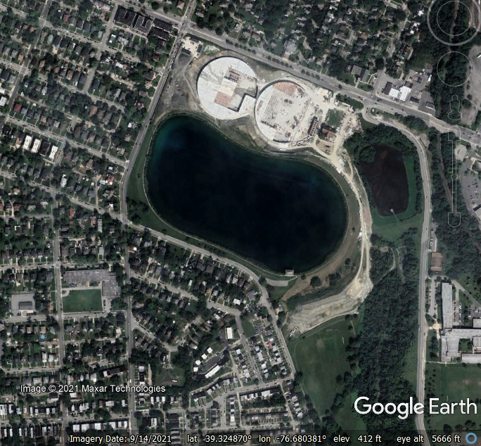
Incorporating Environmental Justice into Dam Safety Programs (2)
Lake Ashburton Example
High hazard, earthen embankment
Baltimore City finished water supply
Constructed 1910
40 ft tall, 650 acre-ft at normal pool
Construction of closed tanks in 2018 created significant concerns
Loss of public park space
Removal of 200+ mature trees
Possible contaminated soil

Slide 16
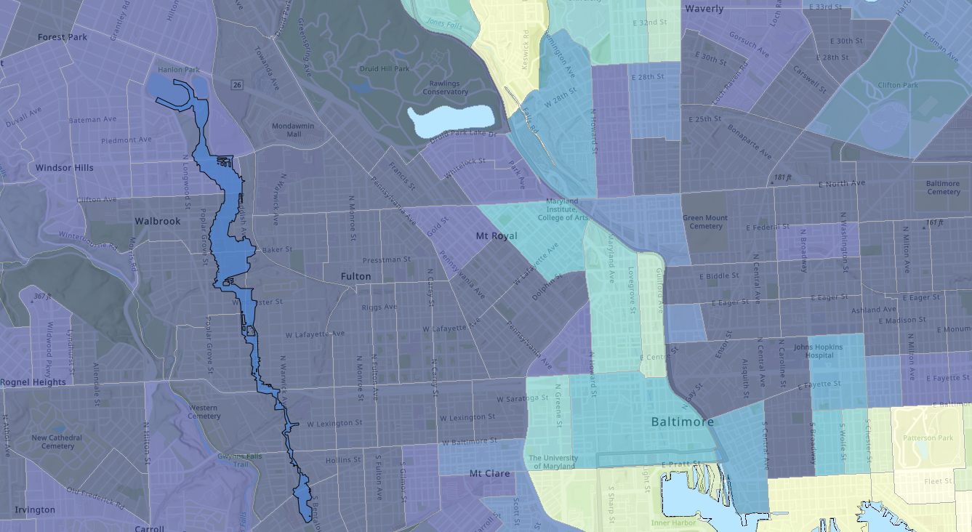
Best practices for presentation design
Notes:
So – beyond the obvious, why is this a big deal?
Explain this is the failure area overlain on the as-yet released MDE EJ mapping tool. Darker colors represent historically more vulnerable populations – very much the result of local, state and federal planning, infrastructure and other policies. In fact, the disparity in Baltimore is a well known and studied issue, and the term the “black butterfly” was coined by local professor Lawrence Brown. The black butterfly is the counterpart to the “white L”.

Slide 17
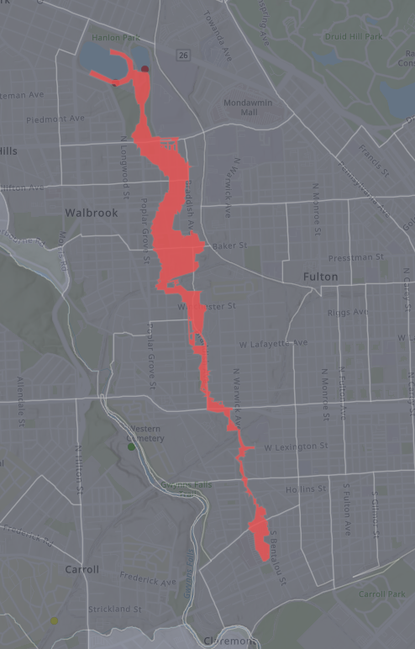
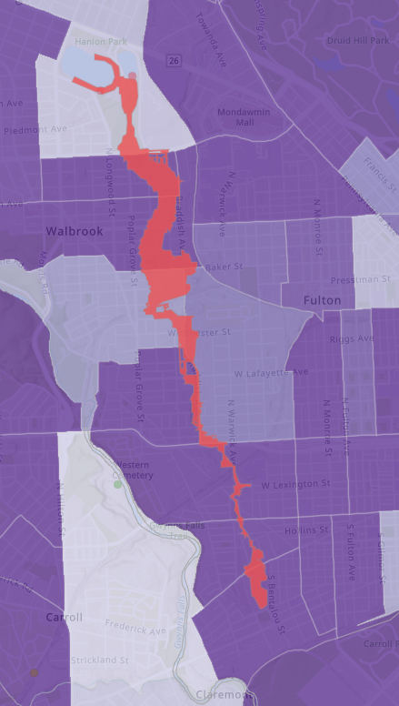
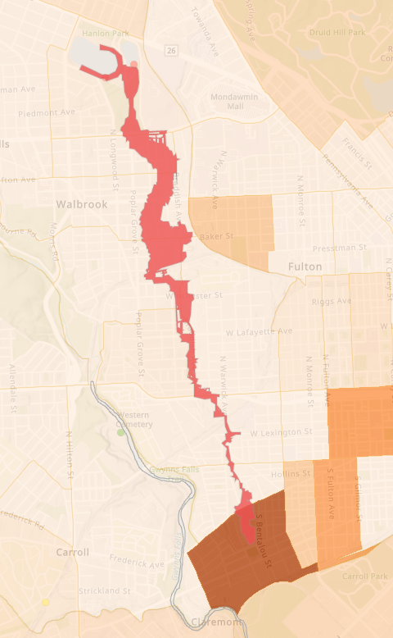
Best practices for presentation design (2)
Notes:
Left – households with no vehicle access – 25 to 70% of households have no vehicle access. While a lot of literature is out there relating to evacuation and demographic factors that help or hinder evacuation, I have not come across anything that discusses lack of vehicle access. But from a common sense standpoint – evacuations will certainly be hindered. So do we need to coordinate with the local transit agencies to help facilitate moving people (if we have time)
Middle – disabilities – generally 40 to 70% of population over 65 have disabilities – which likely complicates evacuation, sheltering needs and other social services during an emergency – so how can we improve planning to account for this?
Right – households with linguistic isolation and/or limited English language proficiency – in general the issues are less here – most areas report less than 1% of population. But in one area, there is over 22% of the population with limited English proficiency. So – when it comes to messaging during emergencies, ensuring that public notice and public hearings are translated and they are distributed in publications/forums that are used by the community.

Slide 18
Identifying Critical Infrastructure to Improve EAPs
Goal to create a simple appendix to highlight critical infrastructure in or near inundation boundaries
Highlights these locations for better planning and response
Could inform planning for new infrastructure
Police, Fire, Hospitals, Landfills, Wastewater, Correctional facilities, Government buildings
FEMA Resilience Analysis and Planning Tool (RAPT)
Offers many layers and ability to pull a list from within an emergency boundary
Users can add a shapefile but cannot run tool based on those boundaries
ESRI Hazard Vulnerability Assessment Solution
May be an option once planned updates are rolled out in late 2022

Slide 19
Contact Slide Option 2
Contact Information
John Roche, P.E.
Chief, Dam Safety Permits Division
Stormwater, Dam Safety, and Flood Management Program
John.Roche@Maryland.gov

