Slide 1
RCEM Overview Part II: Practice
National Dam Safety Program Technical Seminar | February 24, 2022

Slide 2
Outline – Table 1 of the methodology document
Task | Description
1 | Select dam failure scenarios (e.g. sunny day, flood, etc.) that correspond to dam potential failure modes
2 | Select appropriate time categories (e.g. day/night, seasonal, weekend/weekday, etc.)
3 | Review and evaluate flood inundation mapping and define appropriate reaches or areas flooded (by river reach, town, etc.) for each dam failure scenario
4 | Estimate flood severity range (i.e. DV range) for the flooded areas. Some towns or river reaches may have PAR in multiple DV ranges, depending on the flood characteristics (see Task 4 discussion below). Justify the estimates.
5 | Estimate the population at risk (PAR) within each reach for each failure scenario, DV range and time category. Justify the estimates and provide any references resources.
6 | Estimate when dam failure warnings would be initiated (depends on many factors, suggest using range; see Task 6 discussion below). Estimate the warning time categories for flooded areas (e.g. little to no warning, adequate warning, or between the two; see Task 6 discussion below). Justify the estimates.
7 | For each PAR reach, use the graphical approach to estimate an appropriate fatality range based on DV values, warning time and other considerations. Justify the estimates.
8 | Estimate life loss range for each PAR reach by applying appropriate fatality rate range limits to each PAR. Sum the life loss estimates for each PAR to get the total estimated life loss range. Estimate life loss range for different dam failure scenarios as needed in Task 1.
9 | Evaluate how uncertainties and variability in various parameters affect overall uncertainties in life loss estimates. Perform sensitivity studies if needed. Identify areas of higher and lower uncertainty.
10 | Build the case for the life loss estimates by documenting all assumptions and references used. Discuss confidence in the life loss estimates.

Slide 3
RCEM process – alternative outline
Setup tasks
  (1) Select the most appropriate inundation scenarios; (3) Select inundation reaches; (4) Estimate flood severity; (5) Estimate PAR; (6) Select warning partition; (2) Select PAR temporal partition; (7) Select fatality rates
Calculation tasks
  Set up the spreadsheet
  Determine how to capture the uncertainty (determine what to average out and what to track separately)
Interpretation tasks
  (9) Identify key sources of uncertainty; (10) Build the case for the life loss estimates – why are the best estimate and/or range considered reasonable
  Use the information to support a dam safety decision

Slide 4
RCEM process – this presentation
Setup tasks
  (1) Select the most appropriate inundation scenarios; (3) Select inundation reaches; (4) Estimate flood severity; (5) Estimate PAR; (6) Select warning partition; (2) Select PAR temporal partition; (7) Select fatality rates
Calculation tasks
  Set up the spreadsheet
  Determine how to capture the uncertainty (determine what to average out and what to track separately)
Interpretation tasks
  (9) Identify key sources of uncertainty; (10) Build the case for the life loss estimates – why are the best estimate and/or range considered reasonable?
  Use the information to support a dam safety decision

Slide 5
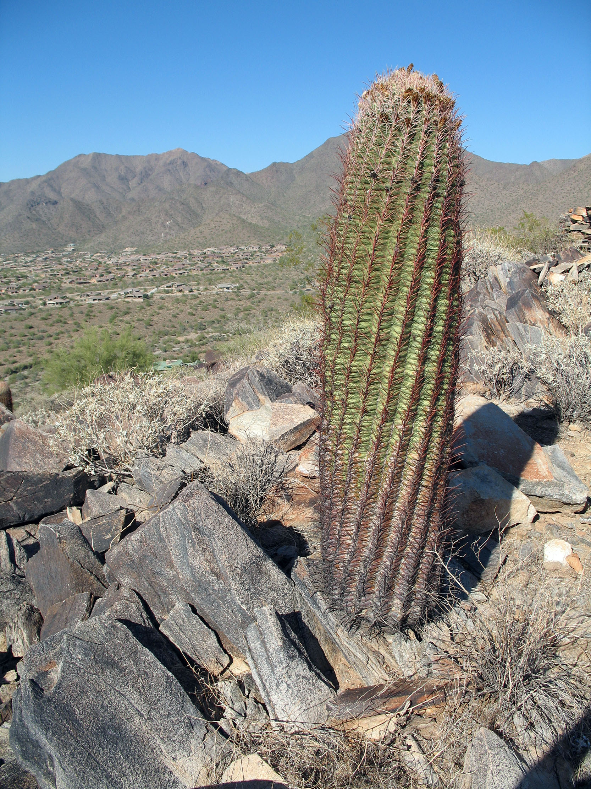
Example problem overview
Cactus Dam is a 300-foot high embankment structure
located in the southwestern United States.
The dam was constructed in 1970 and has had a
history of seepage through the right abutment.
After the last periodic review, a recommendation was made
to collect additional seepage data and re-evaluate the risk of
internal erosion along the right abutment contact under normal
operating conditions.
As part of the risk analysis, the life loss estimates associated
with the right abutment internal erosion potential failure mode
will need to be updated.

Slide 6
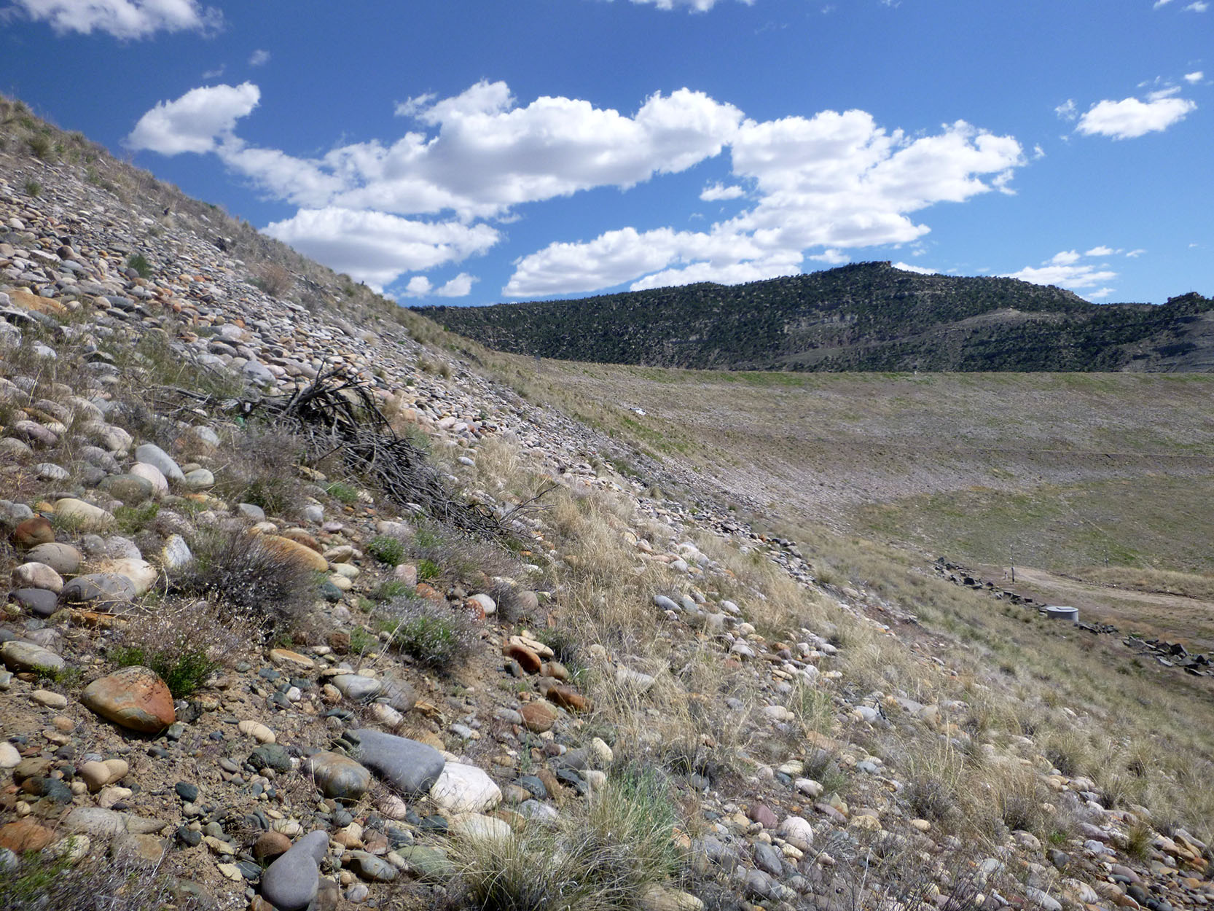
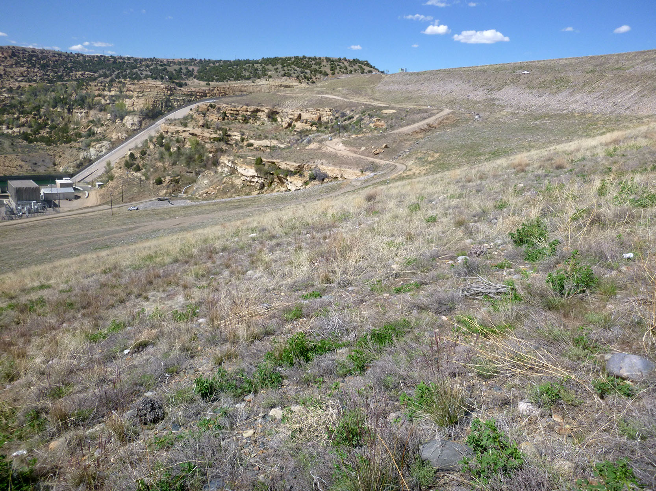
Description of dam
Zoned earthfill embankment with a wide clayey core and
filter compatible shell zones.
Right abutment consists of a series of sandstone terraces
that gradually level off.
Lack of foundation treatment, especially near the terrace forming cliffs (where there are stress relief joints present), represents a key deviation from modern design practice.
Height of the right abutment embankment section varies
from 100-200 feet.
Normal pool is about 60 feet below flood pool.

Slide 7
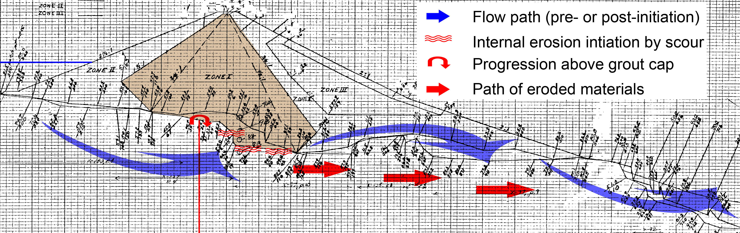
Controlling potential failure mode (PFM)
Internal erosion by scour along the right abutment embankment to foundation contact (normal operating conditions)

Slide 8

Downstream area details
The dam is located within a State Park
The area immediately downstream of the
dam is very popular with anglers
There is a campground located about 5 miles downstream
There is a small town (Dam Town) located approximately
6 miles downstream, with several shops and hotels that
caters to anglers
The next approximately 20 miles are sparsely populated
A relatively large town (Southwest City) is located 30 miles d/s
Downstream of Southwest City, the river enters a very large reservoir that would safely contain the failure flood

Slide 9
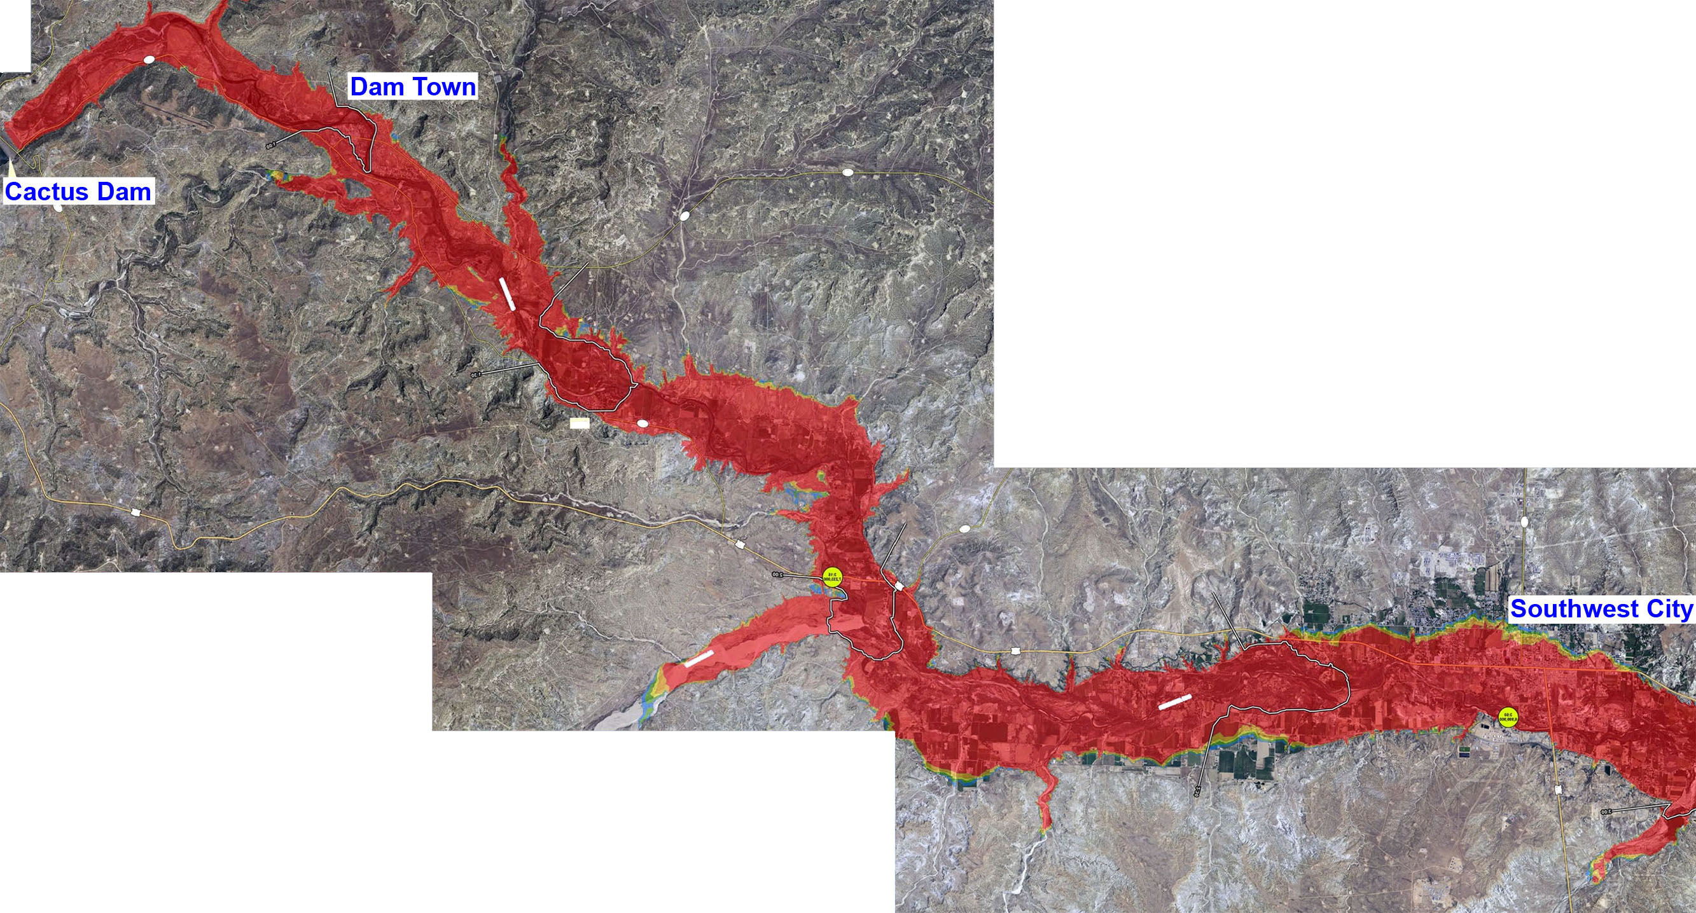
Inundation maps
Best available inundation mapping is for a hydrologic breach scenario
Static breach inundation maps exist but are much older and were based on 1D modeling
1 hr
4 hr
Leading edge flood wave travel time is just over 4 hours to Southwest City

Slide 10
Reaches defined in PAR Study
Authors of the PAR study used the 2D flood failure inundation maps rather than the older 1D static breach inundation maps
7mi
25 mi
Reach 1 – miles
zero to 7
Reach 2 – miles 7 to 25
Reach 3 – miles 25 to 33 (end)

Slide 11
Reach 1 PAR estimates by DV range
< 25 ft²/s: 50 Residential
25-50 ft²/s: 33 Residential
50-75 ft²/s: 25 Residential
75-160 ft²/s: 64 Residential
160-200 ft²/s: 32 Residential
200-500 ft²/s: 146 Residential, 42 Recreational (peak season/daytime)
500-700 ft²/s: 65 Residential, 2 Recreational (peak season/daytime)
700-1000 ft²/s: 147 Residential
> 1000 ft²/s: 400 Residential, 416 Recreational (peak season/daytime)

Slide 12
Reach 2 and Reach 3 PAR estimates by DV range
< 25 ft²/s: 5 Residential
25-50 ft²/s: 3 Residential
50-75 ft²/s: 5 Residential
75-160 ft²/s: 7 Residential
160-200 ft²/s: 2 Residential
200-500 ft²/s: 11 Residential
500-700 ft²/s: 3 Residential
700-1000 ft²/s: 11 Residential
> 1000 ft²/s: 21 Residential
< 25 ft²/s: 1111 Residential
25-50 ft²/s: 419 Residential
50-75 ft²/s: 360 Residential
75-160 ft²/s: 647 Residential
160-200 ft²/s: 312 Residential
200-500 ft²/s: 1790 Residential
500-700 ft²/s: 871 Residential
700-1000 ft²/s: 859 Residential
> 1000 ft²/s: 1008 Residential

Slide 13
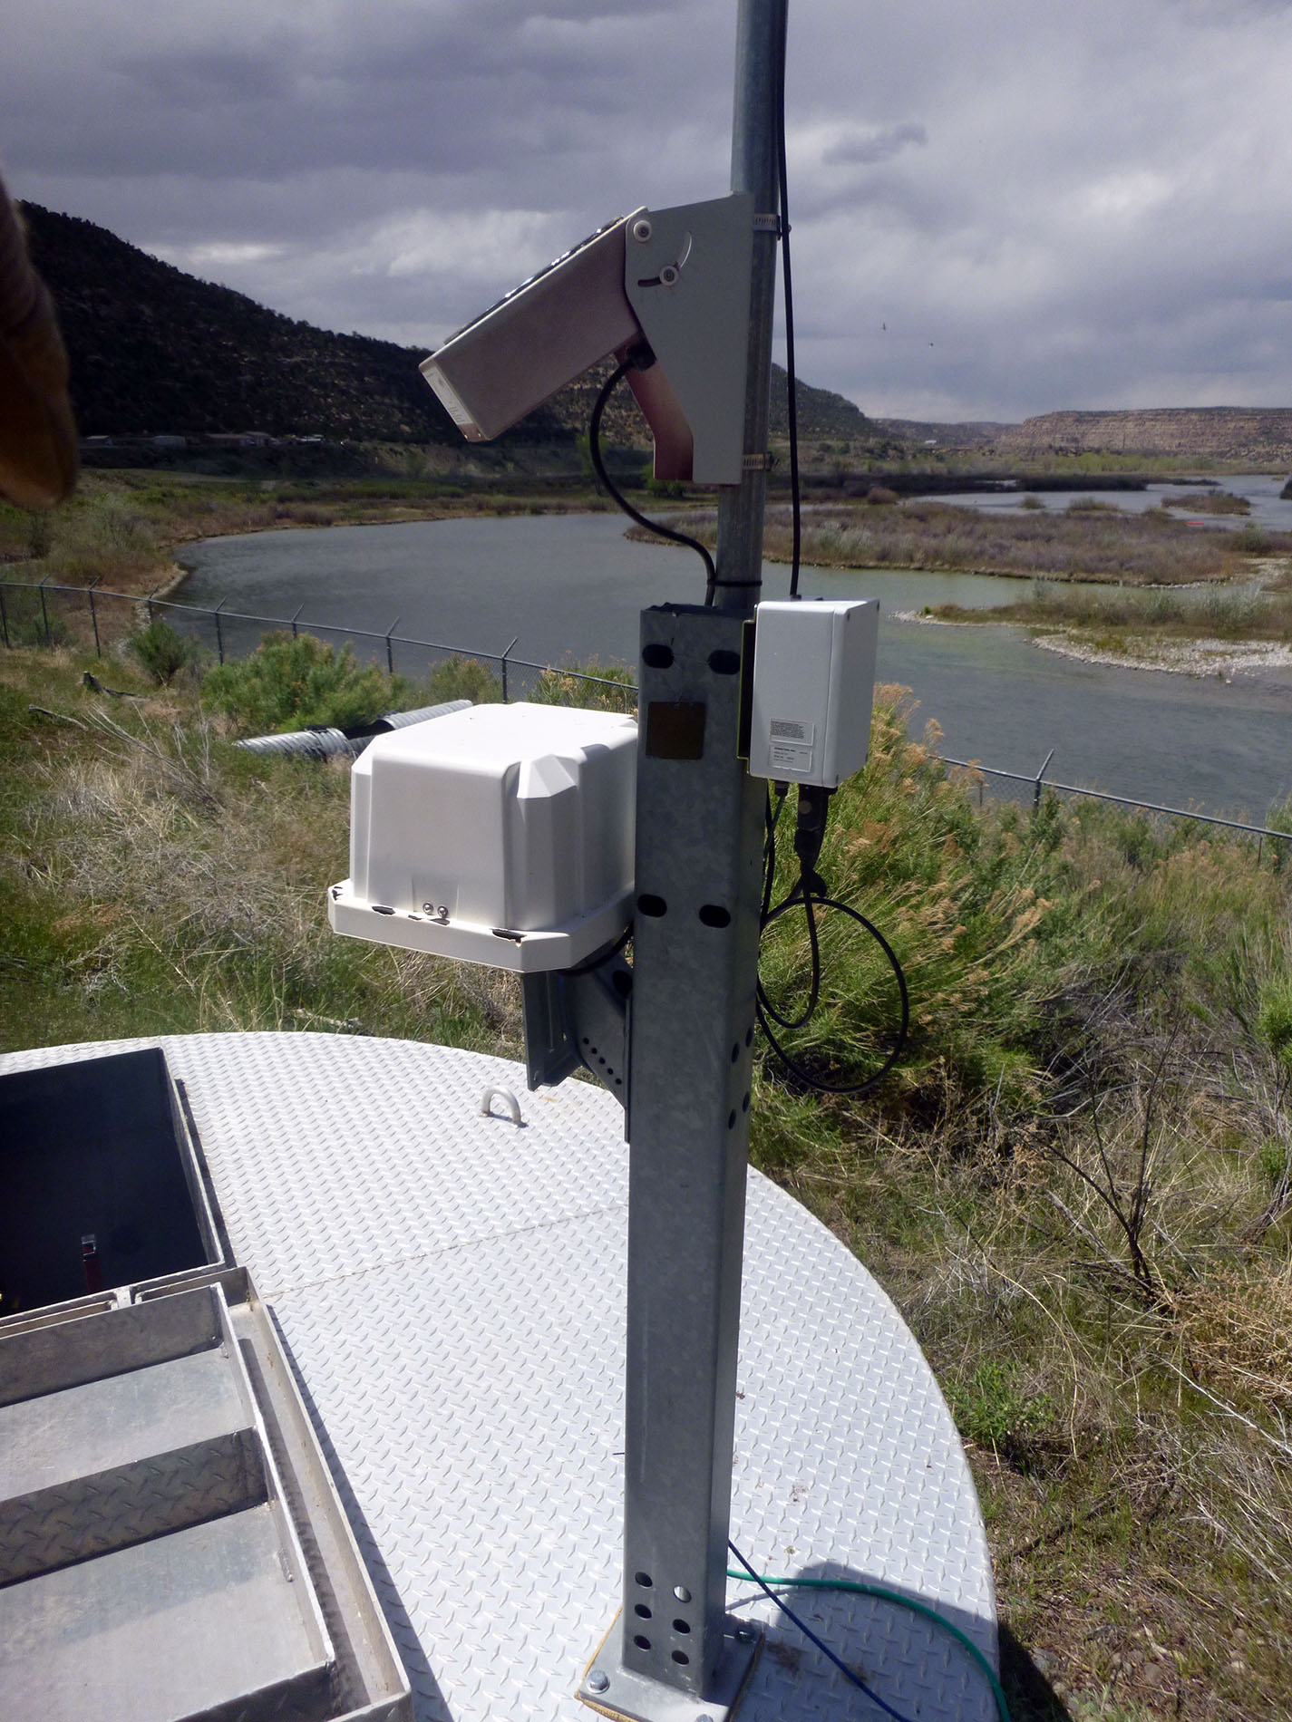
Staffing of dam and understanding of PFMs
The dam is staffed 4 x 10 hour days per week
The dam is extensively instrumented, and the instrumentation is well maintained
Key instrumentation is automated, with alarm conditions programmed and the notification system recently tested
Staff from the dam have participated in past risk analyses and emergency exercises, and they provided support during the last periodic review (when the recommendation to perform a risk analysis was issued)

Slide 14
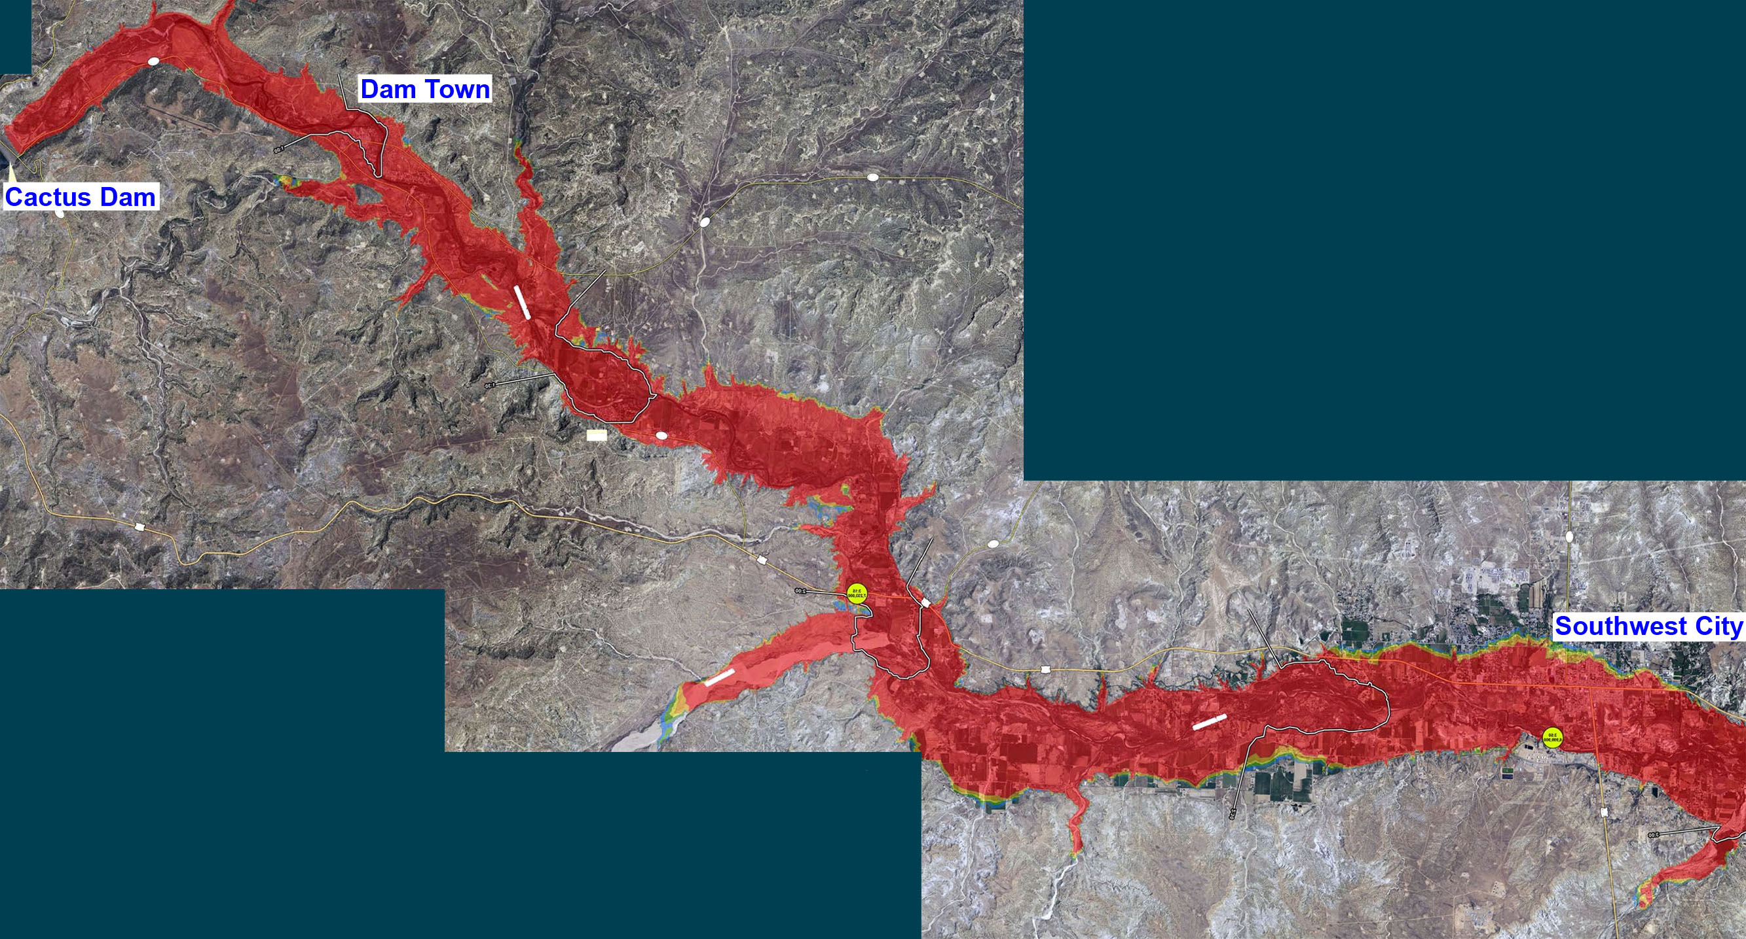
EAP and escape routes
Emergency action plan (EAP) was recently revised, and a tabletop
exercise performed with local authorities
Entire inundation area is in one county, so there is no jurisdictional overlap
Reach 1 – of the two roads exiting Dam Town in the direction away
from the dam, one rises above the inundation area fairly quickly
Reach 2 – all of the roads are eventually flooded,
but the sides of the valley are not excessively steep
Reach 3 – there is a highway leading away from
the river on both sides of the river (plus local roads)

Slide 15
Setup tasks

Slide 16
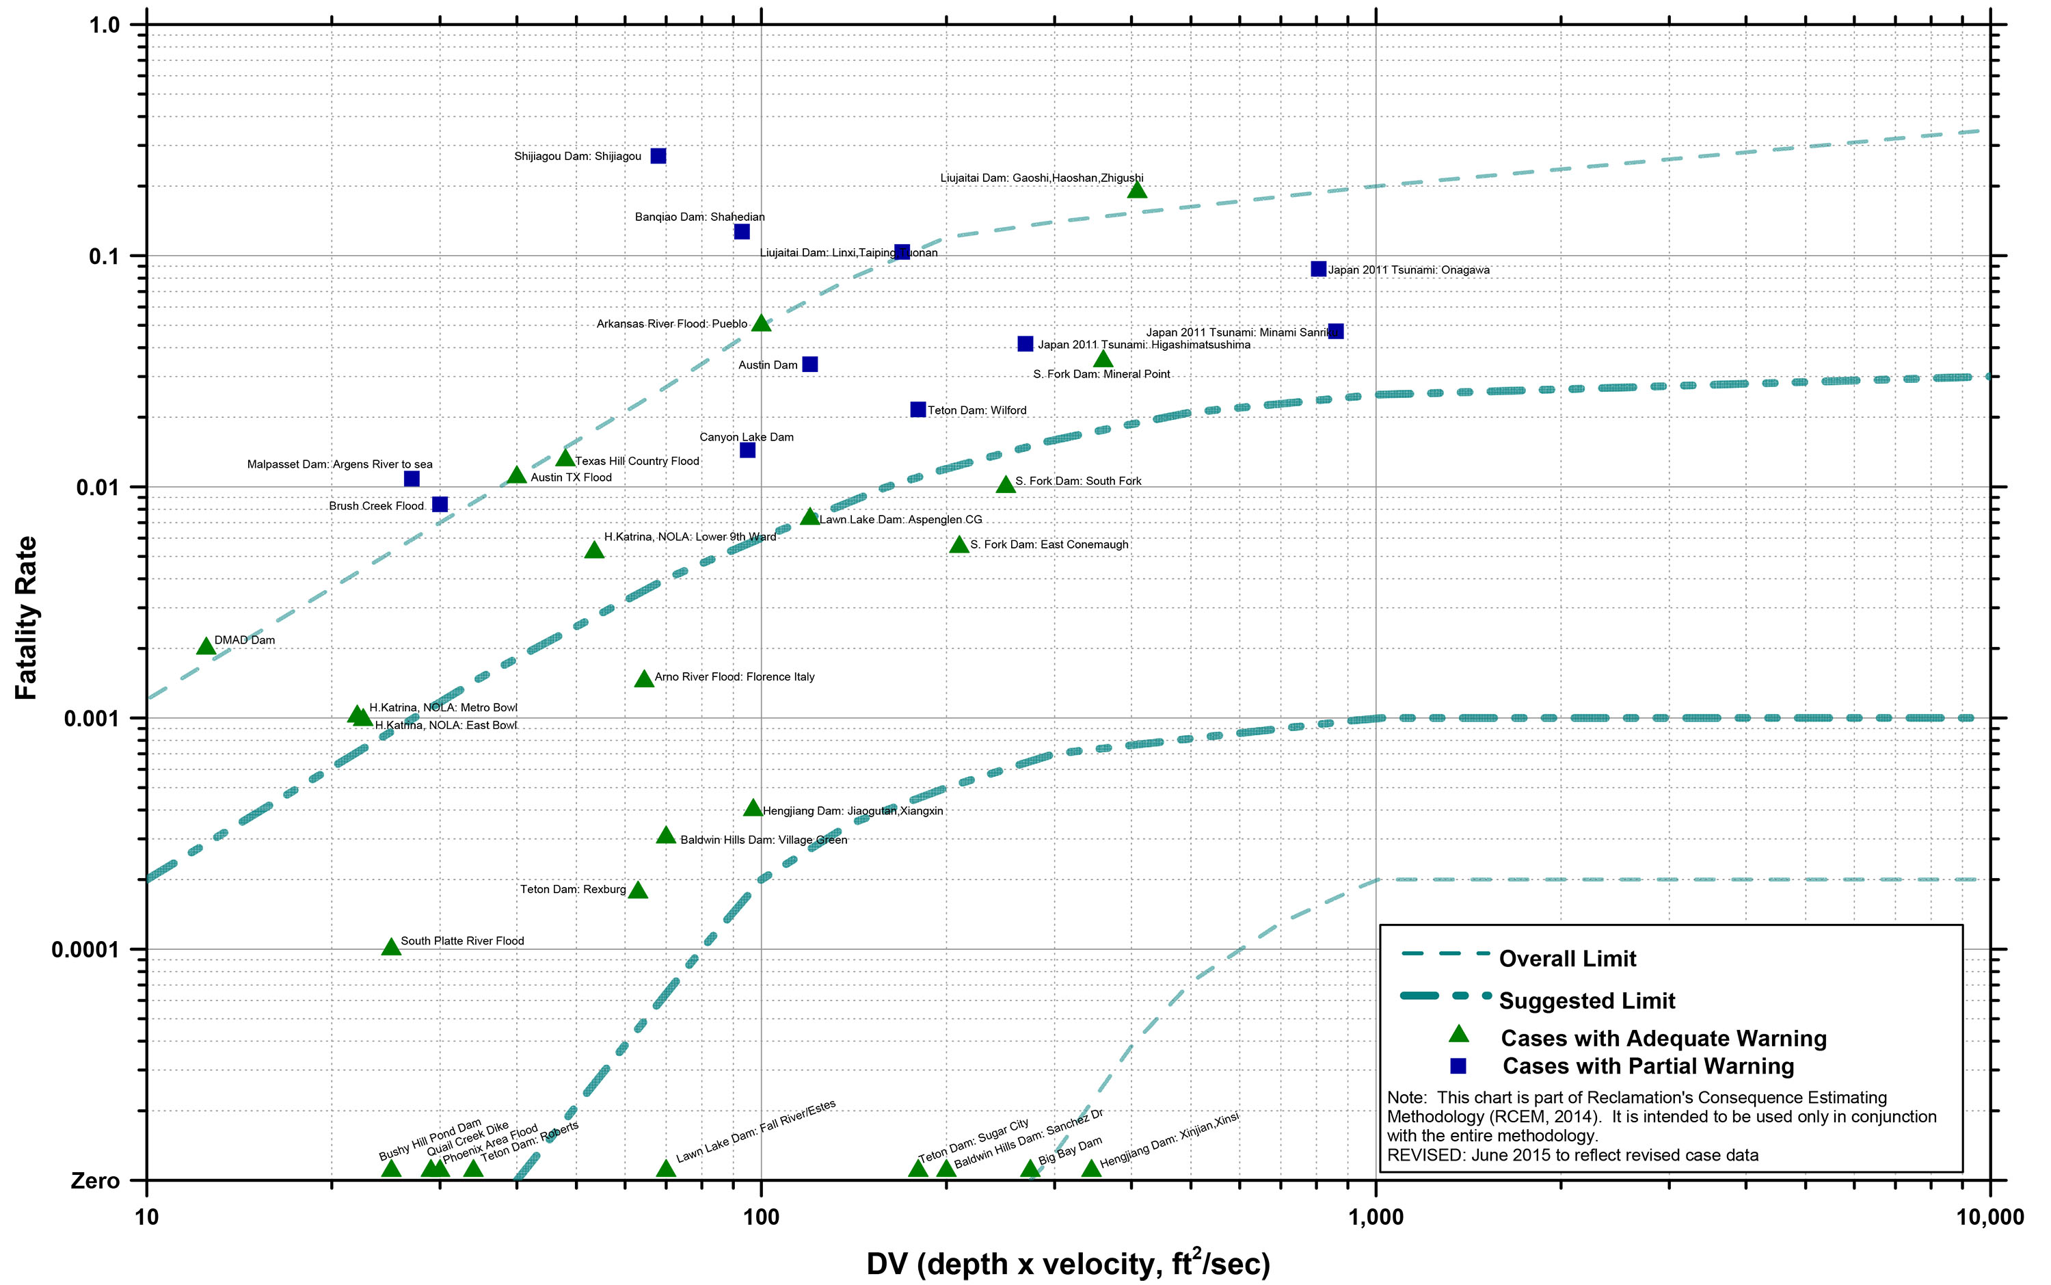
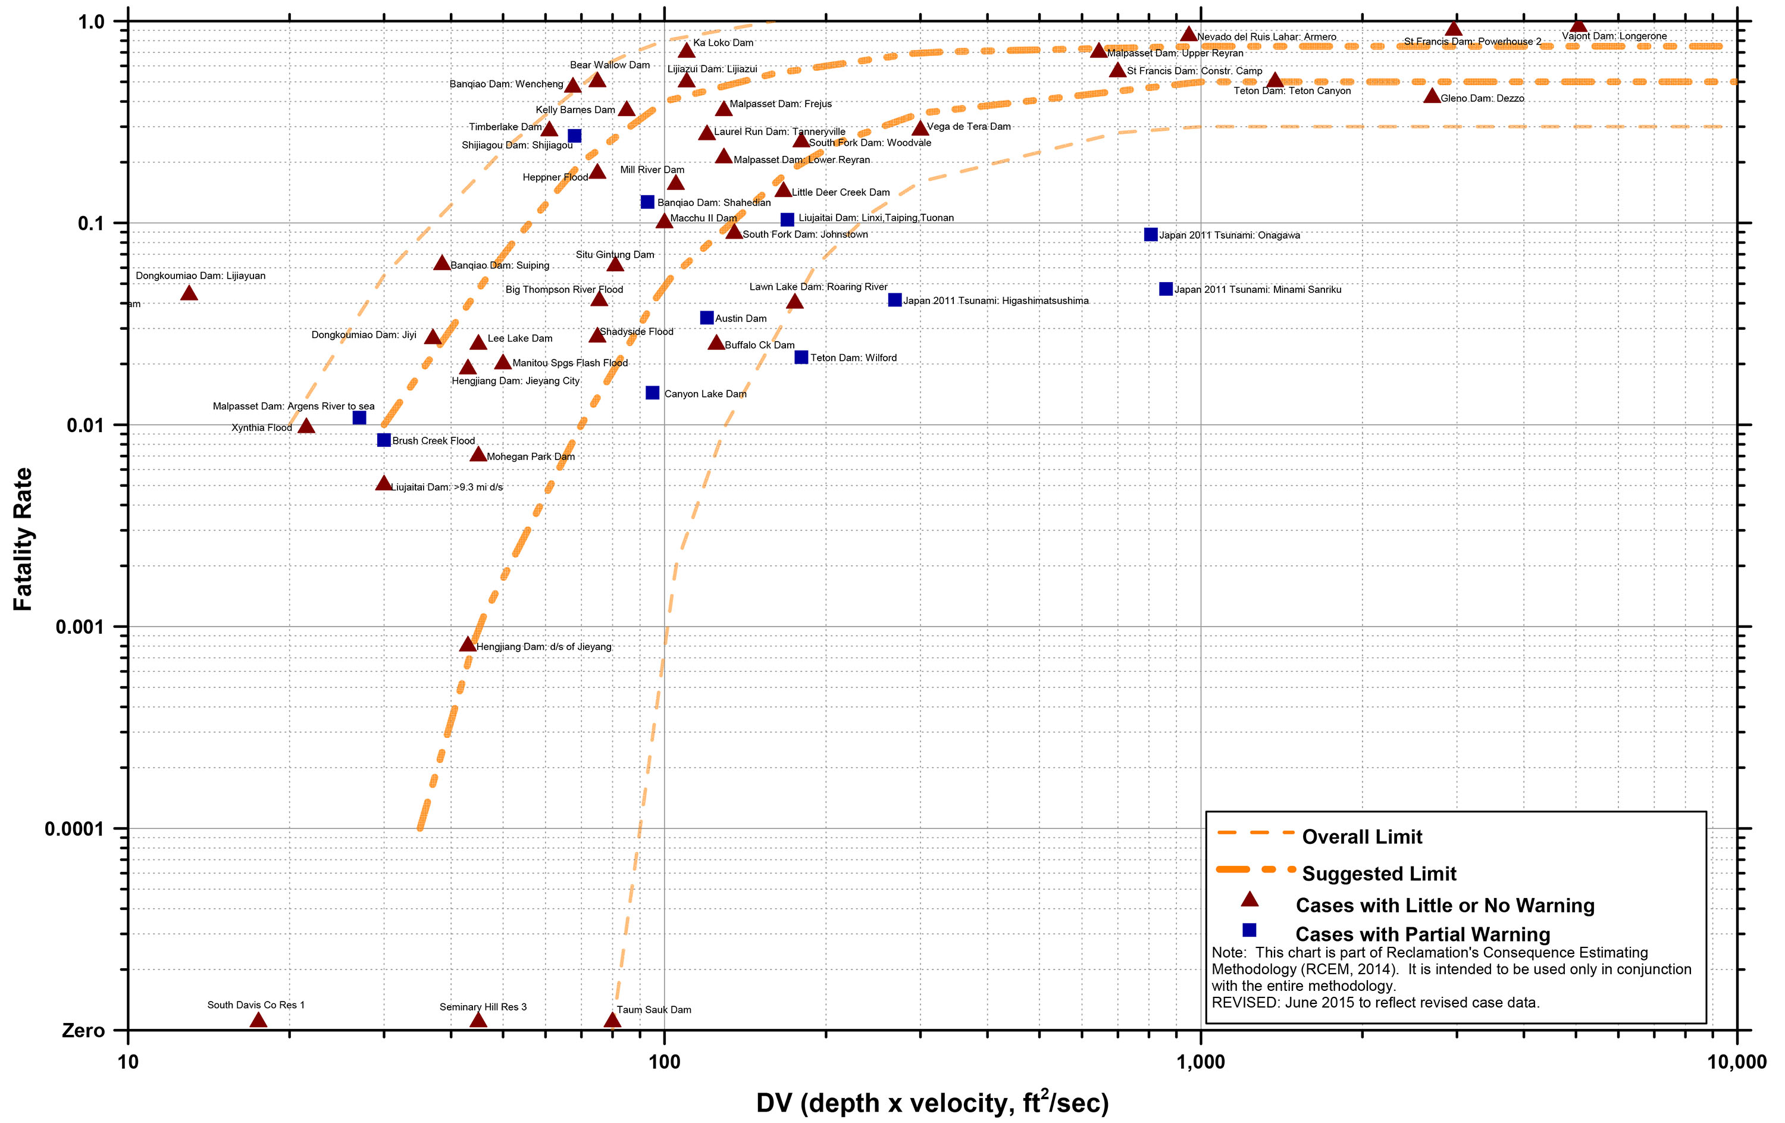
Select warning partition
Objective is to subdivide the PAR between the “Adequate” and “Little to no warning” categories. Each of these categories will ultimately point to one of two fatality rate charts
There is no pre-determined amount of warning lead time can be used to select between these categories (varies case by case)
Generally, if it is likely that warning will be in the form of direct observations of flooding, this would indicate “Little to no warning”
Common mistake is to equate the flood wave travel time with the warning time, when the actual warning time could be much longer
Key question is how likely a problem is to be detected (and local authorities to be alerted) well in advance of the breach

Slide 17
Select warning partition
Factors supporting the idea that for a static breach of Cactus Dam, warning will be issued well in advance of breach:
  The dam is attended 40 hours a week
  Key seepage measurement weirs are automated
  There are two public roads at the dam, one across the crest and one that crosses the downstream face
  Except in bad weather, there are dozens of fishermen present downstream of the dam, in a good position to notice any changes in water quality
  The embankment includes a wide plastic core, so a failure would be expected to be slowly developing
  The EAP has been recently exercised, and key evacuation routes are simple
  Camping is permitted at only one location within Reach 1

Slide 18
Select warning partition
Factors supporting the idea that there could be more limited warning time:
  Foundation-related static PFMs tend to develop more quickly than embankment-only PFMs. For example, the similarly sized Teton Dam failed within hours of the first observation of anomalous seepage (though Teton was composed of much more erodible silty materials)
  Scour type internal erosion PFMs tend to develop more quickly than backward erosion piping PFMs
  It could be difficult to warn dispersed daytime recreational users within Reach 1
  Evacuation efforts could be more disorganized if they occur at night

Slide 19
Select warning partition
Assume there is a 90 percent chance
that the problem will be detected
(and evacuation orders issued) well in
advance of breach
  For this scenario, 100% of the PAR gets
  adequate warning
Assume that there is a 10 percent chance
that the problem will either be detected shortly
before breach (more likely) or not detected until
after the dam begins to breach
  For this scenario, assume that some portion of the PAR in each reach will receive Adequate warning and some will receive Little to no warning (LTNW)

Slide 20
Discussion
Does the warning partition have to be selected this way?
  No. We could just as easily have selected the total percentages of those with Adequate and Little to no warning for each reach
  Using a “weighting of weightings” is just one way to do it
Could the use of some weighting other than 90% for the PAR subset receiving 100% Adequate warning be justified?
  Yes. Based on the available information, selecting a 95%, 85%, or even an 80% weighting could also have been reasonable
Could any alternative warning partition be justified?
  Based on the available information, it would be difficult to justify the selection of a weighting much lower than 80% for the subset of the PAR that receives 100% adequate warning (especially in the reach furthest downstream)

Slide 21
Select warning partition – 10% scenario
Reach 1 Residential PAR: 70% Adequate, 30% LTNW
  General adverse factors as listed on Slide 19, but simple evacuation routes
Reach 1 Recreational PAR: 50% Adequate, 50% LTNW
  Harder to warn dispersed recreational users, but most are near campground
Reach 2 Residential PAR: 60% Adequate, 40% LTNW
  Sparsely populated, harder to warn with widely spaced individual residences
Reach 3 Residential PAR: 90% Adequate, 10% LTNW
  PAR well defined; portions of town that could become inundated (for the much larger flood failure scenario) are known to emergency responders
  Longer travel times; multiple and obvious evacuation routes
  Easier to warn; Reverse 911 + interaction between neighbors

Slide 22
Select fatality rate ranges
For each DV range and warning category, need to select a representative range of fatality rates
Simplest way to do this is to use the “suggested limits” in
each warning category chart
If there are any case history data points plotting near the DV range of interest, one approach would be to look into them,
and adjust the fatality rates as appropriate
However, it is often more practical to consider the case
histories at a later stage of the process (when building the
case for the risk estimates)

Slide 23
Select fatality rates – Adequate warning
We’ll use the lower
suggested curve for the
lower DV bounds (purple),
and the upper curve for the
upper DV bounds (orange)
< 25 ft²/s: 0 to 0.001
25-50 ft²/s: 0 to 0.002
50-75 ft²/s: 0.00002
to 0.004
75-160 ft²/s: 0.00007
to 0.01

Slide 24
Select fatality rates – Adequate warning
160-200 ft²/s: 0.0004
to 0.01
200-500 ft²/s: 0.0005
to 0.02
500-700 ft²/s: 0.0008
to 0.02
700-1000 ft²/s: 0.0009
to 0.03
> 1000 ft²/s: 0.001
to 0.03

Slide 25
Select fatality rates – Little to no warning
Use slightly wider
ranges to better
capture the potential
range of day/night
variation
< 25 ft²/s: 0 to 0.01
25-50 ft²/s: 0 to 0.1
50-75 ft²/s: 0.001
to 0.3
75-160 ft²/s: 0.008
to 0.7

Slide 26
Select fatality rates – Little to no warning
160-200 ft²/s: 0.1
to 0.7
200-500 ft²/s: 0.2
to 0.8
500-700 ft²/s: 0.3
to 0.8
700-1000 ft²/s: 0.4
to 0.8
> 1000 ft²/s: 0.4
to 0.8

Slide 27
Calculation tasks

Slide 28
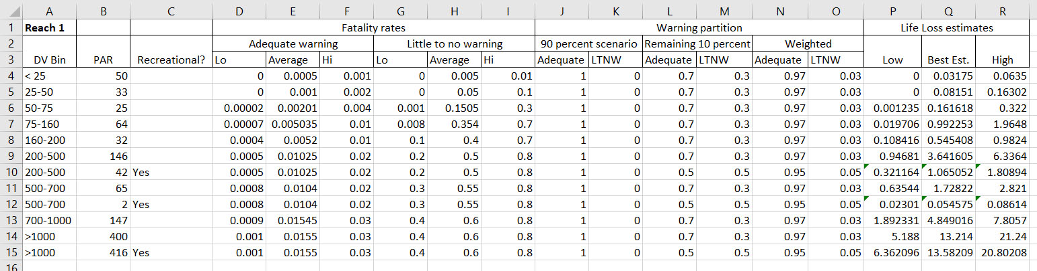
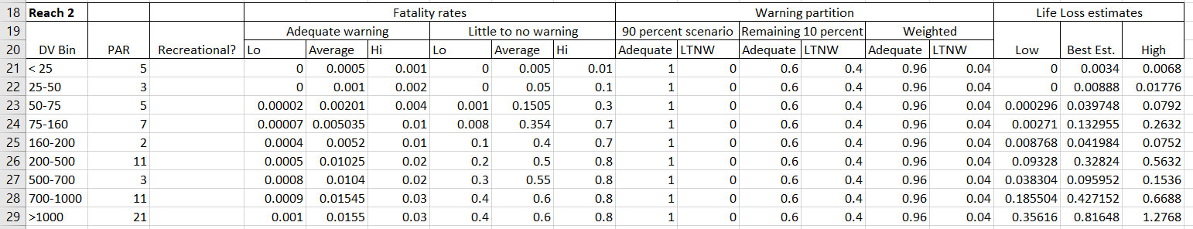
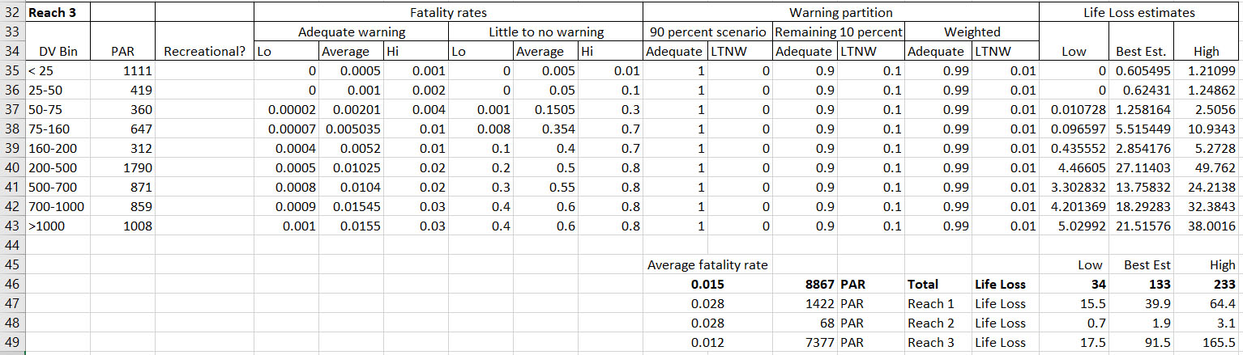
Considerations
Before the calculation spreadsheet can be set up, some decisions need to be made about how the best estimate and uncertainty bounds will be defined and tracked
The best estimate is often thought of as representing the “average of averages”, but caution must be used when calculating the average values of some RCEM inputs
Fatality rate ranges that span multiple orders of magnitude will have an arithmetic mean that is dominated by the upper bound. This could inadvertently skew the best estimate upward

Slide 29
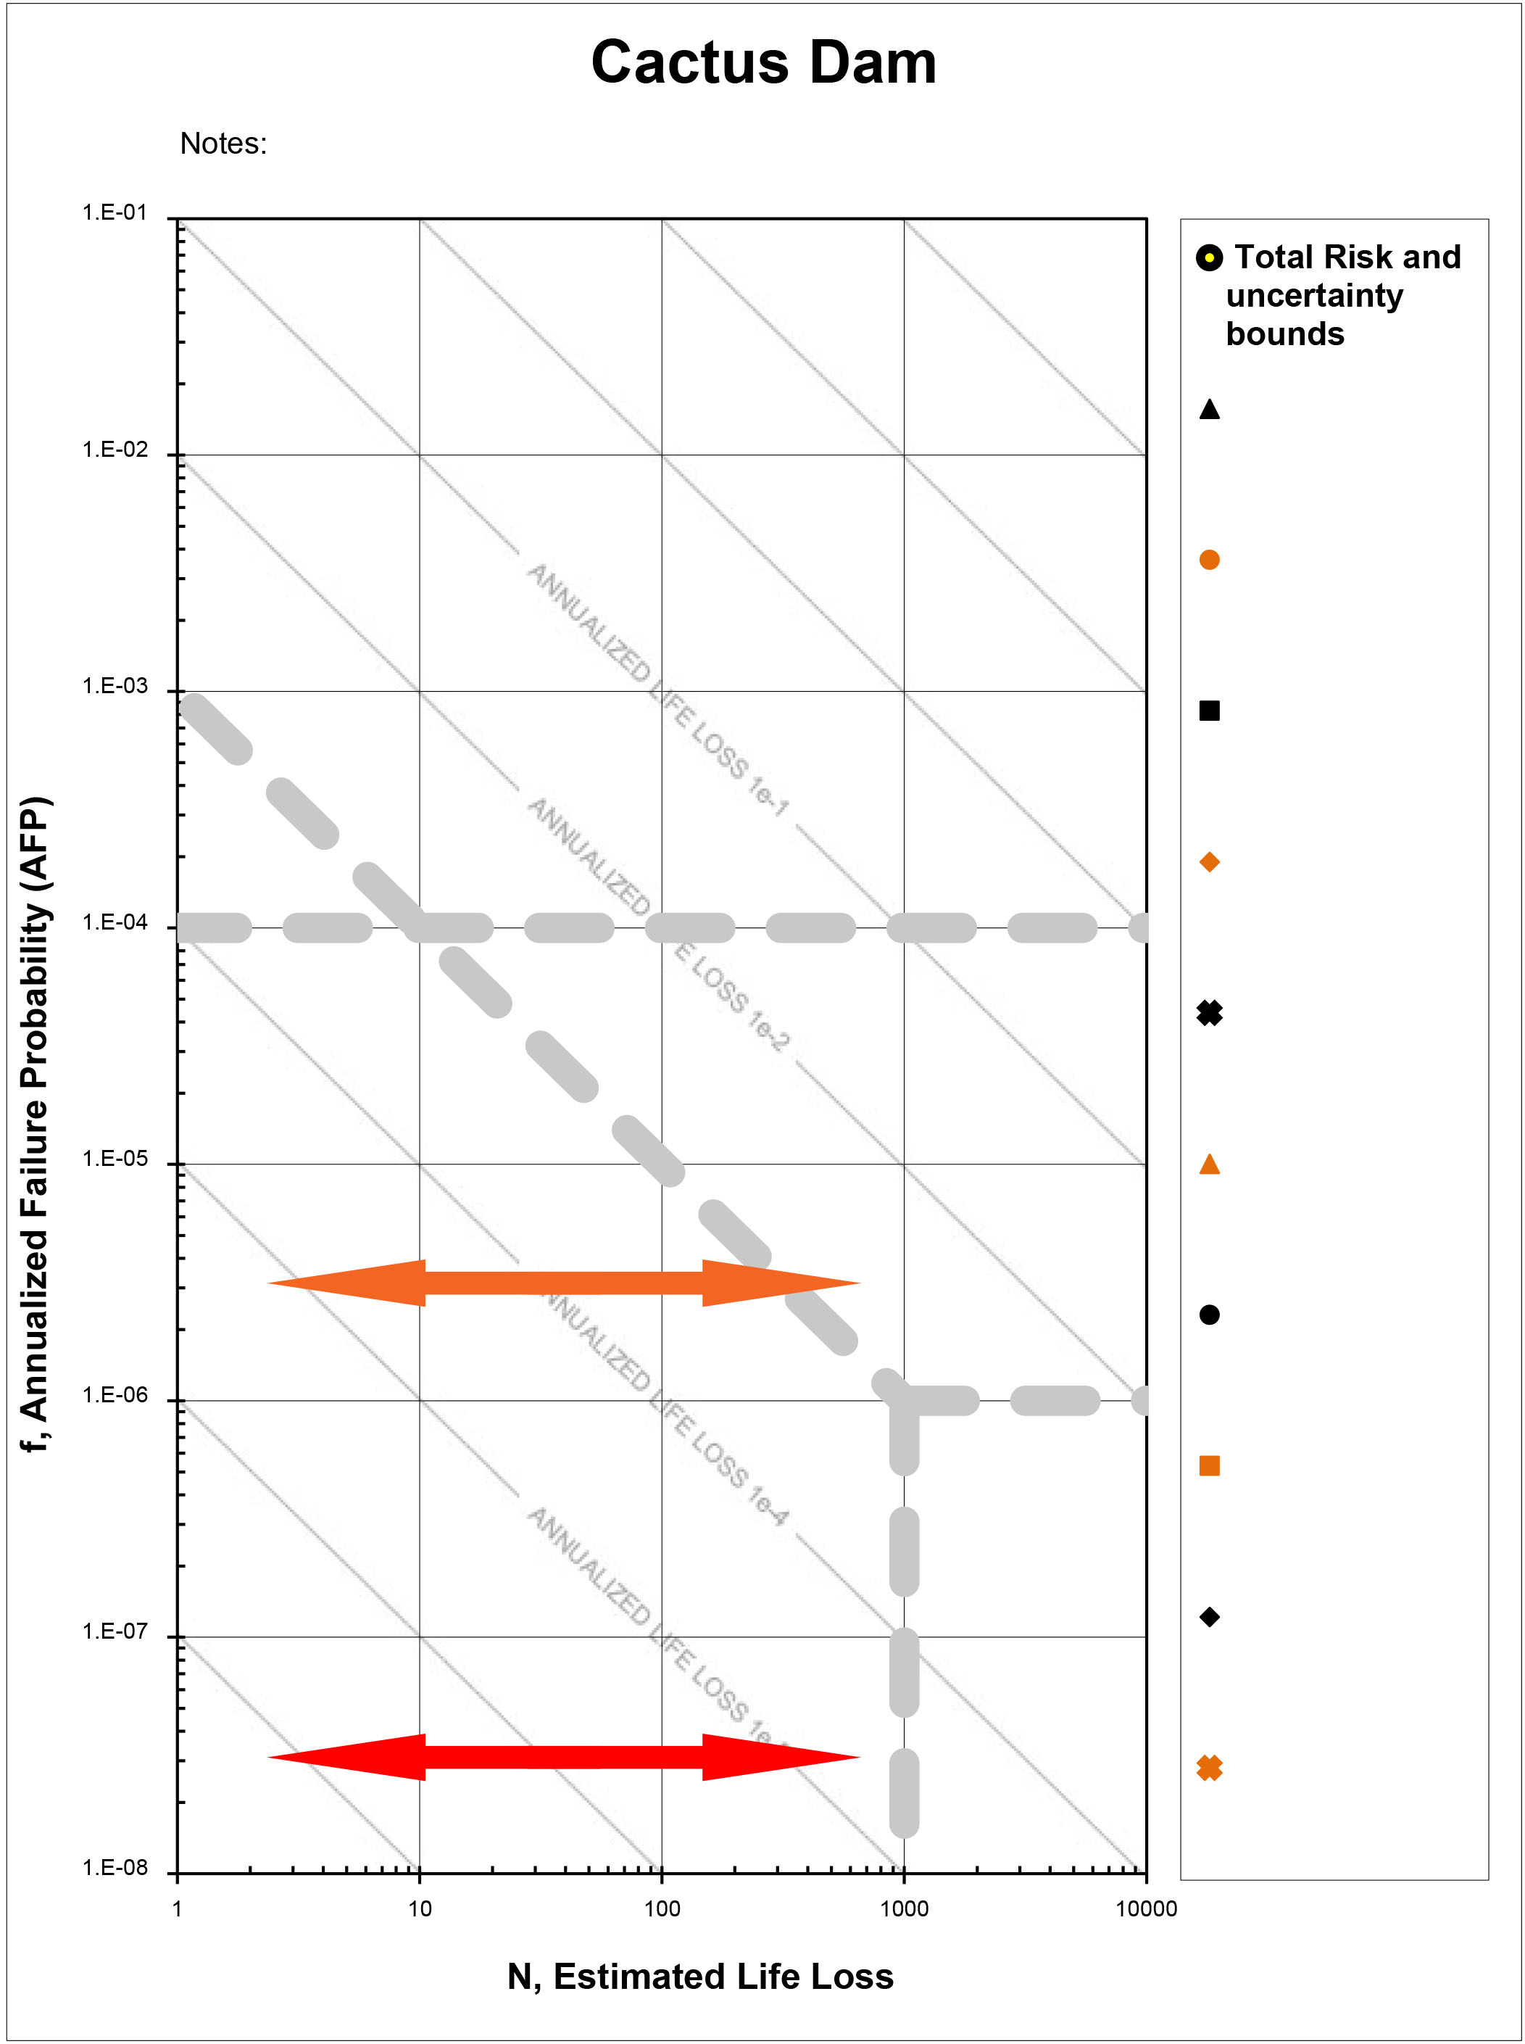
Uncertainty bounds
The upper and lower bound life loss estimates can be defined in a variety of ways. Replicating the “best-estimate” calculations using the upper and lower bound input estimates is one way to do it.
How will this information be used?
  To help convince the client of the need for updated inundation mapping or and/or an updated PAR study?
  To help convey the idea that future changes in the life loss estimates may not affect a modification decision?
  To remind the client that these are not exact numbers
  To help support a legal defense in the event that the dam fails and a different number of people are killed

Slide 30
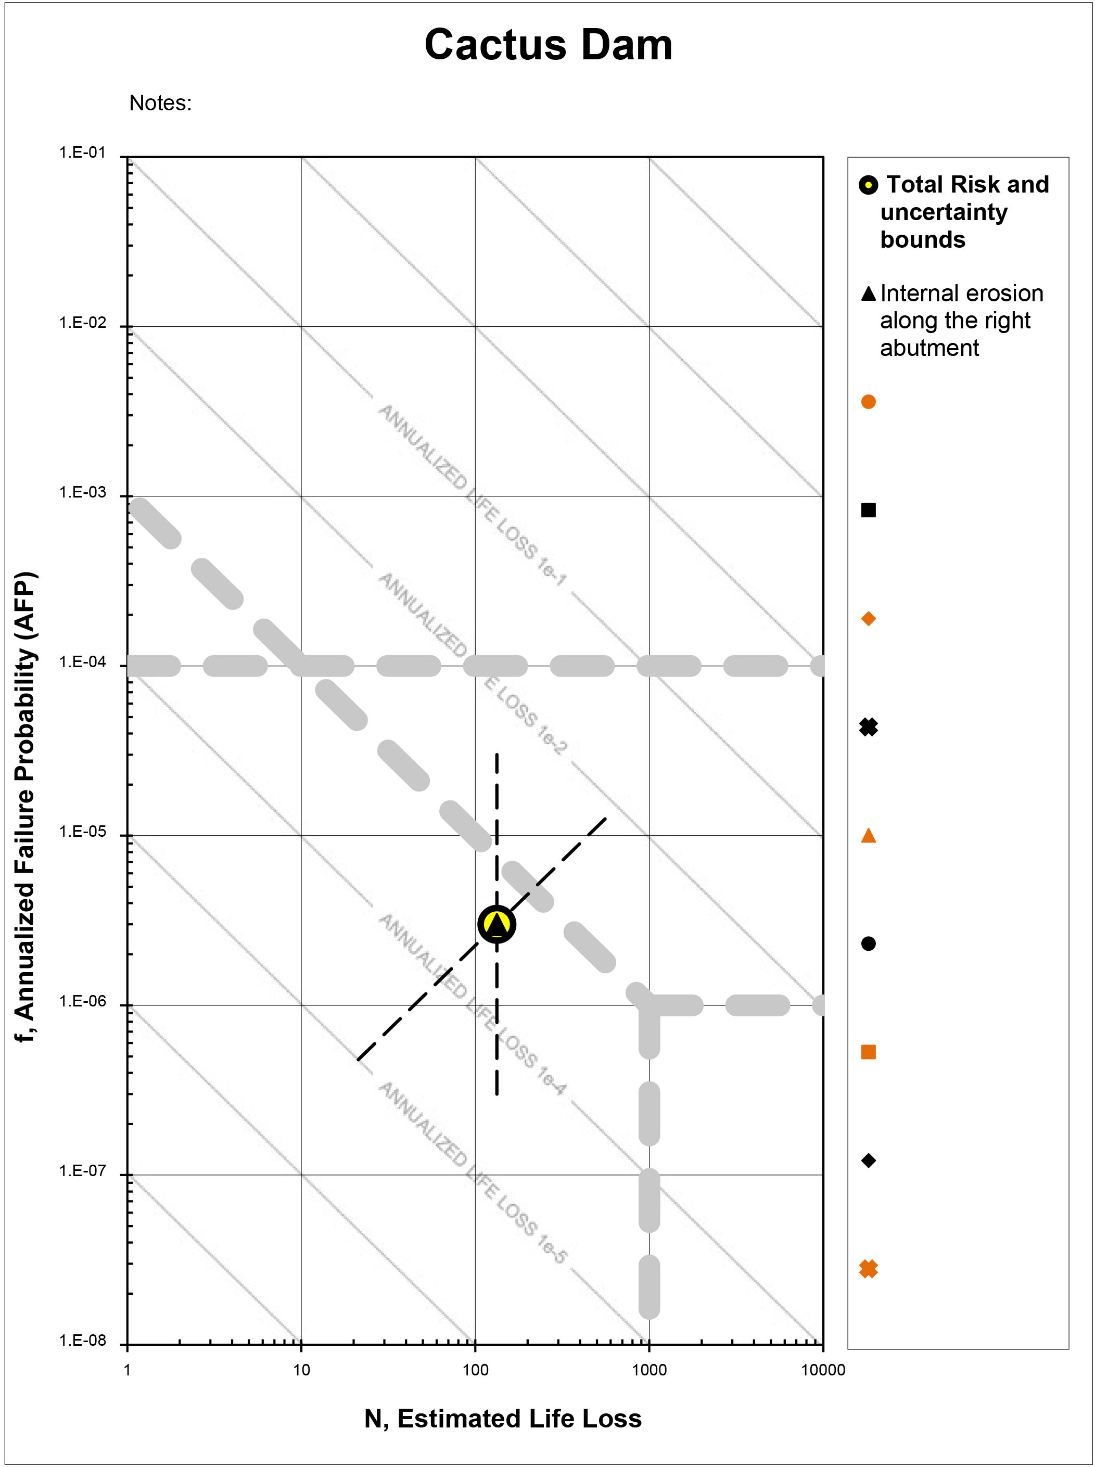
Uncertainty bounds
Based on the estimated probability (AFP) of the risk-controlling PFM and the size of the PAR, the total risk estimate is expected to plot close to guidelines.
It is the preliminary conclusion of the team that additional data will be needed (including data completely unrelated to the life loss estimates) before a decision can be made to modify the dam or not.
As such, the team should ensure that the depiction of uncertainty in the risk portrayal chart is consistent with any recommendations they intend to make.

Slide 31
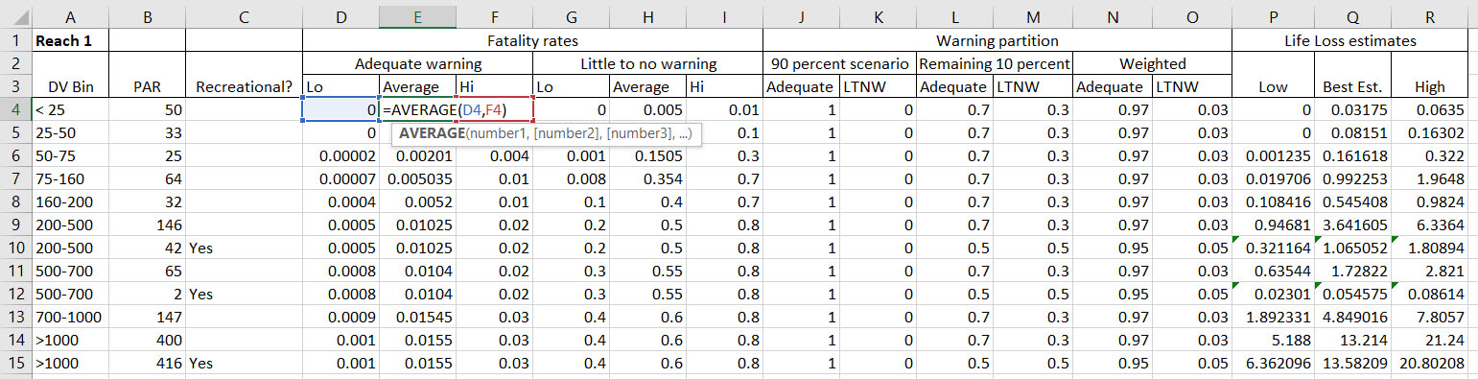
Example spreadsheet calculations
Best estimate (“Average”) fatality rates are being calculated as the arithmetic means of the upper and lower bound fatality rates
Team understands and accepts that the upper bound will dominate the arithmetic mean (but that may not always be the intent when the fatality rate range is selected)

Slide 32
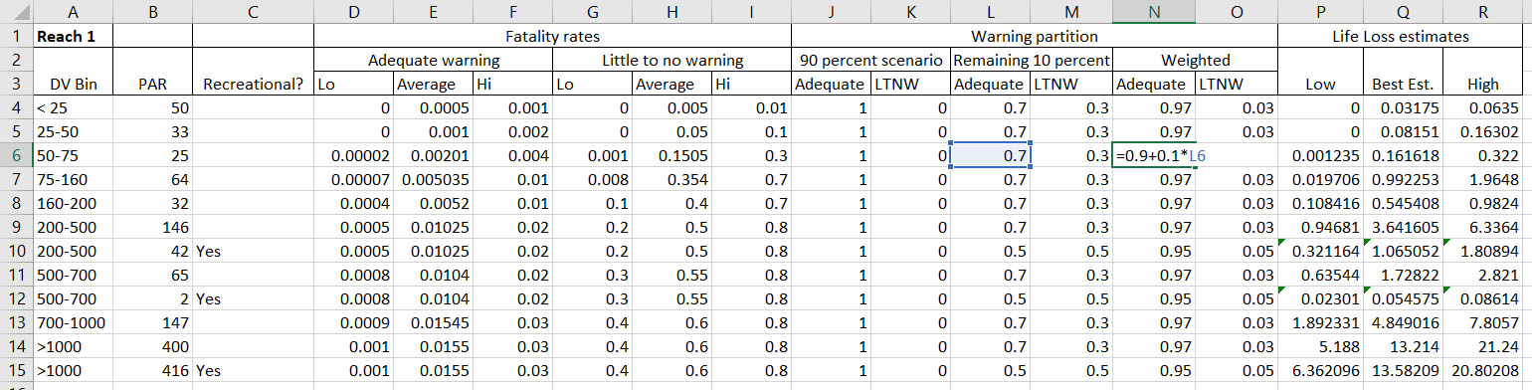
Example spreadsheet calculations
Average percentage of adequate warning is calculated as 0.9 plus 0.1 times the percentage of those of the remaining 10 percent considered likely to get adequate warning (varies by reach and PAR type)

Slide 33
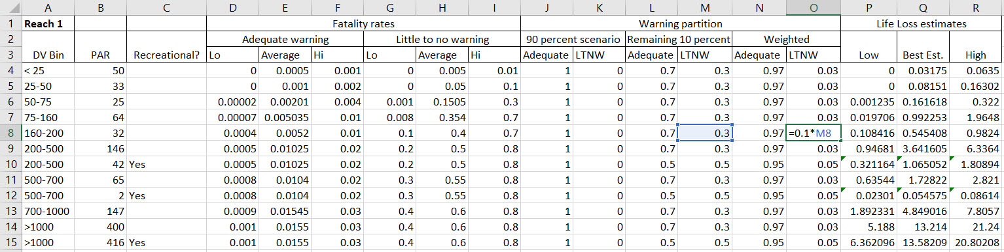
Example spreadsheet calculations
Average percentage of little to no warning is equal to 0.1 times the percentage of those of the remaining 10 percent considered likely to get little to no warning (varies by reach and PAR type)

Slide 34
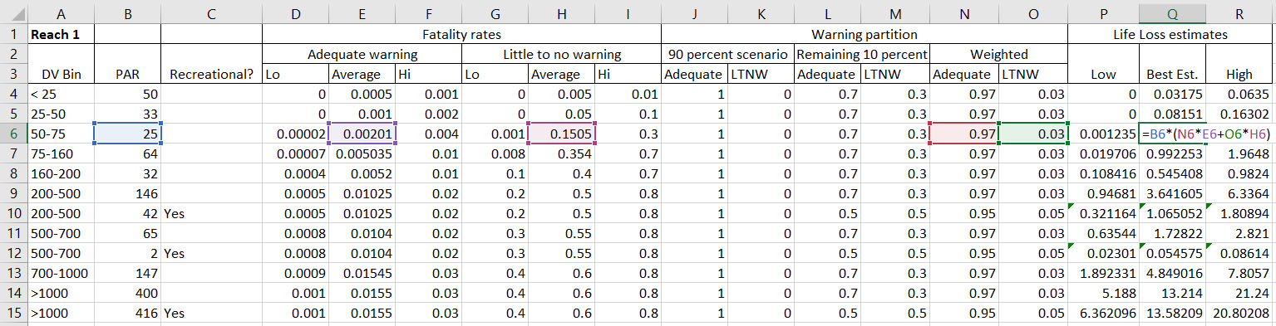
Example spreadsheet calculations
Best estimate life loss is taken as the product of the subset PAR and the weighted average of the average Adequate warning and Little to no warning fatality rates

Slide 35
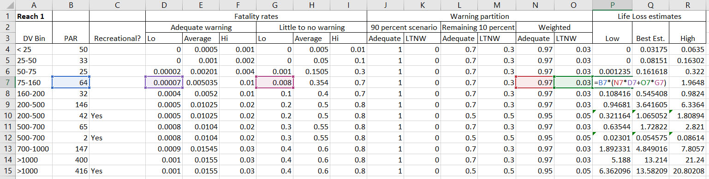
Example spreadsheet calculations
For the upper and lower bound life loss estimates, the calculation is repeated, but with the upper and lower bound fatality rates, respectively, used

Slide 36
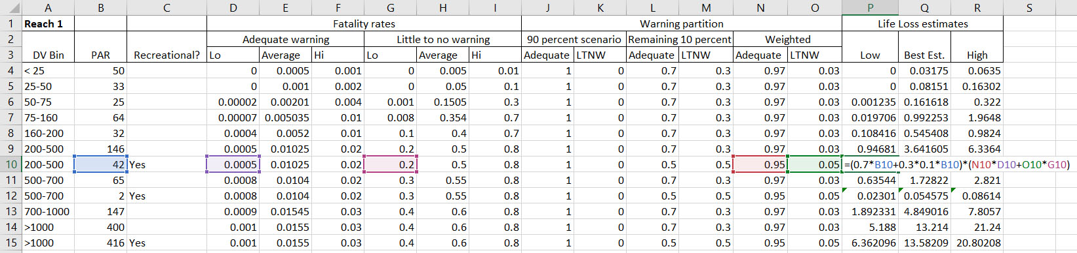
Example spreadsheet calculations
For the Recreational PAR reaches, the size of the PAR is averaged with respect to seasonality (100% of the PAR is assumed to be present 70% of the time, 10% present the remaining 30% of the time)

Slide 37
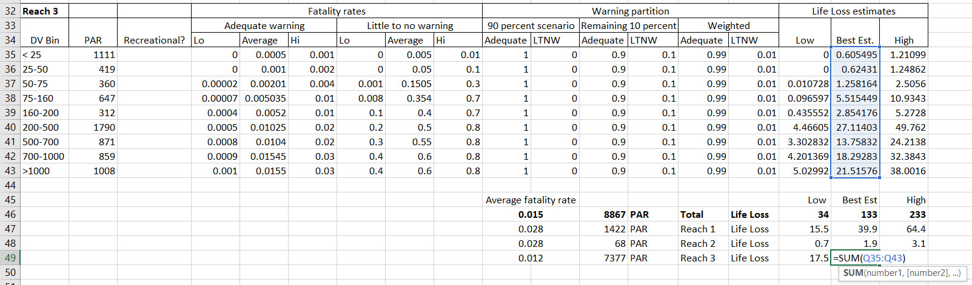
Example spreadsheet calculations
Total is obtained by summing over the PAR subsets for each Reach
Individual reach subtotals are reported as well

Slide 38
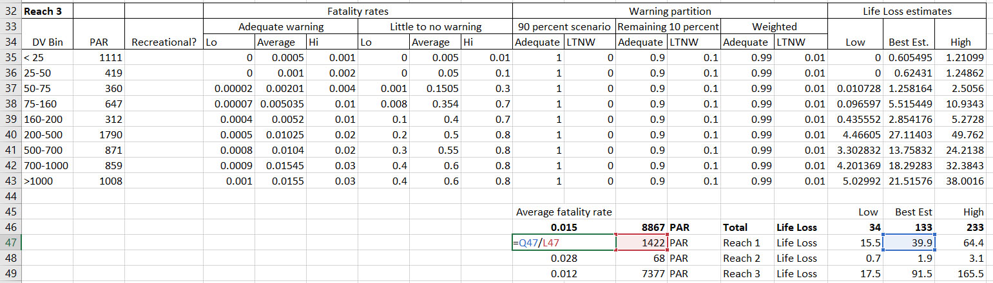
Example spreadsheet calculations
Overall and individual-reach average fatality rates are also reported (calculated here as the best estimate divided by the size of the PAR)

Slide 39
Calculation tasks – Results
Total estimated life loss is 133, ranging from 34 to 233
Highest fatality rates are in Reaches 1 and 2
Highest overall life loss occurs in Reach 3
Average Fatality Rate |  |  |  |  | Low | Best Est | High
0.015 | 8867 | PAR | Total | Life Loss | 34 | 133 | 233
0.028 | 1422 | PAR | Reach 1 | Life Loss | 15.5 | 39.9 | 64.4
0.028 | 68 | PAR | Reach 2 | Life Loss | 0.7 | 1.9 | 3.1
0.012 | 7377 | PAR | Reach 3 | Life Loss | 17.5 | 91.5 | 165.5

Slide 40
Interpretation tasks

Slide 41
Key uncertainty sources
The inundation maps correspond to a flood failure scenario (as well as a full, rather than a partial, breach scenario)
This likely results in the size of the PAR, as well as the DV values that some of the PAR are subjected to, being exaggerated
This source of uncertainty is considered reducible
A new inundation study and PAR study that are better tailored to the specifics of the controlling PFM could be developed
Some kind of improved breach modeling could also be performed (that takes into account the erosion resistance of the embankment)

Slide 42
Key uncertainty sources
Variability in the number of recreational users
The number of recreational users present on a given day (e.g., during the high season) cannot be precisely defined
More generally, the number of fatalities will depend on the actual number of people present within the inundation area, which is a random variable
Additional conversations with State Park staff could give a better sense of weekend and weekday variations
For all intents and purposes, this source of uncertainty is considered irreducible (primarily aleatory, not epistemic)

Slide 43
Key uncertainty sources
The hotel-occupant PAR in Dam Town has not been quantified.
There could potentially be several hundred people present that have not been accounted for in the PAR estimates.
This source of uncertainty is considered reducible.
Conversations with hotel staff could help improve understanding of occupancy patterns.
While there will remain an element of uncertainty that is irreducible (since the actual number of hotel occupants on a given day is a random variable), right now we know very little about this PAR subset, so our understanding can potentially be improved.

Slide 44
Key uncertainty sources
The results are highly sensitive to how the warning partition is selected (general observation about the RCEM process)
An alternative set of uncertainty bounds could be generated by running a suite of warning partitions through the spreadsheet
However, the overall uncertainty associated with the warning partition is considered irreducible because the actual warning time is a random variable
This is why it is especially important to build the case for the warning partition selected by the team

Slide 45
Are the results reasonable?
Broadly speaking, yes
It seems plausible that the failure of a large, but well monitored, embankment under static conditions could result in about 100 fatalities out of the roughly 9000 individuals present downstream
Reasonable for Reach 3 to control because it has the highest PAR
Reasonable for Reaches 1 and 2 to have the highest fatality rates because they are closest to the dam and would have less warning time (if for no other reason than faster leading edge travel times)
Average Fatality Rate |  |  |  |  | Low | Best Est | High
0.015 | 8867 | PAR | Total | Life Loss | 34 | 133 | 233
0.028 | 1422 | PAR | Reach 1 | Life Loss | 15.5 | 39.9 | 64.4
0.028 | 68 | PAR | Reach 2 | Life Loss | 0.7 | 1.9 | 3.1
0.012 | 7377 | PAR | Reach 3 | Life Loss | 17.5 | 91.5 | 165.5

Slide 46
Are the results reasonable?
The overall fatality rate of 0.015 is within a few percentage points
of a number of well
documented Adequate warning case histories
  Including those of Teton Dam (Wilford) and Canyon Lake Dam (Rapid City)

Slide 47
Are the results reasonable?
Teton Dam – Wilford (1976)
Small town located 8.4 miles downstream of dam (similar to Dam Town vs. Cactus Dam)
Similarly sized dam and reservoir
Warning issued, but some did not leave, while others came back to retrieve possessions
Arrival of flooding cut off the available evacuation routes

Slide 48
Are the results reasonable?
Canyon Lake Dam (1972)
PAR of about 9000 in Rapid City, similar to that of Southwest City
162 fatalities downstream of dam (versus 133 calculated for Cactus Dam)
Failure occurred at night, (whereas the life loss estimate for Cactus Dam includes the possibility of both a daytime and nighttime failure)

Slide 49
Are the results reasonable?
As noted in the discussion on uncertainty sources, the results are sensitive to changes in the warning partition. For example, if all of the “remaining 10 percent” were assumed to get Little to no warning, the life loss best estimate would increase from 133 to 435
However, the warning partition selected appears reasonable for a dam as heavily instrumented and as frequently staffed as Cactus Dam
It is difficult to envision a scenario where the PFM of concern initiates, progresses, and develops over the weekend (or overnight) without prior evidence of a worsening condition being observed
  This would be inconsistent with the erosion resistance of the embankment and the relatively predictable performance to date

Slide 50
Are the results reasonable?
It should also be emphasized that the key seepage measurement points are automated and programmed to send out alarm notifications if the performance parameters are exceeded.
Nearly all of the right abutment seeps are directed toward measurement points, and for this PFM it seems unlikely that a breach would not be preceded by a period of increasing seepage.
The data transmittal system has recently been tested with multiple staff correctly receiving the alarm notifications.
Based on these factors, it is probable that the majority of the downstream PAR will have significant warning time.

Slide 51
Interpretation – Wrapping it up
Based on the final portrayal of risk, the team recommended that additional information be developed, including improved field geology data, updated inundation mapping, and an updated PAR study
In this case, it was judged that the information obtained from all three of these areas could potentially change the interpretation of risk
The results of these studies could be helpful in supporting a future decision regarding the need to modify the dam

Slide 52
RCEM process: Key takeaways
The RCEM process offers a lot of flexibility to users.
However, it also requires engineering judgment to be applied.
There is no set procedure for establishing uncertainty bounds. The manner in which they are selected should be consistent with the point that the team is trying to make (which could in some cases be an iterative process).
The team should be aware that if the best estimate fatality rate is calculated as the simple average of the upper and lower bound fatality rates, this could result in a best estimate that is closer to the upper bound than intuition would suggest.
The case must always be built for the life loss estimates that are being presented.
Since different solutions are possible, the numbers are not considered meaningful unless it can be demonstrated that they are reasonable.

Slide 53
RCEM process: Key takeaways
Advocates for the use of alternative consequence estimation methodologies are quick to point out that when the RCEM process is used, different teams working with the same information can come up with different results.
From Reclamation’s perspective, this is not viewed as a weakness of the process. The ability to capture different perspectives at different points in the periodic review process can lead to an improved long-term understanding of the risk.
Reclamation views its dam safety decision process as risk informed, rather than “risk based”. As such, we are not interested in applying a methodology wherein the numbers make the decisions for us.
In a risk informed process, the numbers should support (and be developed so as to support) the decision, not the other way around. From that perspective, the numbers do not need to be exact in order to be useful.

Slide 54
Contact Slide Option 2
Dom Galic
Bureau of Reclamation
dgalic@usbr.gov

