Slide 1
Topic 6: Summary

Slide 2
Benefits of NFIP Participation
NFIP flood insurance
Safer, damage-resistant development
Grants and loans
Faster recovery with more financial support
Notes:
Present the following:
Our discussion focused on four areas. First was how the National Flood Insurance Program and your Floodplain Administrator support your community.
We talked about where your goals as a local elected official may overlap with the benefits of NFIP participation, like having a safe, attractive community and planning for growth.

Slide 3
Benefits of Floodplain Management
Keeps residents safe
Reduces flood risk and damages
Protects the environment
Notes:
Present the following:
We talked about how to support your Floodplain Administrator with resources.
Your Floodplain Administrator is an important part of your floodplain management program.
Floodplain management impacts the whole community.
We covered how you can connect with community members about the floodplain management elements they value, like water quality, business opportunities, and wildlife habitats.

Slide 4
Benefits of Supporting Your Floodplain Administrator
Capacity to maintain your participation in the NFIP
Reduce the risk of legal liability
Increase staff morale and retention
Notes:
Present the following:
We talked about how enforcing floodplain regulations saves you money and reduces risk.
We asked you to consider if your Floodplain Administrator has resources to implement an effective floodplain management program.
We also talked about how resources support your FPA and help them maintain your NFIP participation.

Slide 5
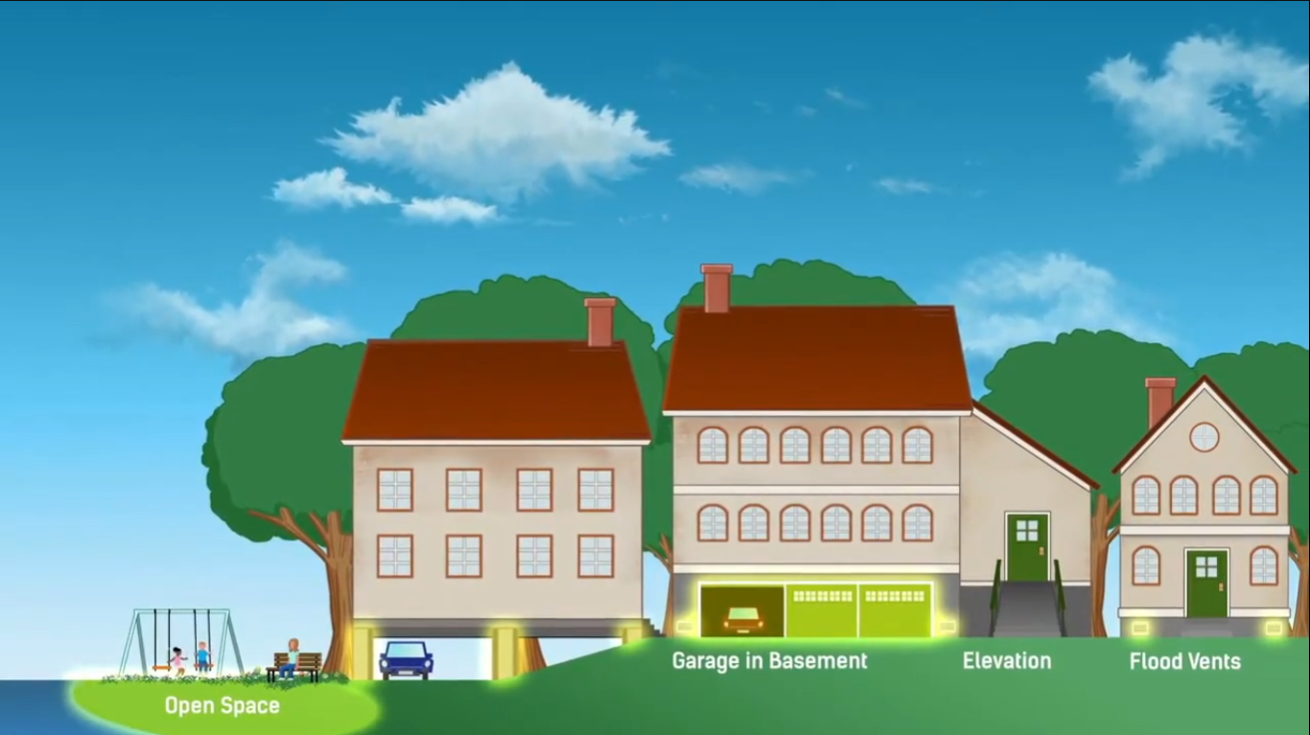
Benefits of Higher Standards
Less damage and faster recovery
More affordable flood insurance
Safer places to live
Increase economic growth
Notes:
Present the following:
We also covered how investing in the NFIP and CRS increases community safety and saves money.
Higher standards help your community recover from the economic and social shocks of a disaster, get more affordable flood insurance, and remain safe. Higher standards also help your economy grow.

Slide 6
Resources for the National Flood Insurance Program
FEMA.gov
Floodplain Management Resources for Local Government Officials
FloodSmart.gov
FEMA Map Service Center
National Flood Insurance Program
Community Rating System
Regions, States and Territories—including contacts
Elected Officials’ Flood Guide
Notes:
Present the following:
Direct the audience to the reference section of the Student Manual for a complete list of resources.
These sites have more information on the National Flood Insurance Program:
FEMA.gov: Landing page for the FEMA website/great place to start when searching for resources.
Floodplain Management Resources for Local Government Officials: Access to many floodplain management topics, such as risk disclosure and higher standards.
FloodSmart.gov: Outreach materials and resident-oriented resources.
FEMA Map Service Center: Digital and historical FEMA products about flood risk.
National Flood Insurance Program: Learn about the National Flood Insurance Program.
Community Rating System: Learn about the Community Rating System.
Regions, States and Territories: Learn more about and/or contact your State and regional partners.
Elected Officials’ Flood Guide: Guide for elected officials, including FAQs about best practices.
For more information:
FEMA.gov (https://www.fema.gov/)
Floodplain Management Resources for Local Government Officials (https://www.fema.gov/floodplain-management/manage-risk/local#:~:text=Local%20Government%20Officials%20-%20Floodplain%20Management%20Resources%201,Tools%20and%20Resources%20to%20Support%20Higher%20Standards%20)
FloodSmart.gov (https://www.floodsmart.gov/)
FEMA Map Service Center (https://msc.fema.gov/portal/home)
National Flood Insurance Program (https://www.fema.gov/flood-insurance)
Community Rating System (https://www.fema.gov/floodplain-management/community-rating-system/case-studies-fact-sheets-blogs)
Regions, States and Territories (https://www.fema.gov/about/organization/regions)
Elected Officials’ Flood Guide (https://floodsciencecenter.org/products/elected-officials-flood-risk-guide/the-essentials/)

Slide 7
Activity: Summary Discussion
Why should you improve the management and enforcement of your community’s floodplain management program?
What actions could you take today to improve your program?
What resources can you provide your Floodplain Administrator and staff?
How can you strengthen the enforcement of your program?
What higher standards could your community benefit from?
Notes:
Present the following:
Purpose:
To help the audience consider next steps to improve their community floodplain management programs.
Procedure:
Direct the audience to Activity 6.1 in the manual.
Direct the audience to reflect on the ways their communities can strengthen their floodplain management programs. Have them consider the steps they will take.
Ask:
Why should you improve the management and enforcement of your community’s floodplain management program?
What actions could you take today to improve your program?
What resources can you provide your Floodplain Administrator and staff?
How can you strengthen the enforcement of your program?
What higher standards could your community benefit from?
Discuss responses with the audience.

Slide 8
Questions?
Local Government Officials - Floodplain Management Resources
https://www.fema.gov/floodplain-management/manage-risk/local
https://floodsciencecenter.org/products/elected-officials-flood-risk-guide/introduction/
Notes:
Present the following:
Ask the audience if they have any questions.
Direct participants to the site Local Government Officials – Floodplain Management Resources (https://www.fema.gov/floodplain-management/manage-risk/local)
Elected Officials’ Flood Guide – Introduction (https://floodsciencecenter.org/products/elected-officials-flood-risk-guide/introduction/)
Thank the audience for their attendance.

