Slide 1
Topic 4: Enforcement

Slide 2
Topic 4 Objective
Describe the importance of enforcing floodplain management ordinances.
Notes:
Review the objective:
At the end of this topic, you should be able to describe the importance of enforcing floodplain management ordinances.
Present the following:
In this topic, we will talk about NFIP regulations, building codes, and how enforcement reduces risk.
Explain the importance of the Elected Official’s Flood Guide:
Elected Officials' Flood Guide – ASFPM Flood Science Center (https://floodsciencecenter.org/products/elected-officials-flood-risk-guide/)

Slide 3
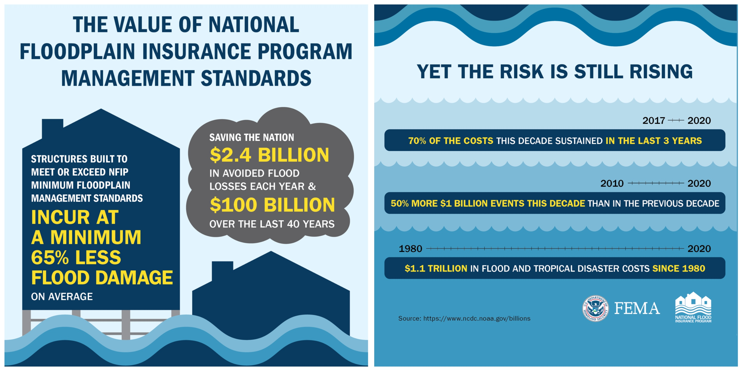
The Value of Well-Enforced NFIP Management Standards
Notes:
Present the following:
Strong floodplain management programs benefit communities by:
Promoting economic stability and growth:
Resilient communities recover from floods more quickly, keeping businesses open and citizens working. They also maintain the value of their stocks, assets, power, and revenue.
Additionally, landscapes that include natural floodplains provide diverse recreation and economic opportunities, attracting people to the area.
Increasing community resilience: Families and their houses are safer from flooding now and far into the future.
Preserving the natural landscape and its functions:
Provides habitat for plants and animals.
Supports plants that filter pollutants.
Maintains natural flood storage capacity.
Transition to the next sub-topic:
Now, let’s discuss the benefits of adopting, implementing, and enforcing flood damage prevention ordinances.

Slide 4
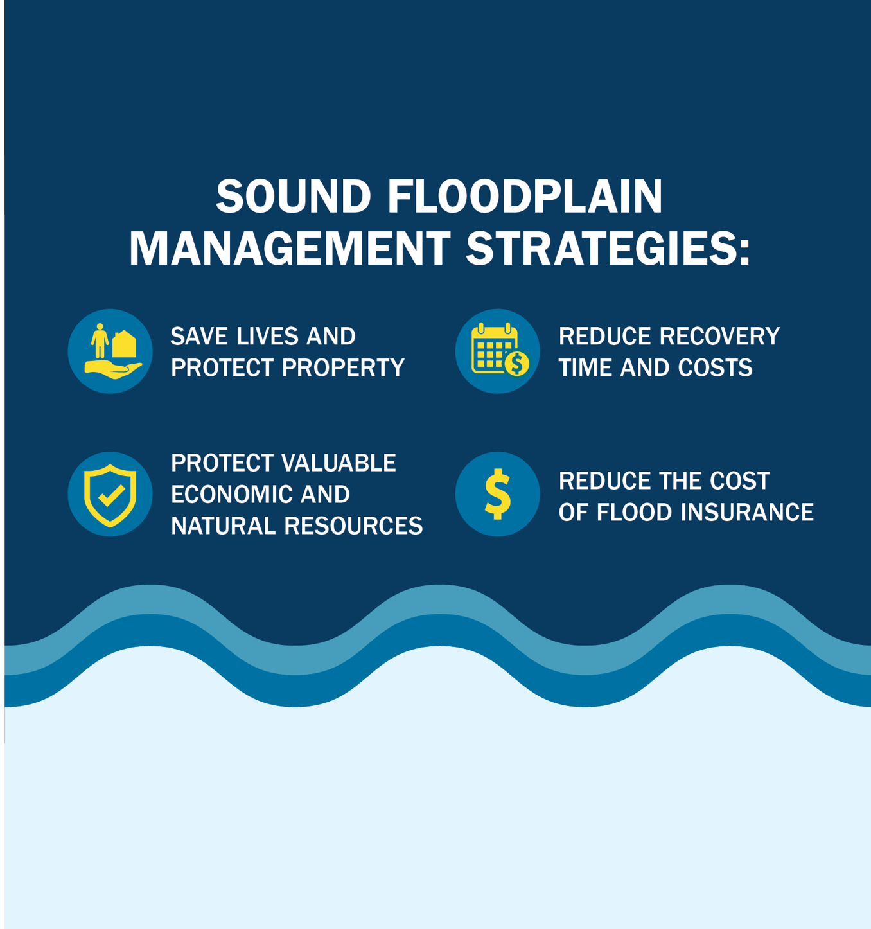
Benefits of Floodplain Management
Promotes economic growth
Increases community resilience
Improves water quality
Protects wildlife habitats
Maintains natural flood storage
Notes:
Present the following:
Strong floodplain management programs benefit communities by:
Promoting economic stability and growth:
Resilient communities recover from floods more quickly, keeping businesses open and citizens working. They also maintain the value of their stocks, assets, power, and revenue.
Additionally, landscapes that include natural floodplains provide diverse recreation and economic opportunities, attracting people to the area.
Increasing community resilience: Families and their houses are safer from flooding now and far into the future.
Preserving the natural landscape and its functions:
Provides habitat for plants and animals.
Supports plants that filter pollutants.
Maintains natural flood storage capacity.
Transition to the next sub-topic:
Now, let’s discuss the benefits of adopting, implementing, and enforcing flood damage prevention ordinances.

Slide 5
Flood Damage Prevention Ordinances
Also called flood or floodplain ordinances or local floodplain regulations
Authority granted by State statutes
Adopted and enforced by local communities
May be part of zoning regulations, building codes, or land development regulations or a stand-alone ordinance
Help keep the community safe from flooding, protect public infrastructure, and reduce the cost of recovery
Notes:
Present the following:
State legislation gives communities the authority to adopt floodplain regulations.
Regulations must be adopted and enforced by the local community.
Flood damage prevention ordinances can be found in land use authority regulations, building codes, or land development regulations. They can also be stand-alone ordinances.
Transition to the next sub-topic:
Next, let’s examine Floodplain Administrator coordination responsibilities and the role of building codes in floodplain management.

Slide 6
Floodplain Administrator Coordination Responsibilities
Multiple departments have floodplain management duties.
Departments that are part of floodplain management:
Emergency Management
Code Enforcement
Stormwater Management
Planning and Engineering
Notes:
Present the following:
Your Floodplain Administrator’s work spans multiple departments. Enforcement requires high levels of coordination across many departments. Your Floodplain Administrator must be supported in their enforcement work. Enforcement is not only their responsibility.

Slide 7
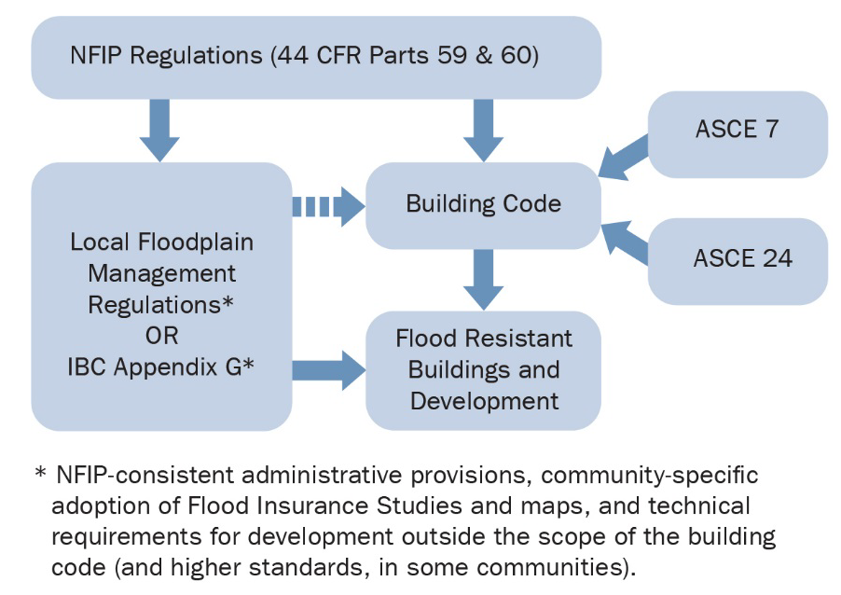
Role of Building Codes in Floodplain Management
Building codes and the NFIP overlap.
Building codes keep people, buildings, and structures safe.
Enforcing building codes may not make you popular, but it might save lives.
Strong codes protect the community from lawsuits.
Notes:
Present the following:
The International Building Code (IBC) standards meet or exceed NFIP requirements for all buildings and structures. So, building code officials also play a role in the NFIP.
Building codes make buildings and other structures safe.
While enforcing building codes may not make you popular, it just might save lives.
Strong codes help protect the community from lawsuits:
Since liability is based on negligence, a community benefits from a well-applied program.
Establish clear ordinance standards to limit misinterpretation.
Transition to the next sub-topic:
Now, let’s discuss how compliance relates to grant funding eligibility.

Slide 8
Compliance Starts with Proper Permitting
Require permit applications for all proposed floodplain development:
New buildings, changes to existing structures, subdivisions, and non-structural work (e.g., fill, grading, and site preparation)
Conduct inspections.
Act on code violations and non-compliant work.
Complete post-disaster assessments and permitting.
Notes:
Present the following:
Proper permitting procedures are required for NFIP compliance.
The FPA must require, collect, and review permits for all proposed floodplain development. This includes:
New buildings, changes to existing structures, subdivisions, and non-structural work.
Substantial Improvement and Substantial Damage assessments.
Conducting inspections ensures that structures are being built to the standards in the plans and permits.
Your community must take enforcement actions when violations or non-compliant work occurs.
There are also assessment and permitting requirements after disasters.

Slide 9
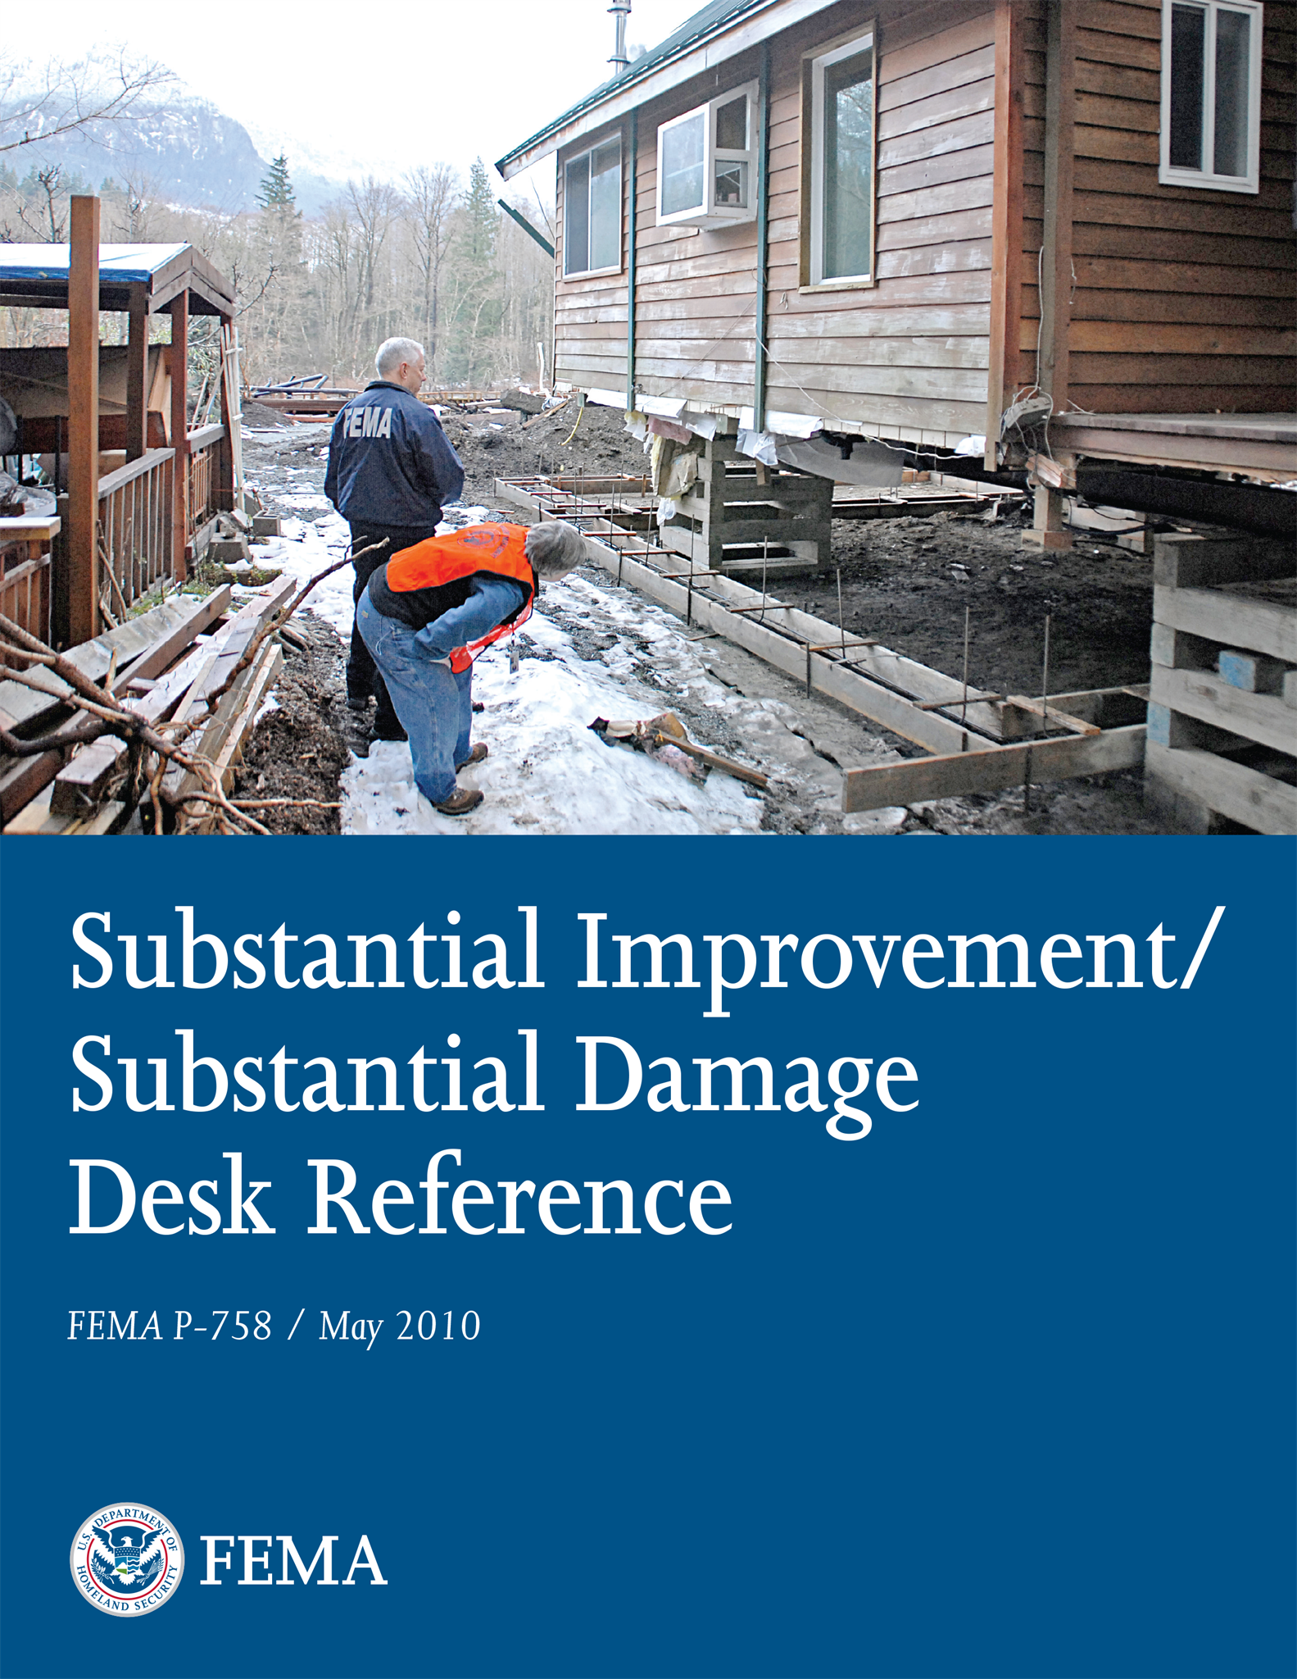
Substantial Improvement Requirements
Any reconstruction, rehabilitation, addition, or other improvement in a floodplain
Cost of improvement equal to or higher than 50% of market value
Substantial Improvement determination made by community
Required by NFIP and International Building Codes
Meets flood ordinance requirements for new construction
Notes:
Present the following:
A major part of ensuring compliance is enforcing Substantial Damage and Substantial Improvement requirements (SI/SD). These requirements make sure properties align with current floodplain regulations before money is spent on repairs.
A structure is considered Substantially Improved when:
The reconstruction, rehabilitation, additions, or other improvement is in a floodplain, and
The cost of improvements equals or exceeds 50% of the structure's market value.
Substantial Improvement determinations can only be made by the local community. The NFIP and International Building Codes require them.
When Substantially Improved, a structure must meet the floodplain ordinance requirements for new construction.

Slide 10
Substantial Damage Requirements
Damage in the floodplain may be from any cause: fire, wind, earthquake, etc.
Substantial Damage determinations are made by the community.
If the repair cost is equal to or higher than 50% of market value, the work must meet the local flood ordinance and building code requirements for new construction.
Substantial Damage determinations are required by NFIP and by International Building Codes.
Does your community do routine emergency preparedness exercises?
Do you have a plan in place to make Substantial Damage Assessments?
Notes:
Present the following:
Substantial Damage is related to Substantial Improvement.
Any hazard can cause damage that triggers Substantial Damage determinations.
If a natural hazard or accident causes damage, a Substantial Damage determination should be completed. The assessment will determine if the repair cost meets or exceeds 50% of the value of the structure.
Only the local community can make a Substantial Damage determination.
Not enforcing SI/SD requirements could put your community’s NFIP participation at risk.

Slide 11
Compliance and Oversight
Local compliance responsibilities:
Enforcing local floodplain management requirements
Following up on violations
Ensuring required permits are obtained, including after disasters
FEMA/State responsibilities:
Training and technical assistance
Primary contact for community audits
Putting communities on probation or suspending them from the NFIP if local deficiencies are not corrected
Notes:
Present the following:
To promote compliance in your community, developers must follow your ordinance. To ensure compliance, your FPA must review permits, complete inspections, and have the authority to enforce the requirements.
Your State NFIP Office and FEMA Regional Office contacts support and oversee your community’s floodplain management program by:
Providing tools, training, and resources;
Identifying and helping to resolve deficiencies and violations;
Placing the community on probation and suspension if deficiencies are not corrected.

Slide 12
Compliance and Grant Funding Eligibility
If not compliant or not participating in the NFIP, communities won’t have access to certain types of disaster aid.
Structures in high-risk flood zones would not be eligible for:
Repair and replacement money for federally declared disasters
FEMA mitigation grants
Other Federal funding
Notes:
Present the following:
Remember, even if your community has adopted NFIP minimum standards, it is only compliant if it adequately enforces them.
Communities that are not compliant or don’t participate in the NFIP won’t have access to certain types of disaster aid.
Additionally, structures in high-risk flood zones are ineligible for FEMA mitigation grants, repair and replacement money for federally declared events, and other Federal funding.

Slide 13
Activity: Enforcement Discussion
What authority does your local Floodplain Administrator have?
Does your Floodplain Administrator have the resources to implement an effective program?
What other roles does your Floodplain Administrator fill (how many hats do they wear)?
Does your city/county attorney support floodplain management?
What are your Floodplain Administrator’s roles during the post-disaster recovery process?
Do you have a plan to make Substantial Damage Assessments after a disaster?
Notes:
Present the following:
Purpose:
To help audience members understand if their community program is fully equipped to protect from flooding and enforce their NFIP regulations.
Procedure:
Direct the audience to Activity 4.1 in the manual.
Ask audience to reflect on and write down responses to the following questions:
What authority does your local Floodplain Administrator have?
Does your Floodplain Administrator have the resources to implement an effective program?
What other roles does your Floodplain Administrator fill (how many hats do they wear)?
Does your city/county attorney support floodplain management?
What are your Floodplain Administrator’s roles during the post-disaster recovery process?
Do you have a plan to make Substantial Damage Assessments after a disaster?
Discuss responses to the questions.
Emphasize: If the answer to any of these questions is “none” or “no,” the program is not equipped to protect from flooding and enforce NFIP regulations.

Slide 14
Topic Summary
Sound floodplain management strategies can:
Save lives and protect property,
Reduce recovery time and costs, and
Reduce flood insurance costs.
Implementing higher standards protects your community further.
Enforce these standards to ensure buildings and structures are built appropriately.
Notes:
Present the following:
On the slide, you’ll see what we covered in this topic. In the next topic, we will discuss the Community Rating System, higher standards, and how you can support them in your community.

